Slide 1
Tompkins County Social Capital Community Benchmark Survey
2012 Cornell University
Social Capital Consulting Group
Notes:
Survey created in 2000 at the Harvard Kennedy School; carried out nationally in 2000 and 2006; carried out in Tompkins County by the CRP 6311 team among 641 local residents.

Slide 2
Strengthening the Impact
I. What is Social Capital?
II. What is the Value of Social Capital?
III. Where Do We Stand as a Community?
IV. Where Do We Go From Here?
Notes:
Our goal is to strengthen the impact of both the 2010 survey findings; as well as the next recommended survey period. Our core client group, including the President of the CoC; Exec Dir of CF; and Pres of 1492 Consulting, suggested we organize our report around these four categories.

Slide 3
Just over 15 years ago, the Journal of Democracy published in its fifth anniversary issue an article by Robert D. Putnam entitled “Bowling Alone: America’s Declining Social Capital.”
The essay struck a chord with readers who had watched their voting precincts empty out, their favorite bowling alleys or Elks lodges close for lack of patrons and members, and their once-regular card games and dinner parties become sporadic. Marshaling evidence of such trends, the article galvanized widespread concern about the weakening of civic engagement in the United States.
But it also roused deep interest in the broader concept of “social capital”...
- from “Still Bowling Alone? The post-9/11 Split”
by Thomas H. Sander and Robert D. Putnam
Notes:
Robert Putnam’s book on

Slide 4

What is Social Capital?
Social capital refers to the social
relationships and the trust that
allow people, organizations, neighborhoods,
and entire communities to work together
in ways that advance everyone’s interests.
- Robert Putman, Bowling Alone
Notes:
Robert Putnam’s book on

Slide 5
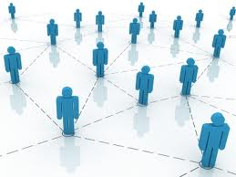
What is Social Capital?
The central premise of social capital is that social networks have value. Social capital refers to the collective value of all "social networks" [who people know] and the inclinations that arise from these networks to do things for each other [norms of reciprocity].
- Harvard Saguaro Seminar Primer
Notes:
Robert Putnam’s book on

Slide 6
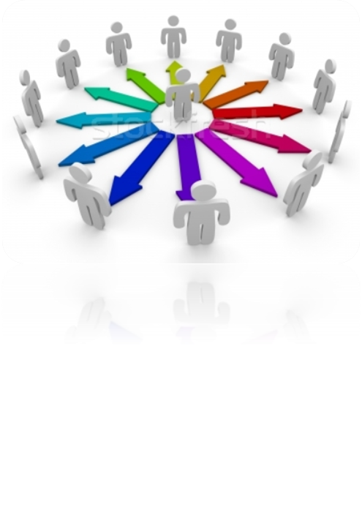
What is Social Capital?
Social capital refers to & incorporates...
Political Participation
Civic Participation
Religious Participation
Connections in the Workplace
Informal Social Connections
Altruism, Volunteering and Philanthropy
Reciprocity, Honesty and Trust
Social Movements and Networks

Slide 7
Value of Social Capital
Higher levels of trust and connectedness are correlated with many positive outcomes...
Social capital has been correlated with better functioning democracies, lower levels of violent crime and stronger economies.
Some studies have shown that when teenagers feel connected to a community, there are better grades in school, and lower rates of depression.
Other studies have found that higher levels of trust are correlated with a faster recovery time after surgery or illness.
Notes:
economy: potentially healthier citizens; more knowledgeable during job search; encouraging entrepreneurship

Slide 8
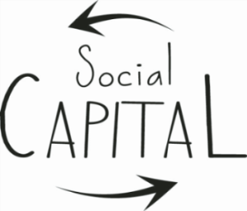
Value of Social Capital
The social capital community benchmark survey helps increase resiliency and responsivity by...
Helping communities isolate key strategic issues and therefore determine strategies that can help strengthen areas of social capital that are low.
Empowering residents to come up with solutions that are community-driven and community-based, providing the tools and opportunities to get involved.
Enabling cross-community comparisons, allowing each participating community to determine the absolute, as well as relative value, of their findings.
Connecting communities – as participating counties connect around findings and response strategies, national levels of social capital rise.
Notes:
Important to communicate results to citizens so that they can take initiative.

Slide 9
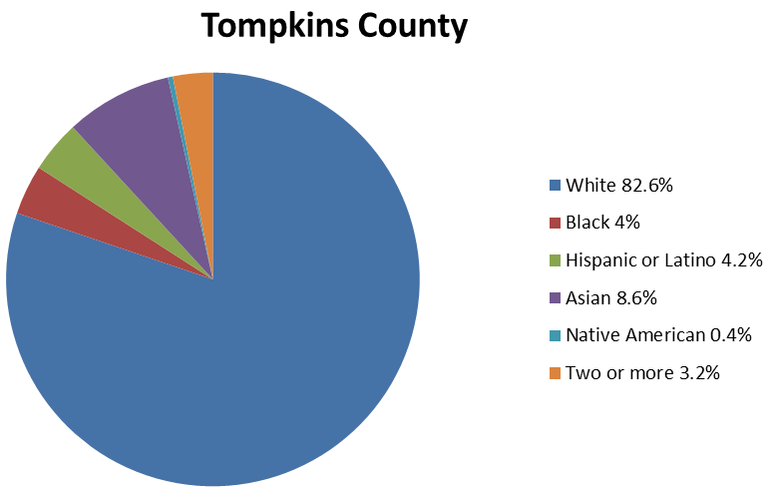
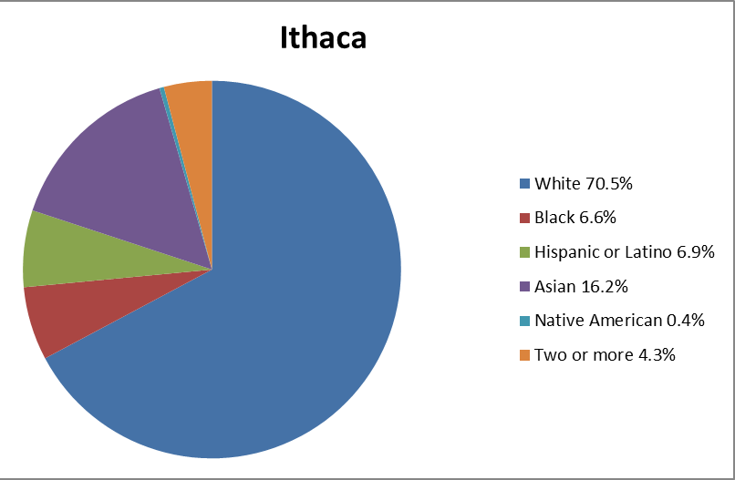
Community Demographics
Notes:
In 2010, there were 101,564 residents in Tompkins County and 30,014 residents in Ithaca.

Slide 10
Where We Stand as a Community
Methods...
Quantitative data analysis of 2010 results, comparing Tompkins County findings to national averages, as well as select communities (Winston-Salem and Rochester) with similar demographics.
Qualitative cross-community comparison looking into initiatives in select communities (Winston-Salem, Rochester, Boulder and Ann Arbor) that might inspire action for Tompkins County. As well as a review of what we’re already doing well.

Slide 11
Where We Stand as a Community
Core Quantitative Findings...
Our analysis focused on SOCIAL TRUST and correlations between trust and:
    Social engagement
    Those with lower levels of trust
    The role of politics
Disclaimer: There are some limitations and assumptions that must be accounted for and considered when comparing data, including different time periods; altered questions; and differing methods.

Slide 12
Where We Stand as a Community
Findings...
Social Trust: Tompkins County rates higher than national averages, as well as Winston-Salem and Rochester.
People with disabilities rate relatively high in trust (both in terms of trusting of others and being trusted by others).
There is a relatively high level of trust towards the Hispanic community.
White and black racial relations need attention.
Social trust is not an isolated variable, but is correlated with the economy, education and perceptions of inclusiveness.
Notes:
‘perceptions of inclusiveness’ refers to perceptions of medical provider diversity for ex.

Slide 13
Where We Stand as a Community
Findings...
Social Engagement: Different social events/activities were found to have very different effects on trust.
Attending blood drives and political meetings or rallies were actually shown to lower levels of trust.
Public meetings (discussing town or school affairs) and volunteer projects raise trust.

Slide 14
Where We Stand as a Community
Those with lower levels of trust:
Males
Young people
Non-U.S. citizens
Short-period residents
Members of specific races or ethnic groups
Those separated and never married
Lower income families
Less educated people
Temporarily laid off workers
Notes:
Clear correlations or hypotheses about why this might be true?

Slide 15
Where We Stand as a Community
Findings...
Politics: High levels of political interest and participation correlate with high levels of trust in Tompkins County – more so than in many other communities.
Transparency in local governance, including good communication with citizens, is central to strengthening social trust and in turn, social capital.
Notes:
Clear correlations or hypotheses about why this might be true?

Slide 16
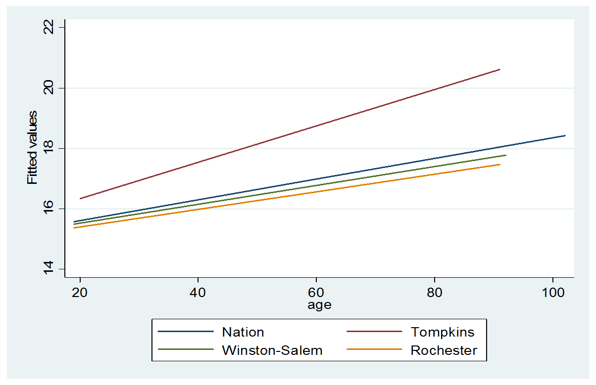
Where We Stand as a Community
Age
Notes:
Clear correlations or hypotheses about why this might be true?

Slide 17
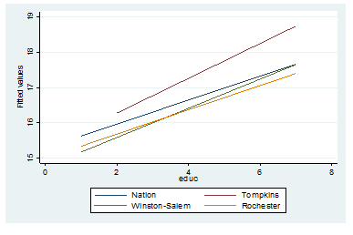
Where We Stand as a Community
Education
Notes:
Clear correlations or hypotheses about why this might be true?

Slide 18
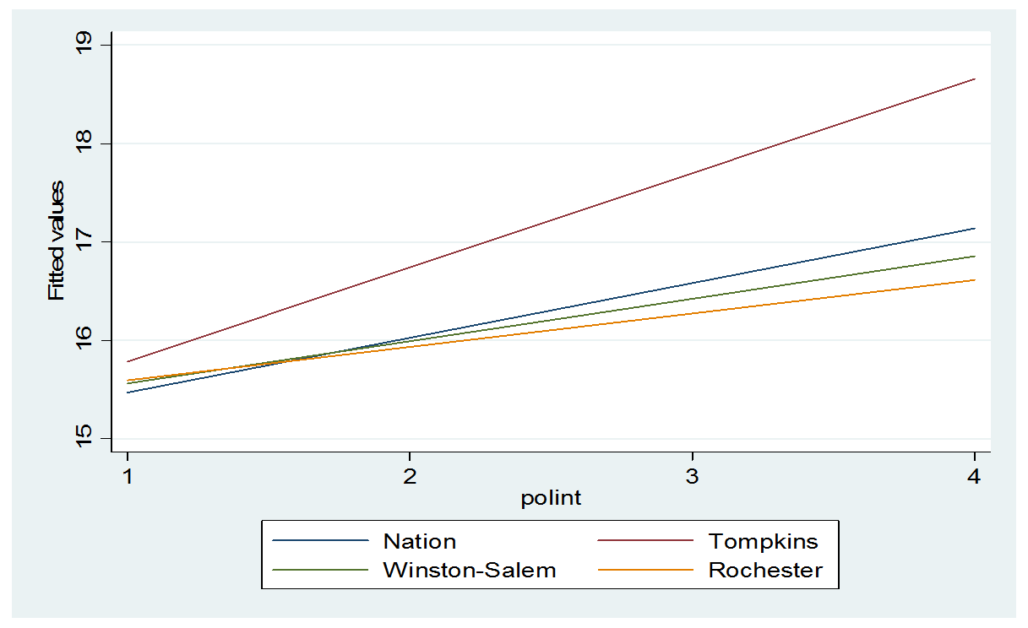
Where We Stand as a Community
Political Interest
Notes:
Clear correlations or hypotheses about why this might be true?

Slide 19
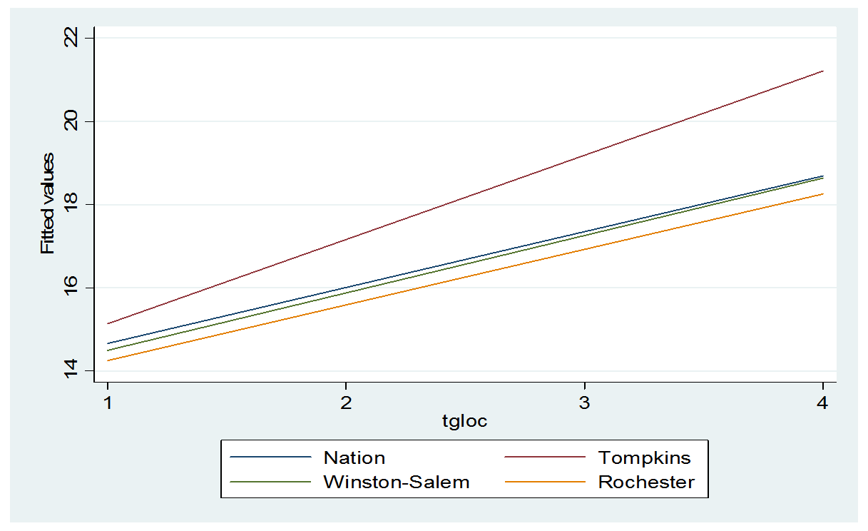
Where We Stand as a Community
Trust in Local Government
Notes:
Clear correlations or hypotheses about why this might be true?

Slide 20
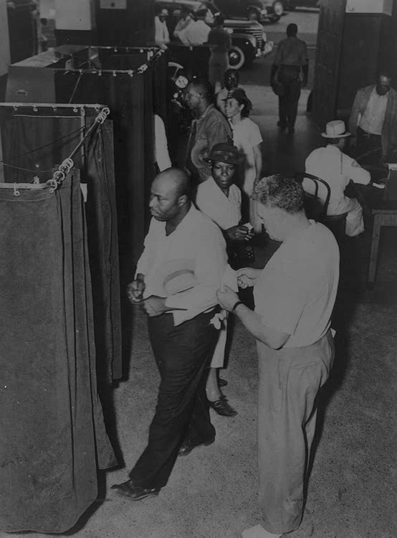
National Trends
Nationally, Tompkins County rates high in social capital on measures such as trust, and while this is something to be proud of and build upon, it’s important to keep this in perspective...
National levels of social capital
have been in an overall decline
since the 1960s...

Slide 21
National Trends
From a relative high point in the early 1960s, voter turnout had by 1990 declined by nearly a quarter; tens of millions of Americans had forsaken their parents' habitual readiness to engage in the simplest act of citizenship. Broadly similar trends also characterize participation in state and local elections.
A series of questions posed by the Roper Organization to national samples ten times each year over the last two decades reveals that since 1973 the number of Americans who report that "in the past year" they have "attended a public meeting on town or school affairs" has fallen by more than a third.
Similar (or even greater) relative declines are evident in responses to questions about attending a political rally or speech, serving on a committee of some local organization, and working for a political party.

Slide 22
National Trends
By almost every measure, Americans' direct engagement in politics and government has fallen steadily and sharply over the last generation, despite the fact that average levels of education--the best individual-level predictor of political participation--have risen sharply throughout this period.
Every year over the last decade or two, millions more have withdrawn from the affairs of their communities.
Americans have also disengaged psychologically from politics and government over this era. The proportion of Americans who reply that they "trust the government in Washington" only "some of the time" or "almost never" has risen steadily from 30 percent in 1966 to 75 percent in 1992.

Slide 23
National Trends
In Robert Putnam’s Bowling Alone, he describes the decline in social capital that we have seen in the United States since the 1960s as part of the “ups and downs in civic engagement” – part of an ongoing story of “collapse and renewal.”
Our efforts today are part of creating and ensuring the next phase of renewal in our communities and ultimately in our nation...

Slide 24
What We Can Do
Recommendations based on quantitative findings...
Focus on public meetings and volunteering- make opportunities available and visible
Focus on black-white racial trust relationships
Focus on political trust – transparency and communication
Focus on hiring and maintaining diverse staff

Slide 25
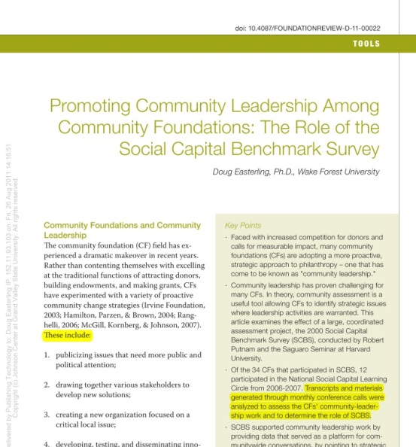

Where We Stand as a Community
Core Qualitative
Findings...
There is a real interest among national social capital leaders to build a relationship with Tompkins County leaders. Leaders include Robert Putnam and Thomas Sanders from Harvard’s Kennedy School; and Scott Wierman and Doug Easterling from the Winston Salem Foundation.

Slide 26

Where We Stand as a Community
Other Communities...
Use of media to broadcast town meetings
Use of awards for those “caught in the act”
Large grants awarded for sustained efforts
Non-profits were formed in some communities
Faith-based organizations were engaged
Committees formed for strategizing around key findings
Series of community discussions initiated
Affordable housing choices, transportation, economic opportunities and healthy food access issues addressed

Slide 27
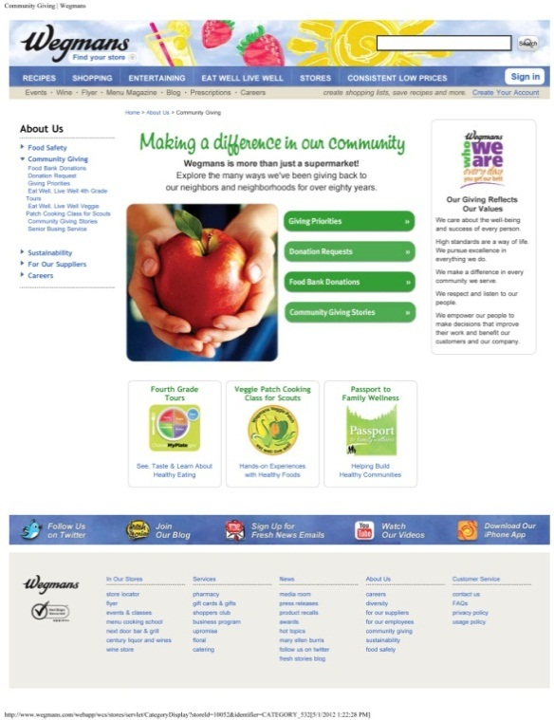
Where We Stand
Tompkins County...
The core client group generously
engaging time and resources
Survey was carried out successfully in
2010 with the help of the core client
group, and Cornell and Binghamton
University students
Other key community leaders, including
political leaders are contributing their time and input
Organizations and businesses carrying out community-building activities, ex. Short Stop Deli maintains a diverse staff; Wegmans features community giving stories on their website
Notes:
Most communities dedicated $10,000 to carry out the survey; Tompkins County had volunteers doing the work

Slide 28
What We Can Do
Recommendations based on qualitative findings...
Seek funding for initiatives (single national and diverse local sources)
Offer grants to local organizations
Reward community leaders and citizens “caught in the act”
Synchronize Tompkins County survey period with the national survey
Nurture relationships with leaders at Harvard and in Winston-Salem who are heading up national efforts

Slide 29
Where We Stand as a Community
To determine how best to reach community leaders with information about social capital, we carried out a
FORCE FIELD ANALYSIS to identify perceptions, as well as
driving and restraining forces.
A force field analysis provides a framework for looking at the factors (forces) that influence a situation. It looks at forces that are either driving movement toward a goal or restraining and blocking movement toward a goal.

Slide 30
Where We Stand as a Community
Driving Forces...
Survey identified some “key” areas for improvement
Ithaca rates relatively high in social capital nationally
Research offers new insight into the issues and their possible solutions
Leaders working to strengthen the diverse community
City of Ithaca developing a Comprehensive Plan (700 stakeholders)
City of Ithaca currently developing a communication campaign
Realistic potential for connecting students with local arts programming
Attention to hiring diverse staff
Resources from local Universities
Community comes together in open forums to discuss race-related events
Notes:
CMA: Cayuga Medical Associates

Slide 31
Where We Stand as a Community
Restraining Forces...
Communicating social capital survey findings is complex; many are put on the defense; listening and framing are key
Lack of fundamental understanding of social capital
Limited resources
Difficulty sustaining good improvement initiatives over the
long term as leaders change, community priorities flux
High levels of mistrust of municipalities and non-taxable entities
Fractured/weakened media outlets
Housing issues/balkanization: social groups are isolated in homogenous neighborhoods/segments of the city
Lack of diversity in socially homogenous groups/activities
Notes:
“Town Down” - 67% of land in Ithaca is tax exempt – owned by Cornell or town; is the community being fairly compensated?

Slide 32
Next Steps...
Now that we better understand the findings of the 2010 survey; where we stand as a community in comparison to other communities; and a number of driving and restraining forces, we move into the next steps of action, which include...
Determining how to best reach and inspire a wide variety of community members — including leaders, as well as individual citizens — through a communication strategy that involves sharing information, as well as listening.
Determining how best to disseminate survey invitations during the next survey period through locality testing so that we reach a balanced sample, including even the most marginalized members of the community.
Determining how best to brand and market the survey through a marketing strategy/kit so that the community becomes familiar with the survey and sees it as a legitimate tool that will give them a voice, something they can be excited to be a part of.

Slide 33
Communication Strategy
We now have information ready to present to the community — leaders and citizens — about social capital in Tompkins County and about its measurable value. So, how do we get this information to people in a way that inspires a sustained commitment to a strong commUNITY?

Slide 34
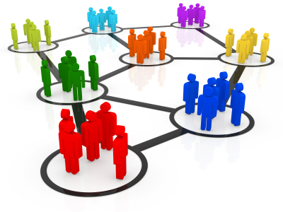
Communication Strategy
The overarching goal of the communication strategy is to develop and stimulate greater awareness of social capital and its value; as well as to stimulate greater interest and involvement in strengthening social capital and in our community.

Slide 35

Communication Strategy
Methods...
Identify key leaders and organizations
Develop a set of questions to gather feedback from leaders
Identify local community groups and outlets
Establish a set of communication recommendations

Slide 36
Communication Strategy
Community leaders present at the 2010 meeting of survey findings:
  J.R. Clairborne, City councilperson
  County Board chair Martha Robertson- email sent 4/25
  Rabbi Scott Glass
  James Brown, United Way
  Carolyn Peterson, Former Mayor
  Sherman Bodner, Ithaca Journal publisher
  Bruce Estes, Ithaca Journal editor
  Michelle Berry, Chamber board member
  Kathy Schlather, Human Services Coalition

Slide 37

Communication Strategy
We have created a set of questions to help us gauge levels of understanding and perceptions of social capital among these and other leaders; a survey monkey link to these questions is available.
It is important that we open up dialogue with these leaders to better understand their responses to the 2010 findings, and to identify the dimensions of social capital most relevant
to them, as well as their passions.

Slide 38
What We Can Do
Communication Recommendations...
As resources become available, hire a full-time social capital specialist housed at Community Foundation
Invite a core group of community leaders to meet once a month with the initial task of determining concrete goals and actions
Piggyback on local radio shows (i.e. “All Things Equal”), media outlets and community building events
Communicate with the community – where do we need to focus our attention and what can we do as individuals?
Notes:
[trust, political engagement, giving and volunteering, faith-based engagement, informal socializing, involvement in associations, civic leadership, diversity of friendships, and equality of civic participation]

Slide 39
What We Can Do
Communication Recommendations...
Involve the arts (Have a HeART©) for children and adults [poster, t-shirt, bumper sticker design contest; window art; etc..]
Initiate a series of community conversations
Invite well-known speakers to town- Robert Putman, etc.; make an event of these talks (involving diverse community members).
Publicly broadcast Town Hall Meetings
Notes:
[trust, political engagement, giving and volunteering, faith-based engagement, informal socializing, involvement in associations, civic leadership, diversity of friendships, and equality of civic participation]

Slide 40
What We Can Do
Communication Recommendations...
Ask religious leaders (who already hold interfaith meetings) to encourage building diverse relationships; and hold events
Begin conversations with the Housing Authority to help keep social capital central to planning
Begin conversations with Cornell about the importance of communicating with the community and giving back; as well as the importance of student involvement outside of the University bubble.
Encourage the City to make efforts of communicating with citizens to ease ‘Town Gown’ mistrust
Notes:
[trust, political engagement, giving and volunteering, faith-based engagement, informal socializing, involvement in associations, civic leadership, diversity of friendships, and equality of civic participation]

Slide 41
What We Can Do
Communication Recommendations...
Contact leaders developing the City’s Comprehensive Plan to see how social capital might be included (ASAP)
Contact the City’s Chief Communication Officer, Julie Holcomb, to see if the new website can include a page on social capital – including a section for laurels
Join in Veteran’s Parade and other local parades and events
Create simple media messages (see ex. of Altanta Energy Commercial)
Create a clear and realistic strategy and goals that are fine-tuned and responsive
Notes:
[trust, political engagement, giving and volunteering, faith-based engagement, informal socializing, involvement in associations, civic leadership, diversity of friendships, and equality of civic participation]

Slide 42
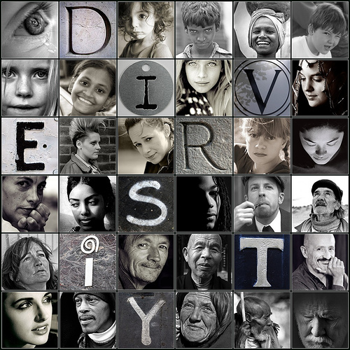
Communication Strategy
It is important to actively involve people from all corners of the county- from the mother to the farmer to the student to the preacher to the town leader, and make it fun!
Social capital ultimately increases the overall wellbeing of individuals, as well as the community as a whole– that message should be at the core of communication efforts.

Slide 43
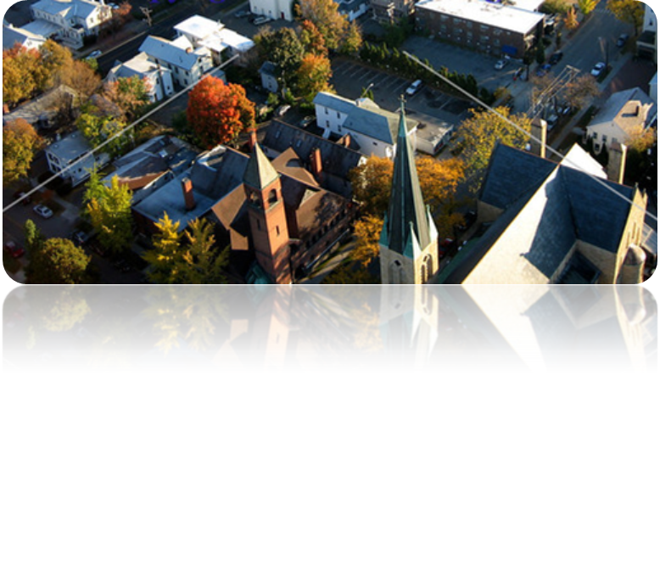
Locality Testing
To determine how best to reach individual community members, especially those who are marginalized, during the next survey period, we carried out locality testing.

Slide 44
Locality Testing
Methods...
First, we identified locations where diverse populations can be reached, including:
  Schools
  Health Care clinics
  Libraries
  Community Centers
  Grocery Stores
Next, we identified specific contacts at many of these locations.
Finally, we developed a set of questions to help us better understand the diversity of people that frequent each establishment, as well as recommended ways to distribute invitations at individual establishments.

Slide 45
Where We Go From Here
Recommendations for next survey period...
Plenty of time should be given prior to the next survey period for IRB approval and for making initial contact at each location.
Many locations will require a display that entices people to pick up an invitation with the survey link- display design and wording should be given adequate time and creative consideration.
At locations such as grocery stories, putting invitations in grocery bags would help reach the maximum amount of customers.
Alternative channels for inviting participants should be considered for those who don’t frequent local establishments –
such as the City website, organization websites, and Facebook.
Notes:
When creating the leaders group- each individual member will need a carefully constructed, individualized introduction to the ‘project’.
There is the possibility of founding a new organization, but this may or may not be needed in TC (Community Foundation can house initiatives)

Slide 46

Where We Go From Here
Recommendations for next survey period...
Be sure to reach outside Ithaca
Consider coupons as incentives (win-win-win)
Consider offering translated versions of the survey
Synchronize with the national survey period
Implement the marketing strategy
Notes:
When creating the leaders group- each individual member will need a carefully constructed, individualized introduction to the ‘project’.
There is the possibility of founding a new organization, but this may or may not be needed in TC (Community Foundation can house initiatives)

Slide 47
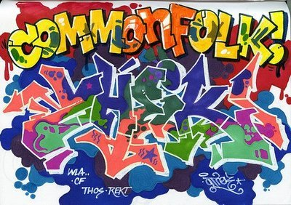
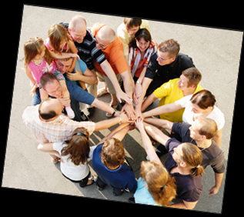
Through respect, good communication and mutual inspiration, We can increase levels of trust and engagement and ultimately strengthen the vibrancy and resiliency of our community!

Slide 48

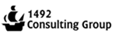




Thank You

