Slide 1

Tompkins County
Transfer of Wealth Opportunities
Human Services Coalition Forum
Wednesday, November 14, 2012
Notes:
Good Day.
Thanks for giving me the opportunity to share some thought-provoking ideas about securing New York’s future… and to share a surprising secret about money in [County].
Preparing for your presentation:
As you get ready to make this presentation, remember that copies of the Securing Our Future handout and county report provide good summary information as well as a nice leave behind.
Especially when in front of an audience that is hearing about the local wealth transfer for the first time, you may be asked questions about the research and methodology used to calculate your figures. The state report is a comprehensive resource for wealth transfer in your state and county. Familiarize yourself with particularly the source information and methodology sections toward the end.

Slide 2


Making a Difference Close to Home
traveling together…
…sharing the journey
]
Notes:
(Customize this slide with your community foundation identity)
Thank you for taking time to meet with me today.
We are the [your local foundation name]... your community foundation. And we are here...
“For good. For ever.” This phrase lies at the heart of what I’d like to address with you today... it’s what community foundations are all about.
My point in talking with you today is that if you choose to give, and do so effectively, you should consider your values, your reasons for giving, your goals (philanthropic and financial), and create a plan. We have with us today a person representing one of the means of strategic giving you have available to you — your local community foundation.
Your community foundation can help you realize your goals and deliver you customized personalized service as you work to achieve them. Here to speak with us today is [name of community foundation presenter], [title/role] of [your local foundation name]. I think that you will find [his/her] presentation useful as you consider how you’d like to get involved and give back.
[click]

Slide 3




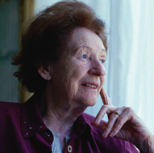
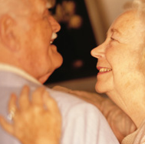
We are is a tax-exempt public charity created in 2000 by and for the people of Tompkins County to serve as a growing permanent endowment and information source to support everyone’s philanthropic action as a means of improving the quality of life for the Tompkins County community.
Notes:
(Customize this slide with the name of your town/area)
Here’s a more specific description of [your local foundation name] — we are a tax-exempt public charity created by and for the people of [local area].
So, now that you know what we are, the next logical question might be…
What is different about a community foundation?
Just what differentiates community foundations from other forms of organized philanthropy? Well…
[click]

Slide 4


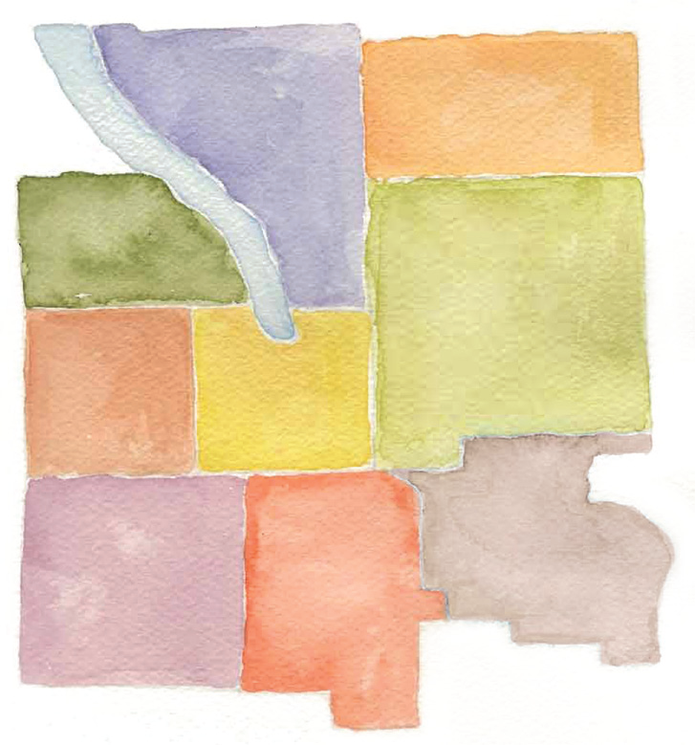
funds
Over 70 Funds
Tompkins Today and Tomorrow Fund
    Unrestricted grant making fund
Field of Interest Funds
    Arts and Culture
    Children and Youth Fund
    Crime and Sexual Assault Victims Fund
    Social Justice Fund
    Women’s Fund
Donor Advised Funds & Designated Funds
    These funds have originated to fill the philanthropic goals of individuals, families or organizations
Notes:
4
We are a local organization with deep roots in the community.
Our professional program staff has broad expertise regarding community issues and needs.
We provide highly personalized service, tailored to each individual’s charitable and financial interests.
Our Donor Advised Funds help people invest in the causes they care
about most.
We accept a wide variety of assets, and can facilitate even the most complex forms of giving.
[click]

Slide 5

facts
Nearly $3.9 million granted from 2000 to September 30, 2012
Assets are over $8.4 million held in over 70 different funds
(as of 9/30/2012)
Notes:
(Customize this slide with information on your funds and grantmaking,
as well as your logo)
[logo appears on screen - click to bring up facts]
[Your local foundation name] has more than [ insert number] funds.
[$$ insert number] in endowed assets.
More than [insert $$ number] in annual grants.
And cumulative grants — total grants awarded since our inception — of nearly [insert $$ number].
[You may want to talk about prudent investment practices and statistics on the growth of your local foundation here. This information on grants and financial performance helps you establish credibility and trust with your audience.]
[click]

Slide 6
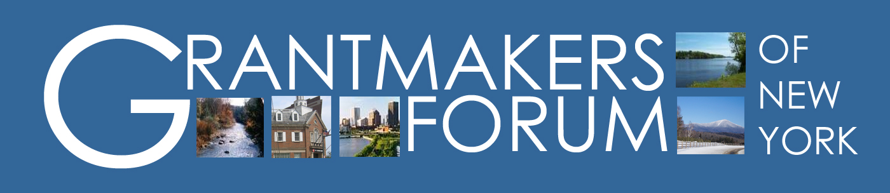
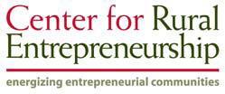
Participating community foundations:
Central New York Community Foundation
Community Foundation of Herkimer & Oneida Counties
Community Foundation of the Hudson Valley
Community Foundation of Tompkins County

Slide 7
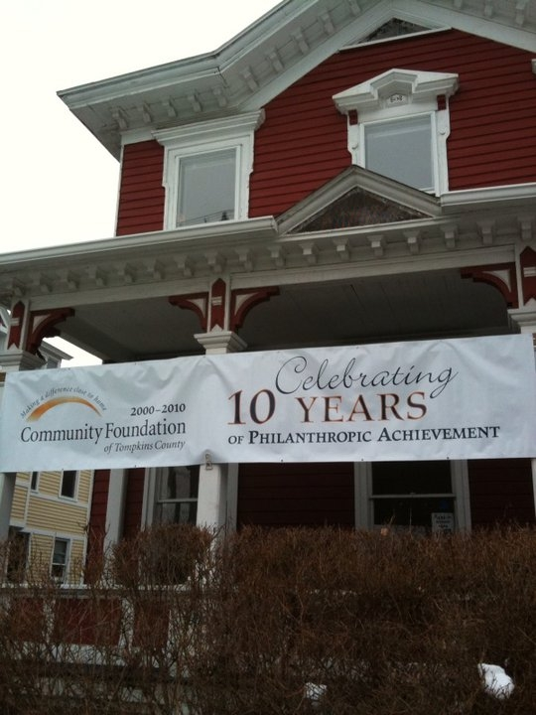
Transfer of wealth (TOW) is the process whereby one
generation transfers their assets to the next generation.
This typically occurs at the time of death and
represents the moment when charitable gifts from estate
planning can result in powerful legacy community giveback.
TOW most likely symbolizes the single largest
under-developed philanthropic resource
available to communities to support their development.
COMMUNITY WEALTH
OUR FUTURE
Creating and growing a “creative” economy with technology transfer holds potential for significant sustained economic and social development.
Vacation, recreational and second home development within the Finger Lakes Region could create a
second pool of seasonal or new residents with both motivation and capacity for giveback.
Notes:
That’s no longer true.
Many of the “next generations” no longer live in [County]… and once the wealth leaves [County], it will never return.
This is important today because in the next 20 years, the largest mass of wealth in history will transfer… from the WW II generation to Baby Boomers, then from Baby Boomers to the next generation.
And of course, the two things we all know we can’t avoid are still death and taxes.
The Community Foundation corollary to both: you can’t take it with you.
So what will happen to all this wealth accumulated by the WWII and Baby Boom generations?

Slide 8

2010-2060 Surprising wealth transfer in next 50 years
$53 trillion in United States
$2.07 trillion in New York State
$38.63 billion total in Tompkins County
Notes:
It all adds up.
Look at these estimates:
$53 trillion in the United States
$2.07 in New York State
[$XXX billion] in [County]… an average of [$XXX,XXX] per household
Experts say these numbers are unprecedented.
The World War II generation, plus the Baby Boom generation, own more private wealth than any time in our history.
Note:
These numbers may be staggering to some; this slide may offer a good opportunity to stop and ask if there are questions regarding the numbers, research, methodology, etc. Again, the state report is a comprehensive source for research and methodology information.

Slide 9
Wealth Transfer
A possible timing scenario for the U.S., New York and Tompkins County
Now is the time to have planning conversations with professional advisors
Notes:
Community foundations worked with the Rural Policy Research Institute Center for Rural Entrepreneurship, state demographers, local experts and Federal data sources to identify how much wealth is scheduled to transfer generations here in [County] over the next 50 years.
Our research estimates that in 2030-2035 the transfer of wealth in New York State will peak
You can see how that compares with national estimates as well.

Slide 10
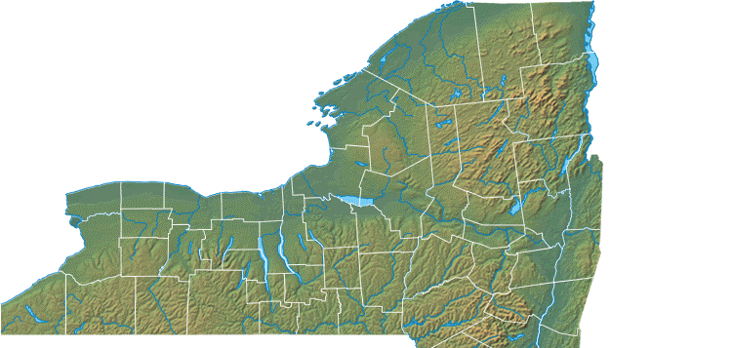
Current Household Net Worth
Tompkins County, New York as of 2010
Population:
101,564
Estimate
2,900 High Net Worth
Households
Assets of >$500,000
$7.4 billion total
$190,200 per household
Notes:
And would it surprise you to learn that right here in [County], experts have documented [$XX billion] in private wealth?
That averages out to more than [$XXX,XXX] per household.

Slide 11
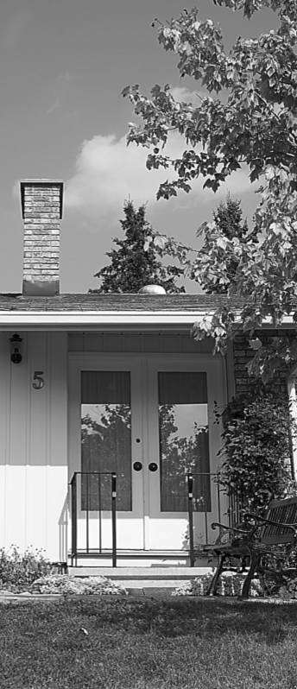
COMMUNITY WEALTH
Yesterday
For generations, people lived entire lives
close to their birthplace
Tompkins County wealth generally passed from generation to generation, but primarily stayed in Tompkins County
Today
Many of the next generation no longer
live in our county
Once the wealth leaves our community,
it will never return
Notes:
Their lifestyles—and their mobility—are unprecedented as well.
For generations, most people lived entire lives close to their birthplace. One family might occupy the same property, even the same home, for multiple generations.
[County] wealth passed from generation to generation, but stayed in [County].

Slide 12


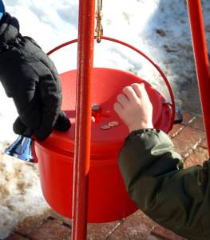
Three beneficiaries
Capture of TOW opportunities could provide critically important new
financial resources necessary for economic and social innovation and renewal.
PASSING WEALTH FROM ONE GENERATION TO THE NEXT
Heirs
Taxes
Community
Notes:
One of three things:
It will be inherited
It will be paid in taxes
It will be given to charity to be invested in community, education and religious organizations
With most estates in the U.S.,
The vast majority goes to heirs.
For the largest estates in the U.S.,
A good chunk can go to taxes.
But although a charitable legacy can actually benefit heirs for those with big estates, historically less than 20% of them have left a charitable legacy.
And for more modest estates—where estate taxes are not a factor—very little goes to charitable causes… even for people who are dedicated and regularly support their church, alma mater, or community throughout their lifetime.
Source:
Charitable Statistics: An Untapped Well of Good
There are more than 260 million Americans, of whom approximately two million die each year.
In 1996, 79,346 estate tax forms were filed with the federal government. (At the time, these forms were required for estates in excess of $600,000.) Eighteen percent of the forms listed a charitable gift.
In other words, 82 percent of the nation's wealthiest individuals left nothing to charity.
Monroe County: In a 2004 survey of individuals 55+, 90% of those with wills gave regularly to charity, but 23% of them included charities in their wills. (WILLpowerSM)
A high percentage of Monroe County adults over 55 have wills – over 80%.
In addition, the IRS tells us that charity is getting a decreasing share of the money in these wealthy estates, from 21.8 percent in 1976 to 6.3 percent in 1992.
According to a 2004 Associated Press news story, only 42 percent of adults have wills, a five percent drop since 2000.
If only 20 percent of Americans left a charitable bequest, the current number of charitable bequests would more than double. Imagine what the impact to charitable organizations would be if the 80 percent of Americans who give during their lifetimes also made a charitable gift through their estate plans!
http://www.leavealegacy.org/why_give.asp

Slide 13

Endowment gifts can be held by Community Foundation for BOTH grant making and for agency endowments
A possibility for the next 10 to 50 years
By encouraging conversations about planned giving into charitable endowments, Tompkins County has the opportunity to retain some portion of our local generational transfer of wealth for grants which will benefit future generations
5%
Notes:
But to realize the 5% potential for [County], the next 10 to 20 years are critical.
It’s a limited window of time… during which we have the opportunity to preserve some of today’s wealth for tomorrow’s generations.

Slide 14



One gift, many generations, endless results
YEAR 1
YEAR 15
YEAR 25
YEAR 50
Establish an endowment
$100,000 in cumulative grants and services
$158,000 balance
$200,000 in cumulative grants and services
$213,000 balance
$625,000 in cumulative grants and services
$455,000 balance
$100,000 gift
INITIAL GIFT INVESTED
1 TIME
2 TIMES
6+ TIMES
WHY ENDOWED GIFTS
assumes 5% annual payout and 8.5% rate of return
Notes:
Consider how one gift of $100,000 can grow.
In the first 15 years, it has doubled in value: generating $100,000 in grants to support local causes and programs, and retaining all of its original value.
By year 25, the value has doubled again, having paid out $200,000 in grants while growing to be worth $213,000.
In just 50 years, the original $100,000 gift has generated nearly $1 million in value: $625,000 in grants, and $355,000 in asset growth.

Slide 15

Impact if only 5% of Tompkins County wealth was given as charitable gifts designated for community endowments
$126.51 million in 10 years
$1.93 billion in 50 years
Notes:
The opportunity is significant.
In [County], population XXX,XXX if just 5% of those assets were earmarked to benefit the community,
that would generate [$XXX million] in just the next 10 years…
a total of [$XX billion] over the next 50 years.

Slide 16

Many gifts, many generations
If people make a charitable gift of 5% of their estate to community endowments
YEAR 10
YEAR 50
$126.5 million charitable gifts
Range from $6.33 to $33.5 million in total grants
$145.5 million community endowments
$1.93 billion charitable gifts
Range from $96.58 million to $3.5 billion in total grants
$3.94 billion community endowments
LOOKING AHEAD
Notes:
And consider the numbers if everyone gives... just think of the good work this kind of money could do in [County].
In year 10, [$XXX million] in charitable gifts would have produced [$XX million] in grants, and grown into a [$XXX million] community endowment.
By year 50, the collective 5% is staggering: nearly one billion dollars in gifts, [XX billion] in grants, and a [XX billion dollar] community endowment.
In the year 2058, that will have made a huge difference for the people of [County].

Slide 17
HISTORY & BACKGROUND
Millionaires in the Millennium (1999)
  Boston College
  $41 Trillion TOW opportunity
  1998-2052 period
Transfer of Wealth in Nebraska (2002)
RUPRI Center for Rural Entrepreneurship
Completed over 38 studies in 1,100 communities

Slide 18
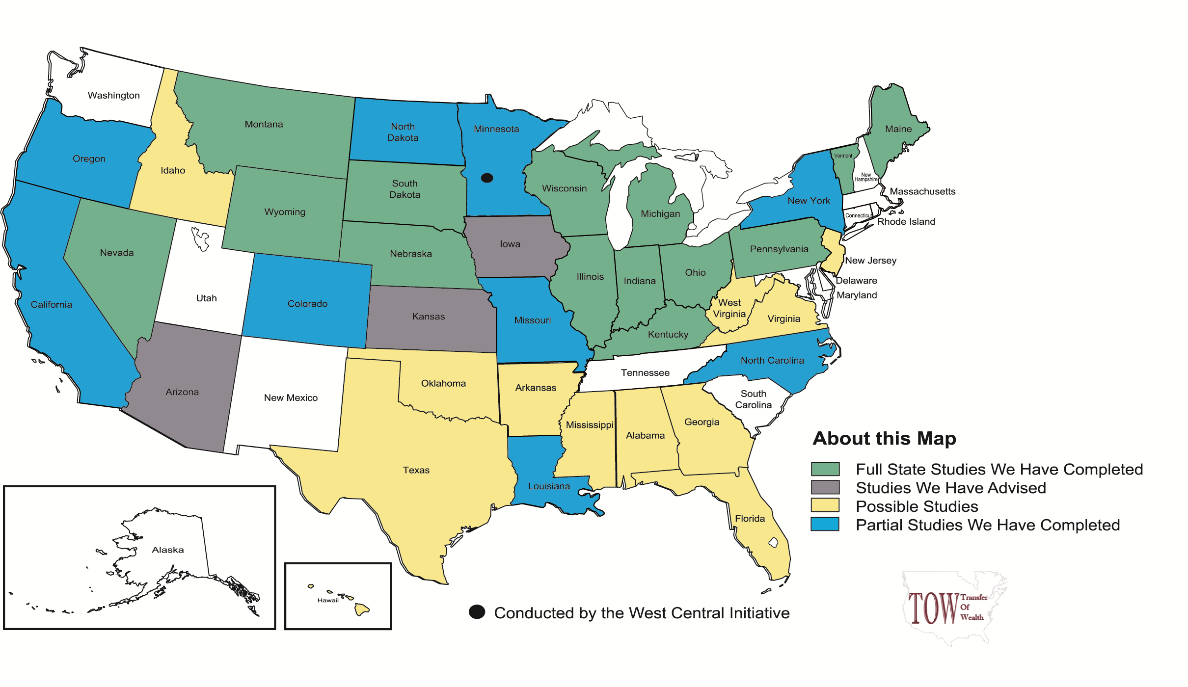
TOW Studies in the United States

Slide 19
U.S. Household Net Worth
1945-1990

Slide 20
Events of the Last Decade
Dot Com & 9-11 Crisis
The Post 9-11 Recession
Housing Bubble
Financial Crisis
The Great Recession of 2008

Slide 21
U.S. Household Net Worth
1990-2010 Q2

Slide 22
Methodology
Suggestive Forecast NOT a Prediction Forecast, NOT a Prescriptive Demand
Base year 2010, for 50 year period 2010-60
Real NOT Constant Dollars
Notes:
The TOW model produces scenarios based on projections of likely futures, not predictions or forecasts of actual future outcomes. Scenarios are driven by key assumptions about the future, based on historical trends. In all cases, we work to create conservative scenarios that represent realistic estimates of TOW opportunities. The scenario numbers generated are not predictive – indicating what WILL result 10 and 20 years from now – but rather demonstrate potential or a “likely future” given past and current trends. They are not designed to dictate policy but rather to provoke strategic discussions driven by a simple question – what if the community were able to capture just 5% of the wealth that will transfer between generations over the next 10, 20, or 50
years to support investments in community betterment?

Slide 23
Estimating Net Worth
Step I
Survey of Consumer Finance, The Federal Reserve Board
  Triennial
  Current Release: 2007
Flow of Funds, The Federal Reserve Board
  Current Release: December 9, 2010
  Next Release: March 10, 2011
Notes:
The Survey of Consumer Finances (SCF) is a triennial survey of the balance sheet, pension, income, and other demographic characteristics of U.S. families.

Slide 24
Estimating Net Worth
Step II
Age Characteristics
Market Valuation of Property by Class
Concentration of Creative Class Employment & Income
Dividends, Interest & Rent (DIR) Income
Proprietors’ Employment & Income
Residential Real Estate, Owned Businesses, Investments
Notes:
The Survey of Consumer Finances (SCF) is a triennial survey of the balance sheet, pension, income, and other demographic characteristics of U.S. families.

Slide 25
Scenario Building
Step I
Population projections
Economic growth scenario
Step II
Wealth Release
Step III
Review & Verification
Notes:
The Survey of Consumer Finances (SCF) is a triennial survey of the balance sheet, pension, income, and other demographic characteristics of U.S. families.

Slide 26
Estimating Net Worth
Step III
Discounting assets
  Motor vehicles, art, jewelry
Immigrants
Group quarters population
High amenities, vacation homes, retirees
Economic development projects
Other special cases

Slide 27
Tompkins County Technical Advisory Committee
Suzanne Aigen, Aigen Agency
Martha Armstrong, Tompkins County Area Development
Fred Ballantyne, TIAA-CREF and former Community Foundation Board
Mary Berens, Cornell (ret.) and Community Foundation Board
Phyllisa DeSarno, Economic Planning, City of Ithaca
David Kay, CARDI, Cornell University
Paula Peter, The Solstice Group
Ed Marx, Tompkins County
Jean McPheeters, Tompkins County Chamber of Commerce
Ed Morton, Chemung Canal Trust Company and Community Foundation Board
Karen Sharkey, Audrey Edelman USA Realty
David Squires, Tompkins County, Director of Finance, and Community Foundation Board
Frost Travis, Travis & Travis Development and Ithaca Rentals and Renovations
Bryan Warren, Warren Realty
Notes:
The Survey of Consumer Finances (SCF) is a triennial survey of the balance sheet, pension, income, and other demographic characteristics of U.S. families.

Slide 28
Average U.S. Net Worth by Age

Slide 29
Average U.S. Net Worth by Work Status

Slide 30
Average U.S. Net Worth by
Education Level

Slide 31
Median Age, 2010

Slide 32
Percent of
Group Quarters Population, 2010

Slide 33
Percent of
Dividends, Interest and Rent Income, 2009

Slide 34
Population Growth
2000-2010 (Annual)

Slide 35
Many gifts, many generations
If people make a charitable gift of 5% of their estate to community endowments
YEAR 10
YEAR 50
$126.5 million charitable gifts
Range from $6.33 to $33.5 million in total grants
$145.5 million community endowments
$1.93 billion charitable gifts
Range from $96.58 million to $3.5 billion in total grants
$3.94 billion community endowments
LOOKING AHEAD
Notes:
And consider the numbers if everyone gives... just think of the good work this kind of money could do in [County].
In year 10, [$XXX million] in charitable gifts would have produced [$XX million] in grants, and grown into a [$XXX million] community endowment.
By year 50, the collective 5% is staggering: nearly one billion dollars in gifts, [XX billion] in grants, and a [XX billion dollar] community endowment.
In the year 2058, that will have made a huge difference for the people of [County].

Slide 36
What other groups and individuals need to hear this information?
How should the Community Foundation market the TOW study results?
What actions should we take to increase the likelihood of charitable endowment TOW gifts?
What organizations and businesses are potential collaborators?
What questions remain? How could this presentation be improved?
Notes:
36
We are a local organization with deep roots in the community.
Our professional program staff has broad expertise regarding community issues and needs.
We provide highly personalized service, tailored to each individual’s charitable and financial interests.
Our Donor Advised Funds help people invest in the causes they care
about most.
We accept a wide variety of assets, and can facilitate even the most complex forms of giving.
[click]

Slide 37
website
For the very latest in
Community Foundation events, grant opportunities and donor services,
visit
our website at
www.cftompkins.org
Notes:
37
We are a local organization with deep roots in the community.
Our professional program staff has broad expertise regarding community issues and needs.
We provide highly personalized service, tailored to each individual’s charitable and financial interests.
Our Donor Advised Funds help people invest in the causes they care
about most.
We accept a wide variety of assets, and can facilitate even the most complex forms of giving.
[click]

Slide 38

To get daily posts on national and local philanthropy news and non-profit information, like us on Facebook at
www.facebook.com/cftompkins
Notes:
38
We are a local organization with deep roots in the community.
Our professional program staff has broad expertise regarding community issues and needs.
We provide highly personalized service, tailored to each individual’s charitable and financial interests.
Our Donor Advised Funds help people invest in the causes they care
about most.
We accept a wide variety of assets, and can facilitate even the most complex forms of giving.
[click]

Slide 39
Visit us
309 N. Aurora Street
Ithaca, NY 14850
607-272-9333
Notes:
39
We are a local organization with deep roots in the community.
Our professional program staff has broad expertise regarding community issues and needs.
We provide highly personalized service, tailored to each individual’s charitable and financial interests.
Our Donor Advised Funds help people invest in the causes they care
about most.
We accept a wide variety of assets, and can facilitate even the most complex forms of giving.
[click]

Slide 40

Everyone can be a philanthropist
Notes:
Hopefully, I’ve convinced you that everyone can be a philanthropist.
One good way is by giving for good.

