Slide 1
Making a Difference Close to Home
traveling together…
…sharing the journey
]
Notes:
(Customize this slide with your community foundation identity)
Thank you for taking time to meet with me today.
We are the [your local foundation name]... your community foundation. And we are here...
“For good. For ever.” This phrase lies at the heart of what I’d like to address with you today... it’s what community foundations are all about.
My point in talking with you today is that if you choose to give, and do so effectively, you should consider your values, your reasons for giving, your goals (philanthropic and financial), and create a plan. We have with us today a person representing one of the means of strategic giving you have available to you — your local community foundation.
Your community foundation can help you realize your goals and deliver you customized personalized service as you work to achieve them. Here to speak with us today is [name of community foundation presenter], [title/role] of [your local foundation name]. I think that you will find [his/her] presentation useful as you consider how you’d like to get involved and give back.
[click]

Slide 2
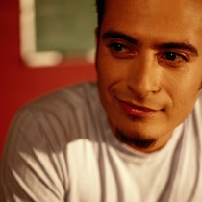
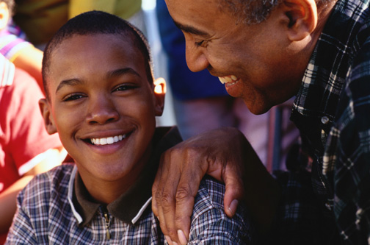
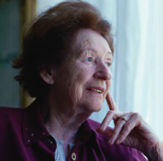
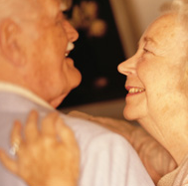
We are is a tax-exempt public charity created in 2000 by and for the people of Tompkins County to serve as a growing permanent endowment and information source to support everyone’s philanthropic action as a means of improving the quality of life for the Tompkins County community.
Notes:
(Customize this slide with the name of your town/area)
Here’s a more specific description of [your local foundation name] — we are a tax-exempt public charity created by and for the people of [local area].
So, now that you know what we are, the next logical question might be…
What is different about a community foundation?
Just what differentiates community foundations from other forms of organized philanthropy? Well…
[click]

Slide 3
foundation
facts
A brief history
1914
First U.S. community foundation established in Cleveland, Ohio
2000
Community Foundation of Tompkins County established
today
734 community foundations in the United States
› Serving 86% of the US population and growing globally
› More than $55 billion in assets nationally
$10.8 million in Tompkins County
› Made grants of more than $4.2 billion nationally in 2010
› Received gifts of more than $4.7 billion in 2010
Notes:
(Customize this slide with information on the formation of your community
foundation)
In 1914, the first United States community foundation was established in
Cleveland, Ohio.
[Insert text about the formation of your foundation]
Since then, community foundations have become established in the U.S.
Today there are over 600:
Serving citizens across the nation
With more than $30 billion in assets
Together, we distribute nearly $2 billion in local grants each year
And our field is growing rapidly, as more and more people discover the value of community foundations.
Now let’s look more specifically at [your local foundation name]…
[click]
(Note: This information could be revised locally to be about the history of your
community foundation or community foundations in your state.)

Slide 4
The I is a member of
Council on Foundations
Grantmakers for Effective Organizations
Grantmakers Forum of New York
Tompkins County Chamber of Commerce
Tompkins County Funders Group
Notes:
(Customize this slide with your community foundation identity)
Thank you for taking time to meet with me today.
We are the [your local foundation name]... your community foundation. And we are here...
“For good. For ever.” This phrase lies at the heart of what I’d like to address with you today... it’s what community foundations are all about.
My point in talking with you today is that if you choose to give, and do so effectively, you should consider your values, your reasons for giving, your goals (philanthropic and financial), and create a plan. We have with us today a person representing one of the means of strategic giving you have available to you — your local community foundation.
Your community foundation can help you realize your goals and deliver you customized personalized service as you work to achieve them. Here to speak with us today is [name of community foundation presenter], [title/role] of [your local foundation name]. I think that you will find [his/her] presentation useful as you consider how you’d like to get involved and give back.
[click]

Slide 5
O Mission: to Encourage and Develop Sustainable Philanthropy for a Broad Range of Community Efforts by
Encouraging the growth of a permanent charitable endowment
Making strategic grants as community investments
Providing donors with vehicles to make giving easy and effective
Serving as a community catalyst and convener to solve problems and improve quality of life
Notes:
(Customize this slide with your community foundation identity)
Thank you for taking time to meet with me today.
We are the [your local foundation name]... your community foundation. And we are here...
“For good. For ever.” This phrase lies at the heart of what I’d like to address with you today... it’s what community foundations are all about.
My point in talking with you today is that if you choose to give, and do so effectively, you should consider your values, your reasons for giving, your goals (philanthropic and financial), and create a plan. We have with us today a person representing one of the means of strategic giving you have available to you — your local community foundation.
Your community foundation can help you realize your goals and deliver you customized personalized service as you work to achieve them. Here to speak with us today is [name of community foundation presenter], [title/role] of [your local foundation name]. I think that you will find [his/her] presentation useful as you consider how you’d like to get involved and give back.
[click]

Slide 6
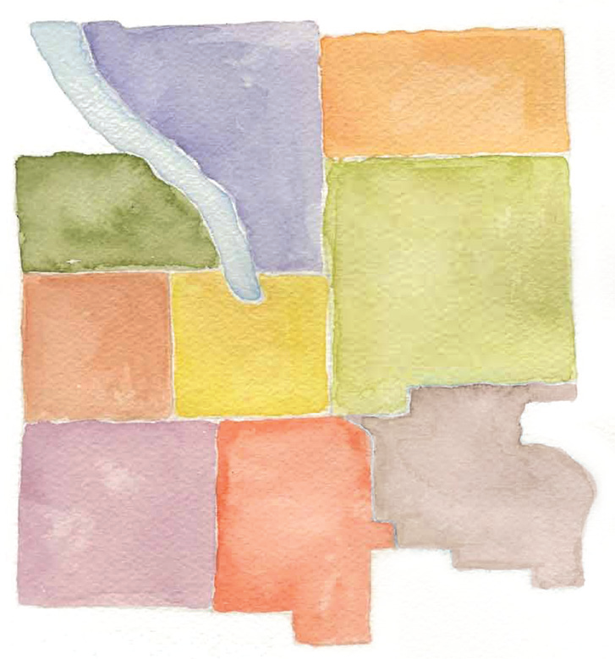
FUNDS
Over 70 Funds
Tompkins Today and Tomorrow Fund
Unrestricted grant making fund
Field of Interest Funds
Arts and Culture
Children and Youth Fund
Crime and Sexual Assault Victims Fund
Social Justice Fund
Women’s Fund
Donor Advised Funds & 4. Designated Funds
These funds have originated to fill the philanthropic goals of individuals, families or organizations
Each type of fund can have either an ENDOWED or EXPENDABLE status
Notes:
6
We are a local organization with deep roots in the community.
Our professional program staff has broad expertise regarding community issues and needs.
We provide highly personalized service, tailored to each individual’s charitable and financial interests.
Our Donor Advised Funds help people invest in the causes they care about most.
We accept a wide variety of assets, and can facilitate even the most complex forms of giving.
[click]

Slide 7
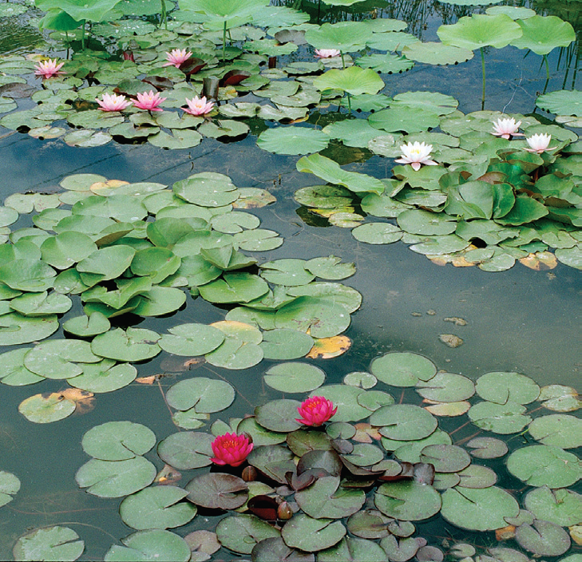
facts
Over $4 million granted from 2000 to December 31, 2012
Assets are over $11 million held in over 75 different funds
63% endowed, 37% expendable
54% foundation, 46% donor advised
(as of 2/28/2012)
Notes:
(Customize this slide with information on your funds and grantmaking,
as well as your logo)
[logo appears on screen - click to bring up facts]
[Your local foundation name] has more than [ insert number] funds.
[$$ insert number] in endowed assets.
More than [insert $$ number] in annual grants.
And cumulative grants — total grants awarded since our inception — of nearly [insert $$ number].
[You may want to talk about prudent investment practices and statistics on the growth of your local foundation here. This information on grants and financial performance helps you establish credibility and trust with your audience.]
[click]

Slide 8
4 Functions with 2 Types of Resources
Acquire
Steward
Analyze
Distribute
Money
Information
Notes:
(Customize this slide with your community foundation identity)
Thank you for taking time to meet with me today.
We are the [your local foundation name]... your community foundation. And we are here...
“For good. For ever.” This phrase lies at the heart of what I’d like to address with you today... it’s what community foundations are all about.
My point in talking with you today is that if you choose to give, and do so effectively, you should consider your values, your reasons for giving, your goals (philanthropic and financial), and create a plan. We have with us today a person representing one of the means of strategic giving you have available to you — your local community foundation.
Your community foundation can help you realize your goals and deliver you customized personalized service as you work to achieve them. Here to speak with us today is [name of community foundation presenter], [title/role] of [your local foundation name]. I think that you will find [his/her] presentation useful as you consider how you’d like to get involved and give back.
[click]

Slide 9
website
For the very latest in
Community Foundation grant opportunities
visit
our website at
http://www.cftompkins.org/granting/grant-opportunities/
Notes:
9
We are a local organization with deep roots in the community.
Our professional program staff has broad expertise regarding community issues and needs.
We provide highly personalized service, tailored to each individual’s charitable and financial interests.
Our Donor Advised Funds help people invest in the causes they care about most.
We accept a wide variety of assets, and can facilitate even the most complex forms of giving.
[click]

Slide 10
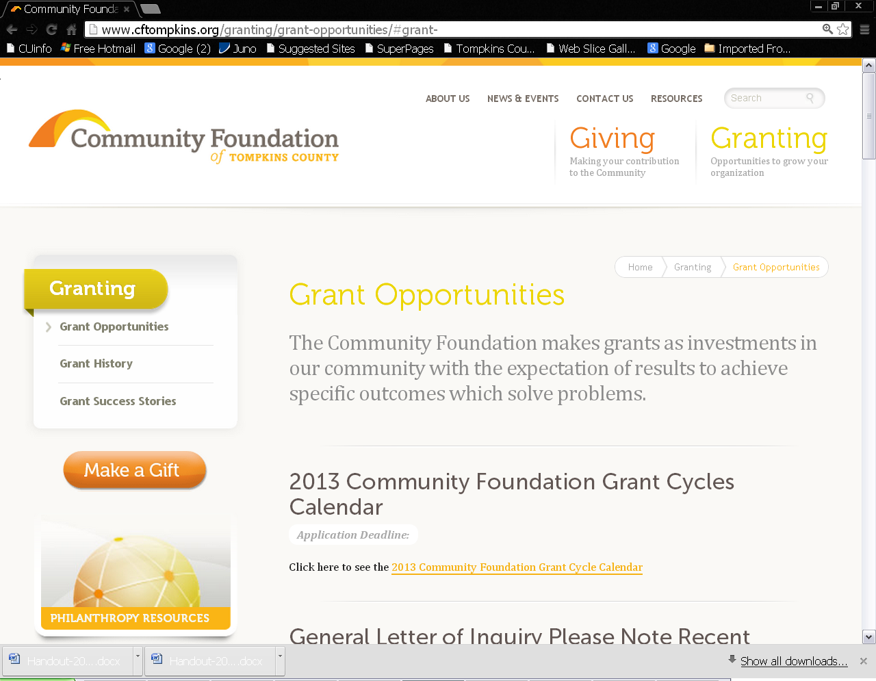
grant opportunities
Over 70 Funds
Notes:
10
We are a local organization with deep roots in the community.
Our professional program staff has broad expertise regarding community issues and needs.
We provide highly personalized service, tailored to each individual’s charitable and financial interests.
Our Donor Advised Funds help people invest in the causes they care about most.
We accept a wide variety of assets, and can facilitate even the most complex forms of giving.
[click]

Slide 11
Two way conversations
Find a partner
You have a total of 6 minutes, 3 minutes each
Answer the following question, be ready to report out to whole group what your partner has shared
What skills do you possess that you have found useful in grant writing?
Notes:
(Customize this slide with your community foundation identity)
Thank you for taking time to meet with me today.
We are the [your local foundation name]... your community foundation. And we are here...
“For good. For ever.” This phrase lies at the heart of what I’d like to address with you today... it’s what community foundations are all about.
My point in talking with you today is that if you choose to give, and do so effectively, you should consider your values, your reasons for giving, your goals (philanthropic and financial), and create a plan. We have with us today a person representing one of the means of strategic giving you have available to you — your local community foundation.
Your community foundation can help you realize your goals and deliver you customized personalized service as you work to achieve them. Here to speak with us today is [name of community foundation presenter], [title/role] of [your local foundation name]. I think that you will find [his/her] presentation useful as you consider how you’d like to get involved and give back.
[click]

Slide 12
Two way conversations Part 2
Find a new partner
You have a total of 6 minutes, 3 minutes each
Answer the following question, be ready to report out to whole group what your partner has shared
What skills do you wantto learn that you think would make you a better grant writer?
Notes:
(Customize this slide with your community foundation identity)
Thank you for taking time to meet with me today.
We are the [your local foundation name]... your community foundation. And we are here...
“For good. For ever.” This phrase lies at the heart of what I’d like to address with you today... it’s what community foundations are all about.
My point in talking with you today is that if you choose to give, and do so effectively, you should consider your values, your reasons for giving, your goals (philanthropic and financial), and create a plan. We have with us today a person representing one of the means of strategic giving you have available to you — your local community foundation.
Your community foundation can help you realize your goals and deliver you customized personalized service as you work to achieve them. Here to speak with us today is [name of community foundation presenter], [title/role] of [your local foundation name]. I think that you will find [his/her] presentation useful as you consider how you’d like to get involved and give back.
[click]

Slide 13
Before you apply
Mission, Vision, Values, Methods
Strategic plan
Organizational capacity and unique qualifications
Theory of change, logic model
Business model, revenue mix, budget, audit, 990
Documentation of need, data, assessments
Program development
Evaluation plan
Notes:
(Customize this slide with your community foundation identity)
Thank you for taking time to meet with me today.
We are the [your local foundation name]... your community foundation. And we are here...
“For good. For ever.” This phrase lies at the heart of what I’d like to address with you today... it’s what community foundations are all about.
My point in talking with you today is that if you choose to give, and do so effectively, you should consider your values, your reasons for giving, your goals (philanthropic and financial), and create a plan. We have with us today a person representing one of the means of strategic giving you have available to you — your local community foundation.
Your community foundation can help you realize your goals and deliver you customized personalized service as you work to achieve them. Here to speak with us today is [name of community foundation presenter], [title/role] of [your local foundation name]. I think that you will find [his/her] presentation useful as you consider how you’d like to get involved and give back.
[click]

Slide 14
Before you apply
How does grant seeking in general fit into your strategic revenue plans?
What criteria do you use to select a particular grant?
Consider your burden of writing the grant application as well as all reporting requirements
Sustainability and subsequent funding needs
Notes:
(Customize this slide with your community foundation identity)
Thank you for taking time to meet with me today.
We are the [your local foundation name]... your community foundation. And we are here...
“For good. For ever.” This phrase lies at the heart of what I’d like to address with you today... it’s what community foundations are all about.
My point in talking with you today is that if you choose to give, and do so effectively, you should consider your values, your reasons for giving, your goals (philanthropic and financial), and create a plan. We have with us today a person representing one of the means of strategic giving you have available to you — your local community foundation.
Your community foundation can help you realize your goals and deliver you customized personalized service as you work to achieve them. Here to speak with us today is [name of community foundation presenter], [title/role] of [your local foundation name]. I think that you will find [his/her] presentation useful as you consider how you’d like to get involved and give back.
[click]

Slide 15
Thinking like a foundation
New services
Core operating support
Expanding and maintaining proven programs
Capital campaigns and projects
Capacity building
New collaborative initiatives
Notes:
(Customize this slide with your community foundation identity)
Thank you for taking time to meet with me today.
We are the [your local foundation name]... your community foundation. And we are here...
“For good. For ever.” This phrase lies at the heart of what I’d like to address with you today... it’s what community foundations are all about.
My point in talking with you today is that if you choose to give, and do so effectively, you should consider your values, your reasons for giving, your goals (philanthropic and financial), and create a plan. We have with us today a person representing one of the means of strategic giving you have available to you — your local community foundation.
Your community foundation can help you realize your goals and deliver you customized personalized service as you work to achieve them. Here to speak with us today is [name of community foundation presenter], [title/role] of [your local foundation name]. I think that you will find [his/her] presentation useful as you consider how you’d like to get involved and give back.
[click]

Slide 16
Organizational readiness
Place in the lifecycle of organizational development
Capacity and Qualifications, staff and volunteers
Relationships, referrals, collaborators, funders
Historical context, longer view
Integrity
Reliability, dependability, trust, communication
Assess and adjust
Notes:
(Customize this slide with your community foundation identity)
Thank you for taking time to meet with me today.
We are the [your local foundation name]... your community foundation. And we are here...
“For good. For ever.” This phrase lies at the heart of what I’d like to address with you today... it’s what community foundations are all about.
My point in talking with you today is that if you choose to give, and do so effectively, you should consider your values, your reasons for giving, your goals (philanthropic and financial), and create a plan. We have with us today a person representing one of the means of strategic giving you have available to you — your local community foundation.
Your community foundation can help you realize your goals and deliver you customized personalized service as you work to achieve them. Here to speak with us today is [name of community foundation presenter], [title/role] of [your local foundation name]. I think that you will find [his/her] presentation useful as you consider how you’d like to get involved and give back.
[click]

Slide 17
Getting to know your funder
Website
Previous grant awards
Know the current cycle priorities, definitions
Ask questions, go to Q&As
Have a draft application critiqued
Notes:
(Customize this slide with your community foundation identity)
Thank you for taking time to meet with me today.
We are the [your local foundation name]... your community foundation. And we are here...
“For good. For ever.” This phrase lies at the heart of what I’d like to address with you today... it’s what community foundations are all about.
My point in talking with you today is that if you choose to give, and do so effectively, you should consider your values, your reasons for giving, your goals (philanthropic and financial), and create a plan. We have with us today a person representing one of the means of strategic giving you have available to you — your local community foundation.
Your community foundation can help you realize your goals and deliver you customized personalized service as you work to achieve them. Here to speak with us today is [name of community foundation presenter], [title/role] of [your local foundation name]. I think that you will find [his/her] presentation useful as you consider how you’d like to get involved and give back.
[click]

Slide 18
Crafting your application
Results, outcomes, changes NOT activities, programs or services
Why are these results important, document need, make the case in context of competing demands on funder’s grant resources
How will you know these results have been achieved? Evaluation NOT feedback
Collaborate, consolidate, innovate
Ask questions, seek feedback, follow directions
Notes:
(Customize this slide with your community foundation identity)
Thank you for taking time to meet with me today.
We are the [your local foundation name]... your community foundation. And we are here...
“For good. For ever.” This phrase lies at the heart of what I’d like to address with you today... it’s what community foundations are all about.
My point in talking with you today is that if you choose to give, and do so effectively, you should consider your values, your reasons for giving, your goals (philanthropic and financial), and create a plan. We have with us today a person representing one of the means of strategic giving you have available to you — your local community foundation.
Your community foundation can help you realize your goals and deliver you customized personalized service as you work to achieve them. Here to speak with us today is [name of community foundation presenter], [title/role] of [your local foundation name]. I think that you will find [his/her] presentation useful as you consider how you’d like to get involved and give back.
[click]

Slide 19
evaluation of applications
This project/program has a clear description. As a reviewer, I understand what is being requested.
It is clear and convincing how this program/project meets the goals of strengthening assets, attaining greater resources, efficiency and/or effectiveness in the organization?
I understand the organizational need that the project addresses
The mission of the organization or the project/program is addressing a valued community need
Desirable outcomes are identified and reasonable and evaluative measures are in place
Notes:
(Customize this slide with your community foundation identity)
Thank you for taking time to meet with me today.
We are the [your local foundation name]... your community foundation. And we are here...
“For good. For ever.” This phrase lies at the heart of what I’d like to address with you today... it’s what community foundations are all about.
My point in talking with you today is that if you choose to give, and do so effectively, you should consider your values, your reasons for giving, your goals (philanthropic and financial), and create a plan. We have with us today a person representing one of the means of strategic giving you have available to you — your local community foundation.
Your community foundation can help you realize your goals and deliver you customized personalized service as you work to achieve them. Here to speak with us today is [name of community foundation presenter], [title/role] of [your local foundation name]. I think that you will find [his/her] presentation useful as you consider how you’d like to get involved and give back.
[click]

Slide 20
evaluation of applications
Budget/narrative is complete and reasonable
Is this organization well suited to meeting this need effectively?
Is the organization pursuing effective collaborations and/or cost saving measures in this project area?
Grant application quality
Overall likelihood of achieving impact
Notes:
(Customize this slide with your community foundation identity)
Thank you for taking time to meet with me today.
We are the [your local foundation name]... your community foundation. And we are here...
“For good. For ever.” This phrase lies at the heart of what I’d like to address with you today... it’s what community foundations are all about.
My point in talking with you today is that if you choose to give, and do so effectively, you should consider your values, your reasons for giving, your goals (philanthropic and financial), and create a plan. We have with us today a person representing one of the means of strategic giving you have available to you — your local community foundation.
Your community foundation can help you realize your goals and deliver you customized personalized service as you work to achieve them. Here to speak with us today is [name of community foundation presenter], [title/role] of [your local foundation name]. I think that you will find [his/her] presentation useful as you consider how you’d like to get involved and give back.
[click]

Slide 21
8 Ways of Making
GRANTS from the
Rosen Library Fund Grant Cycle
Women’s Fund Grant Cycle
Howland Foundation Grant Cycle
Fall Discretionary Grant Cycle
General Letters of Inquiry (LOIs) Twice Annually
Donor Advised Grants Responsive to Cycles or LOIs
Donor Advised Initiated Grants
Annual grants to designated fund agency beneficiary
Notes:
(Customize this slide with your community foundation identity)
Thank you for taking time to meet with me today.
We are the [your local foundation name]... your community foundation. And we are here...
“For good. For ever.” This phrase lies at the heart of what I’d like to address with you today... it’s what community foundations are all about.
My point in talking with you today is that if you choose to give, and do so effectively, you should consider your values, your reasons for giving, your goals (philanthropic and financial), and create a plan. We have with us today a person representing one of the means of strategic giving you have available to you — your local community foundation.
Your community foundation can help you realize your goals and deliver you customized personalized service as you work to achieve them. Here to speak with us today is [name of community foundation presenter], [title/role] of [your local foundation name]. I think that you will find [his/her] presentation useful as you consider how you’d like to get involved and give back.
[click]

Slide 22
grant cycles
Application drafts can be reviewed for comments up to one week before deadline
Community volunteer review panel of 10
Applications are shared with donor advisors for possible pick up
All grant cycle applicants receive both qualitative and quantitative constructive feedback on each application
Notes:
(Customize this slide with your community foundation identity)
Thank you for taking time to meet with me today.
We are the [your local foundation name]... your community foundation. And we are here...
“For good. For ever.” This phrase lies at the heart of what I’d like to address with you today... it’s what community foundations are all about.
My point in talking with you today is that if you choose to give, and do so effectively, you should consider your values, your reasons for giving, your goals (philanthropic and financial), and create a plan. We have with us today a person representing one of the means of strategic giving you have available to you — your local community foundation.
Your community foundation can help you realize your goals and deliver you customized personalized service as you work to achieve them. Here to speak with us today is [name of community foundation presenter], [title/role] of [your local foundation name]. I think that you will find [his/her] presentation useful as you consider how you’d like to get involved and give back.
[click]

Slide 23
grant cycles process
Over 70 Funds
Determine Grant Cycle Priorities
Announce Cycle & Offer Q&A Session
Review Applications & Additional Questions
Share Requests with Donor Advisors & Field of Interest Funds
Board Finalizes Grants & Applicants Receive Feedback
Progress Updates, Site Visits & Final Reports
Notes:
23
We are a local organization with deep roots in the community.
Our professional program staff has broad expertise regarding community issues and needs.
We provide highly personalized service, tailored to each individual’s charitable and financial interests.
Our Donor Advised Funds help people invest in the causes they care about most.
We accept a wide variety of assets, and can facilitate even the most complex forms of giving.
[click]

Slide 24
general info
Listening Learning informs all grant making and is used to set Fall Discretionary Grant Cycle priorities
Grants range between $250-$10,000
Single year, with potential of re-applying next year
Grants for general operations, new program launch, current program expansion, capacity building, staffing, and capital campaigns
Relationship not transactional based, questions, site visits, progress updates, final reports
Helping you leverage additional grants from us in the future and from other funders
Notes:
(Customize this slide with your community foundation identity)
Thank you for taking time to meet with me today.
We are the [your local foundation name]... your community foundation. And we are here...
“For good. For ever.” This phrase lies at the heart of what I’d like to address with you today... it’s what community foundations are all about.
My point in talking with you today is that if you choose to give, and do so effectively, you should consider your values, your reasons for giving, your goals (philanthropic and financial), and create a plan. We have with us today a person representing one of the means of strategic giving you have available to you — your local community foundation.
Your community foundation can help you realize your goals and deliver you customized personalized service as you work to achieve them. Here to speak with us today is [name of community foundation presenter], [title/role] of [your local foundation name]. I think that you will find [his/her] presentation useful as you consider how you’d like to get involved and give back.
[click]

Slide 25
local resources from our website
The Foundation Center News
The Foundation Center Public Policy
The Foundation Center General Non-Profit Management
The Foundation Center Development & Fundraising
The Foundation Center Federal Government Grant Sources
The Foundation Center Technology
Board Source
Philanthropy News Digest
Council on Foundations Philanthropy in the News
Philanthropy News
The NonProfit Times
IRS
Notes:
(Customize this slide with your community foundation identity)
Thank you for taking time to meet with me today.
We are the [your local foundation name]... your community foundation. And we are here...
“For good. For ever.” This phrase lies at the heart of what I’d like to address with you today... it’s what community foundations are all about.
My point in talking with you today is that if you choose to give, and do so effectively, you should consider your values, your reasons for giving, your goals (philanthropic and financial), and create a plan. We have with us today a person representing one of the means of strategic giving you have available to you — your local community foundation.
Your community foundation can help you realize your goals and deliver you customized personalized service as you work to achieve them. Here to speak with us today is [name of community foundation presenter], [title/role] of [your local foundation name]. I think that you will find [his/her] presentation useful as you consider how you’d like to get involved and give back.
[click]

Slide 26
local resources from our website
New York’s US Senator Kirsten Gillibrand’s Grants Central for Federal Funding
New York State Attorney General’s Charity Bureau
Independent Sector
Guidestar
New York State Council of NonProfits
Human Services Coalition of Tompkins County Board and NonProfit Resources
United Way COMPASS II-2.0
Urban Institute
Public/Private Ventures
Notes:
(Customize this slide with your community foundation identity)
Thank you for taking time to meet with me today.
We are the [your local foundation name]... your community foundation. And we are here...
“For good. For ever.” This phrase lies at the heart of what I’d like to address with you today... it’s what community foundations are all about.
My point in talking with you today is that if you choose to give, and do so effectively, you should consider your values, your reasons for giving, your goals (philanthropic and financial), and create a plan. We have with us today a person representing one of the means of strategic giving you have available to you — your local community foundation.
Your community foundation can help you realize your goals and deliver you customized personalized service as you work to achieve them. Here to speak with us today is [name of community foundation presenter], [title/role] of [your local foundation name]. I think that you will find [his/her] presentation useful as you consider how you’d like to get involved and give back.
[click]

Slide 27
Visit us
309 N. Aurora Street
Ithaca, NY 14850
607-272-9333
Notes:
27
We are a local organization with deep roots in the community.
Our professional program staff has broad expertise regarding community issues and needs.
We provide highly personalized service, tailored to each individual’s charitable and financial interests.
Our Donor Advised Funds help people invest in the causes they care about most.
We accept a wide variety of assets, and can facilitate even the most complex forms of giving.
[click]

