Slide 1


Slide 2
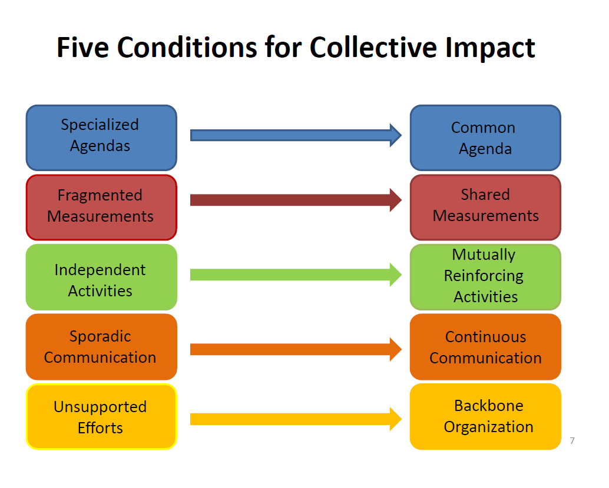

Slide 3
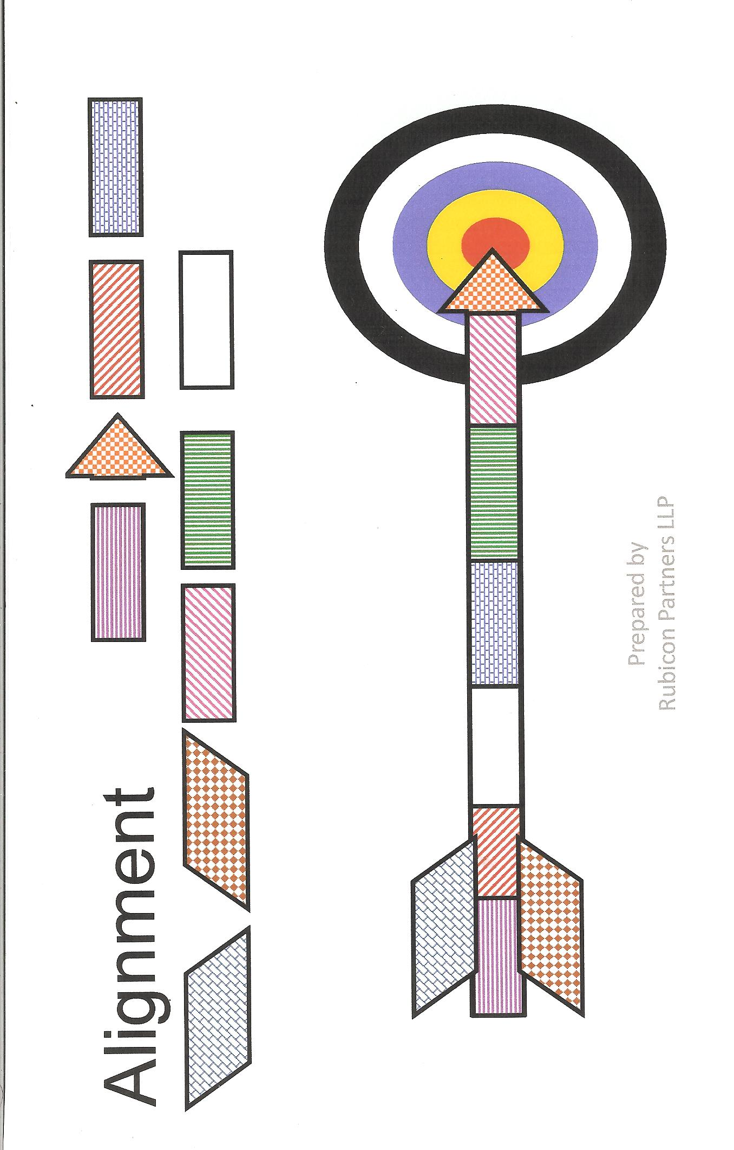

Slide 4
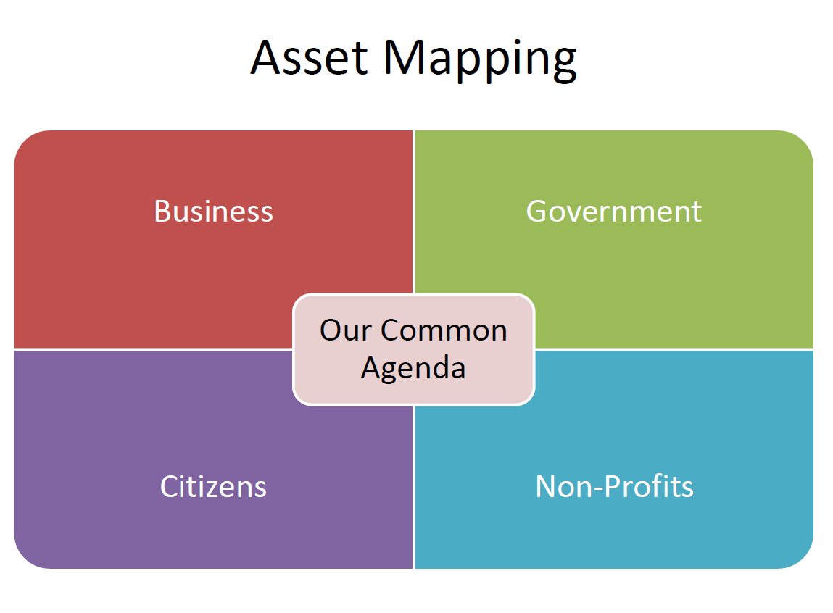

Slide 5
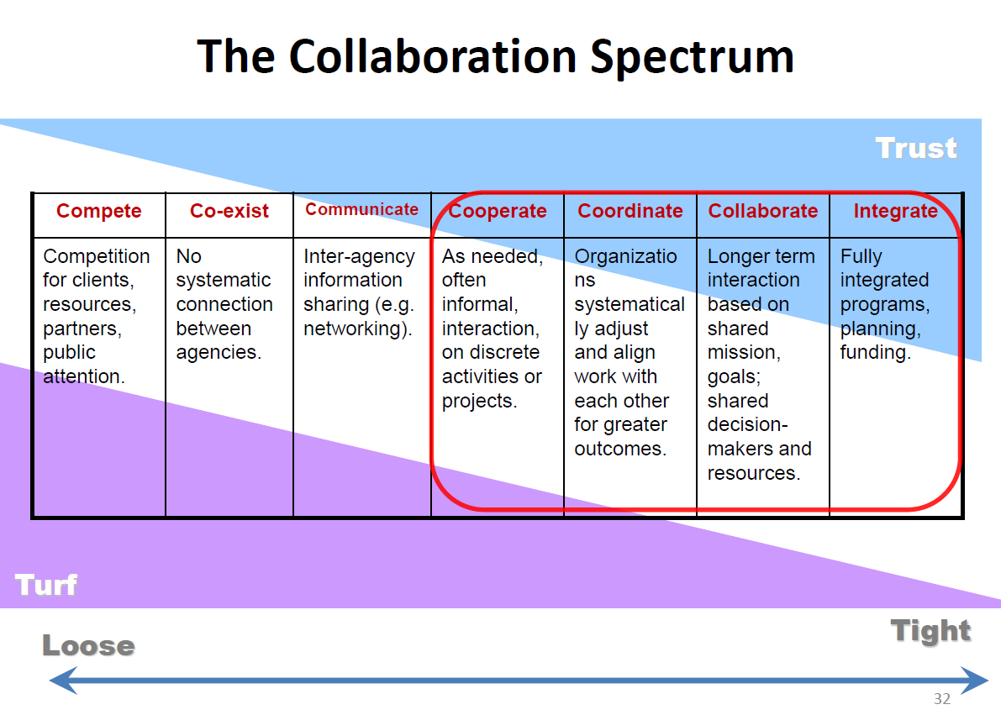

Slide 6
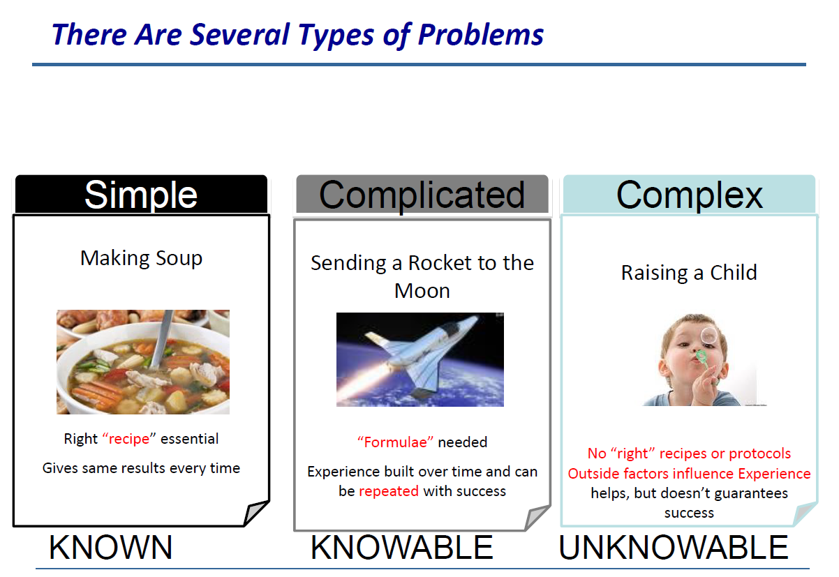
Source: Brenda Zimmerman, “Leadership in Complex Times.” CIS presentation, October 8 2014

Slide 7
Buy-In: Someone else has developed the idea, made the decision, designed an action plan and then asks and needs the staff/citizens to implement it.
Ownership: Front line staff/citizens develops the idea, makes the decisions, designs the action plan and acts on it.
* Buy-in is the opposite of ownership and a danger signal that tells you that your development and implementation process are missing the essential ingredient of involving everyone who needs to be.
Source: Brenda Zimmerman, “Leadership in Complex Times.” CIS presentation, October 8 2014

Slide 8

Mindset Shifts in Collective Impact
Mindset Shift One—Who is Involved
  Get all the right eyes on the problem
Collective seeing, learning and doing
Mindset Shift Two—How people
work together
Think “System Strategy”, not “Program Strategy”
Mindset Shift Three—How progress happens
FSG

Slide 9
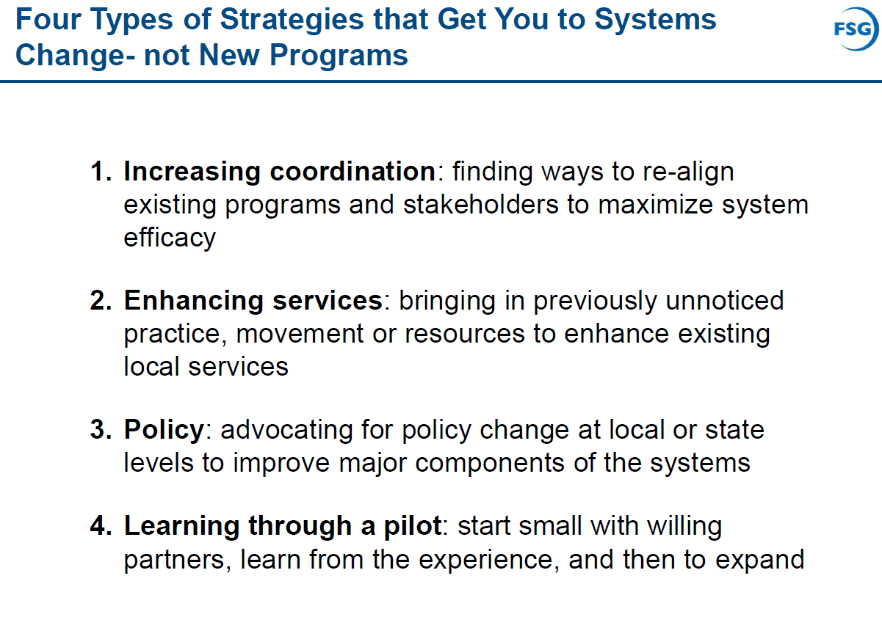
Source: John Kania, “Essential Mindset Shifts in Collective Impact.” CIS presentation, October 7, 2014

Slide 10
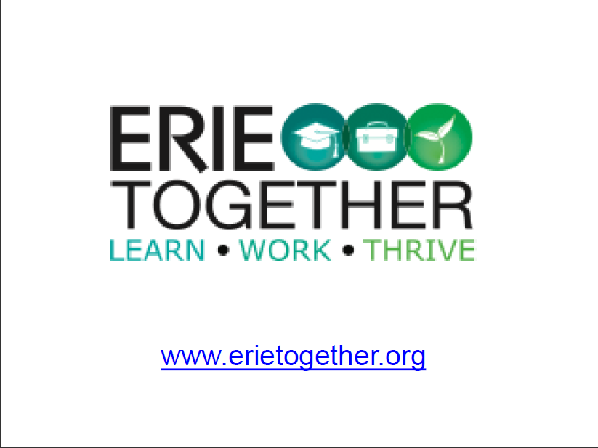

Slide 11
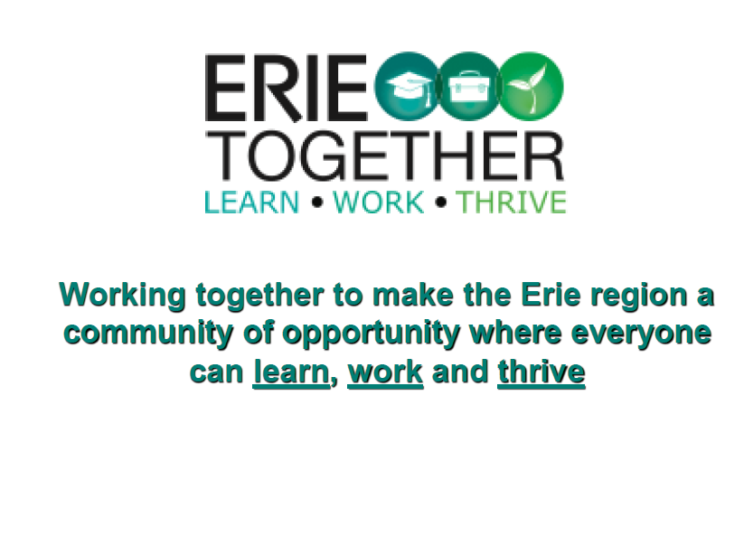

Slide 12
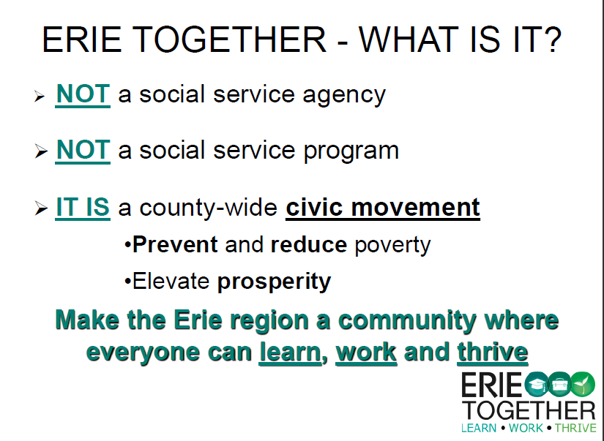

Slide 13
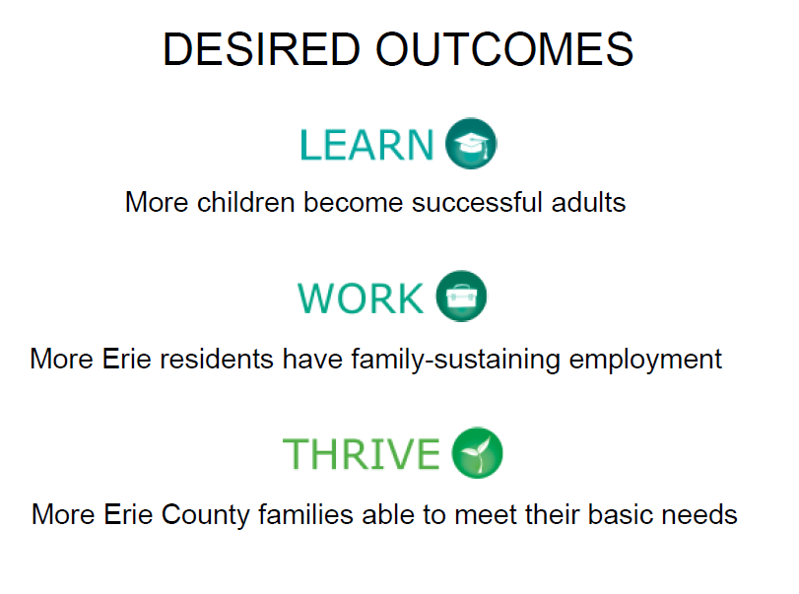

Slide 14
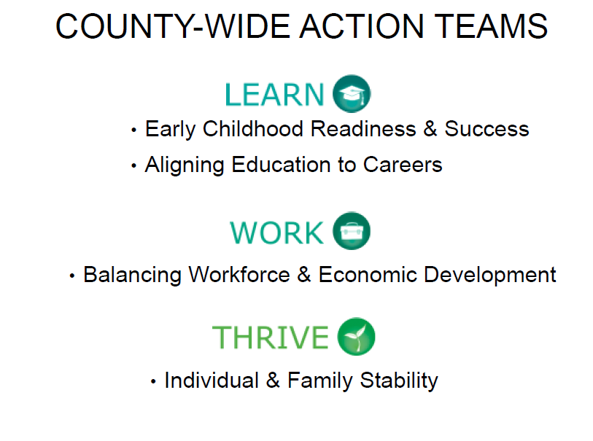

Slide 15
