Slide 1

Celebrating our
Arts and Culture Grantees
in Tompkins County

Slide 2
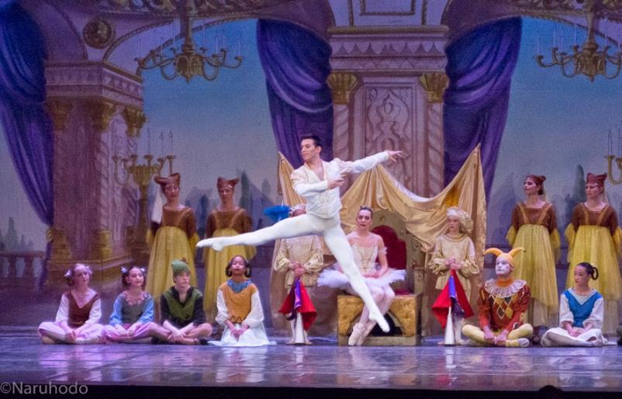
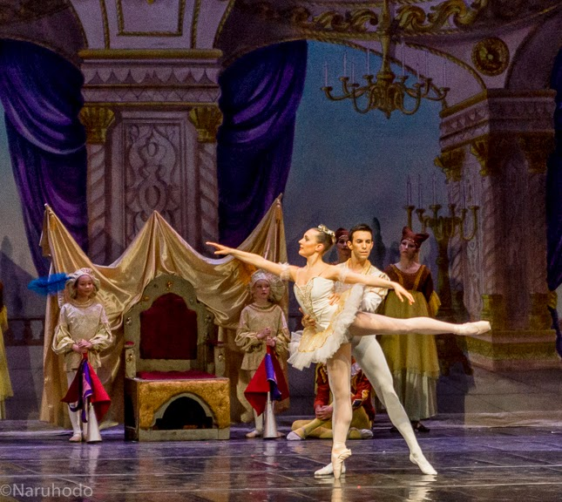
Ithaca Ballet

Slide 3

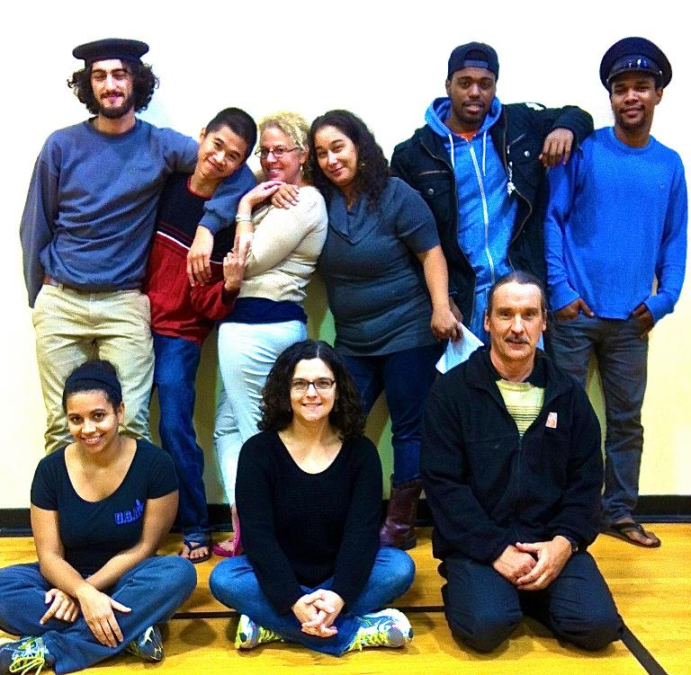
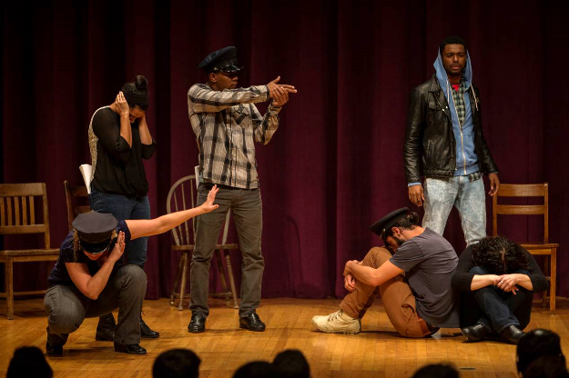
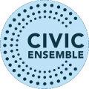
Civic Ensemble

Slide 4
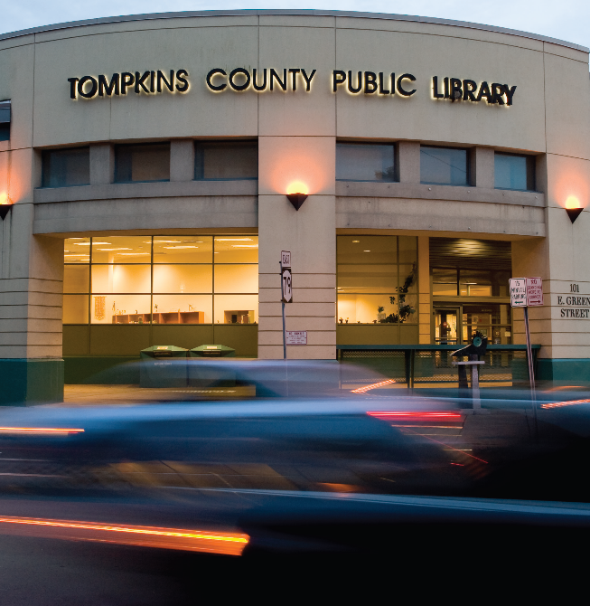
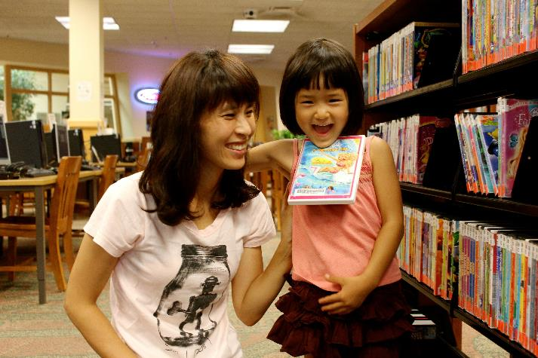
Tompkins County Public Library

Slide 5
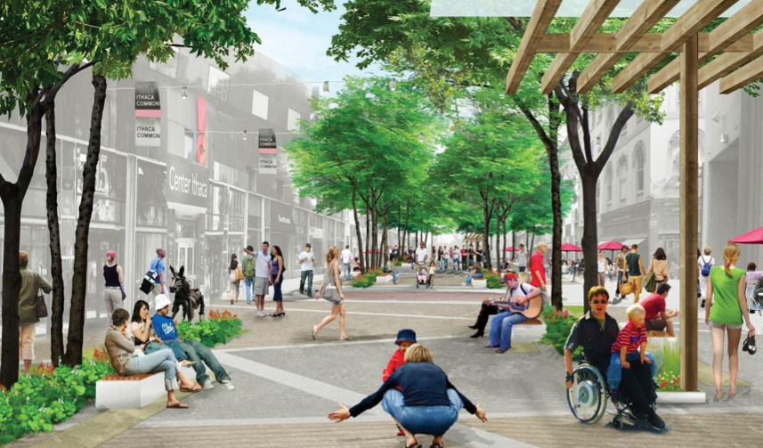
Downtown Ithaca Alliance

Slide 6

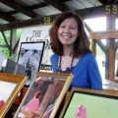

Community Arts Partnership

Slide 7
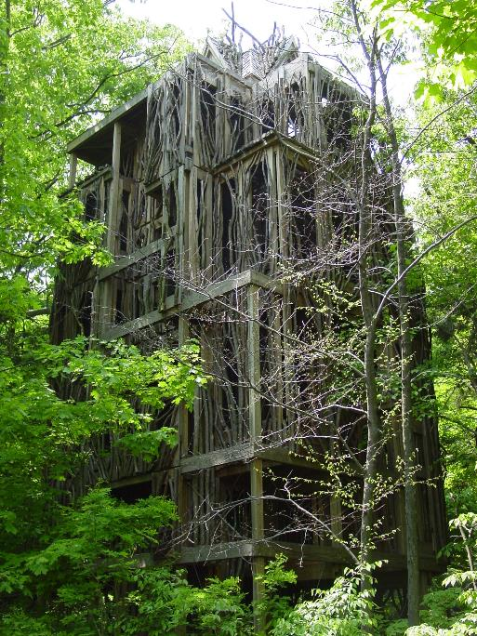
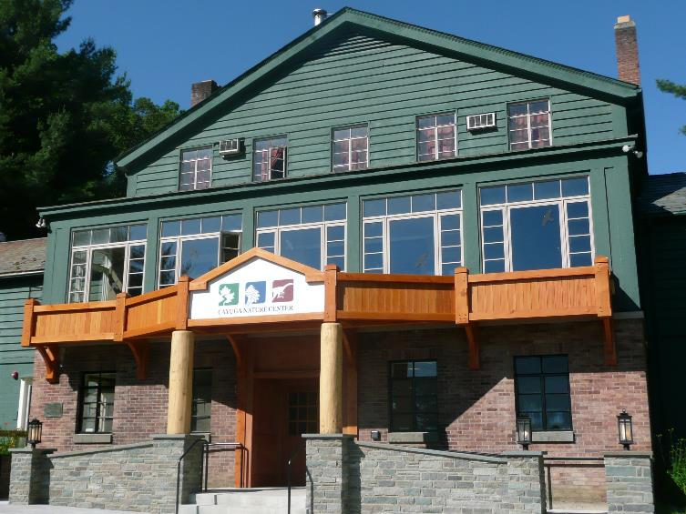
Paleontological Research Institution Cayuga Nature Center
TreeTops!

Slide 8
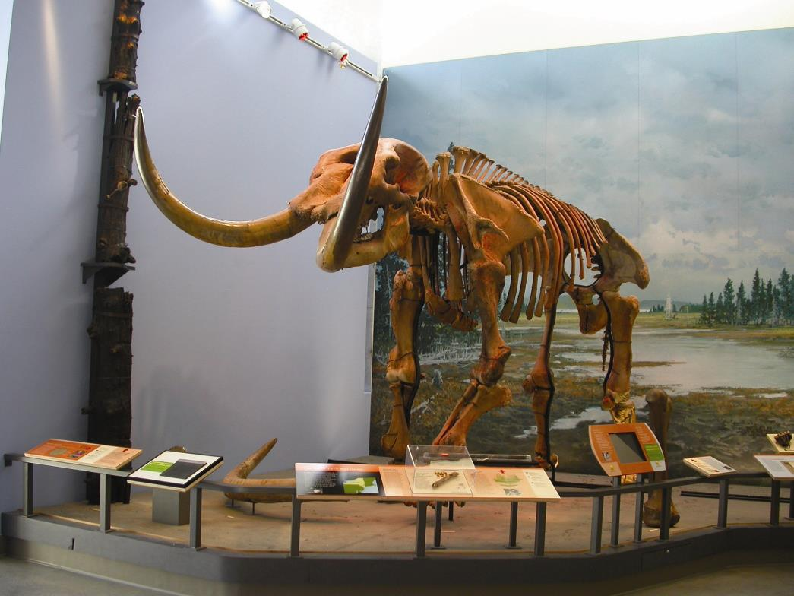
Museum of the Earth

Slide 9
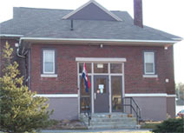
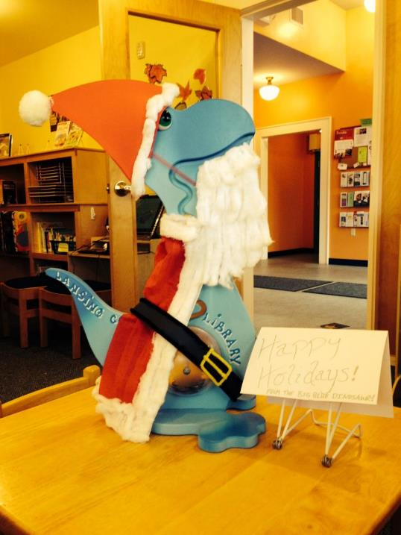

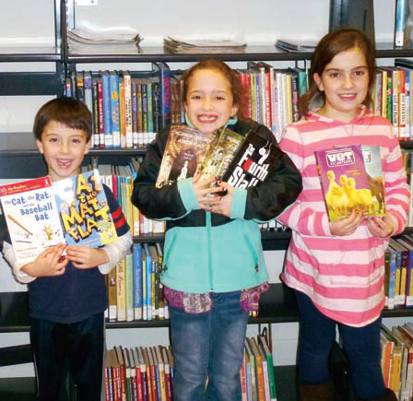
Lansing Community Library

Slide 10
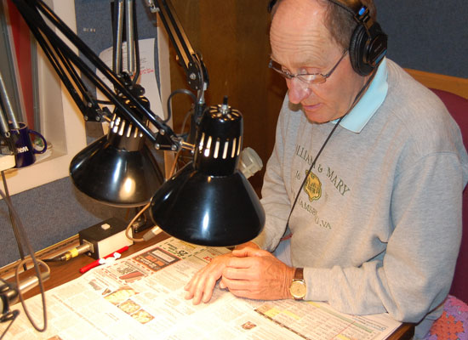

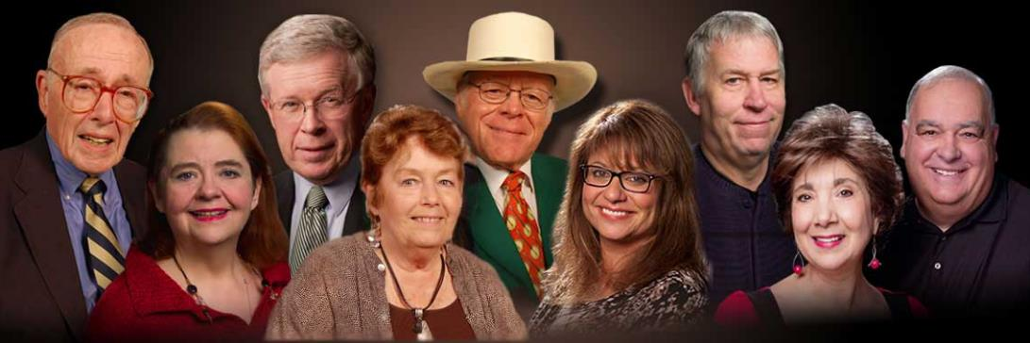

WCNY

Slide 11
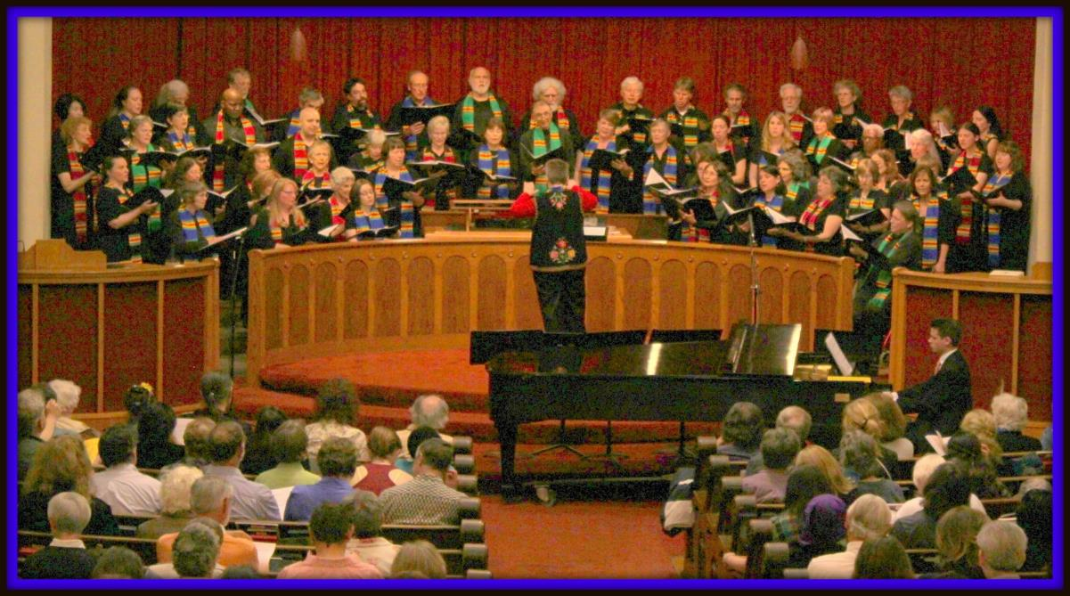
Ithaca Community Choruses
VOICES Multicultural Chorus

Slide 12
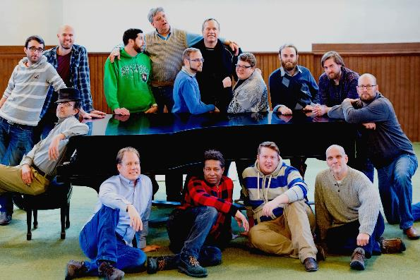
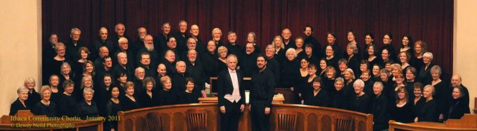
Ithaca Community Choruses
Ithaca Gay Men’s Chorus
Ithaca Community Chorus and Chamber Singers

Slide 13
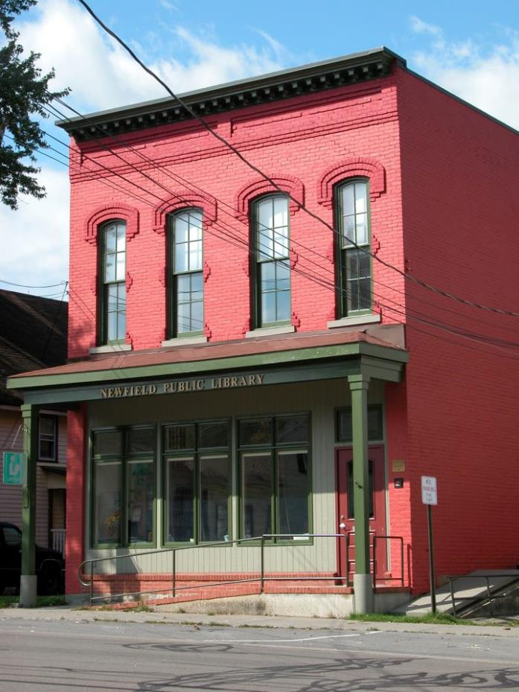
Newfield Public Library

Slide 14
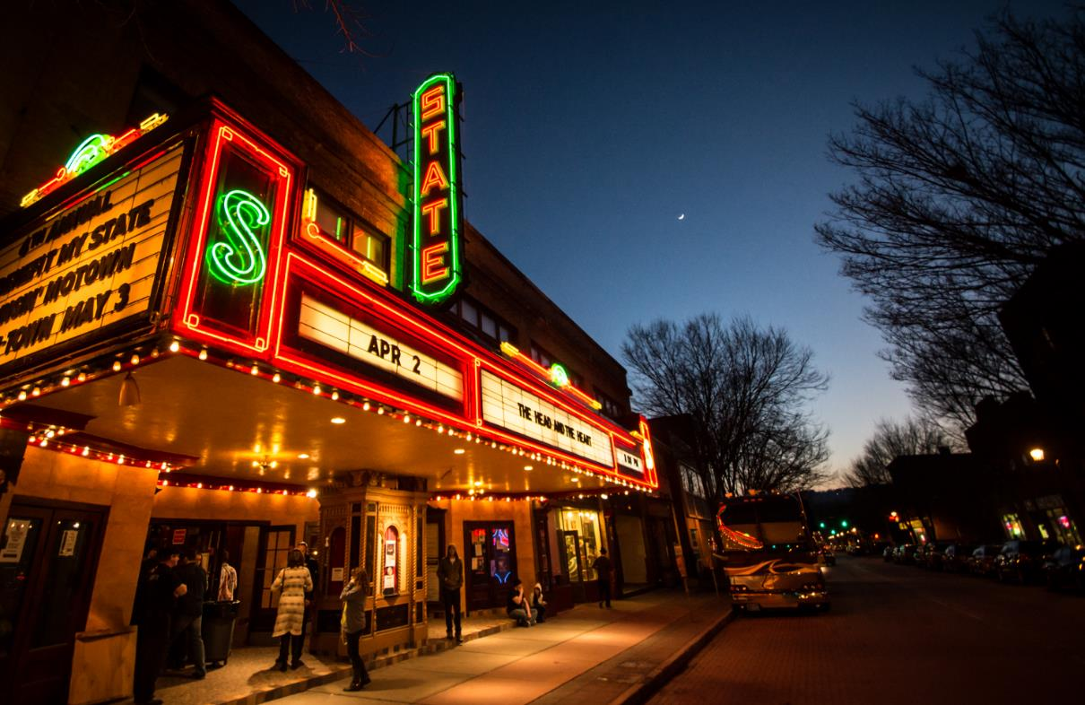
State Theatre of Ithaca

Slide 15
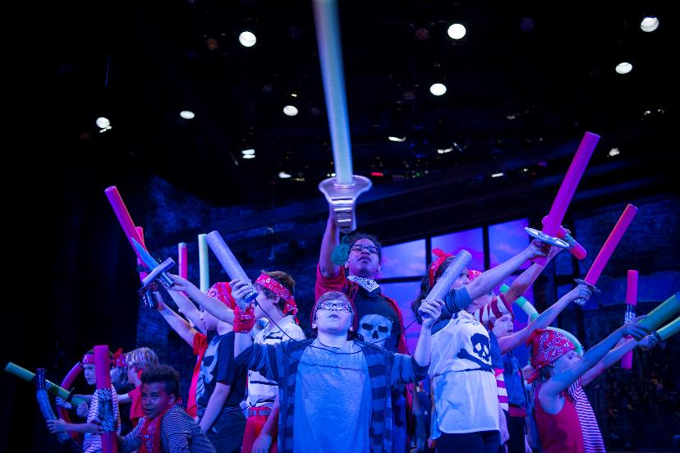
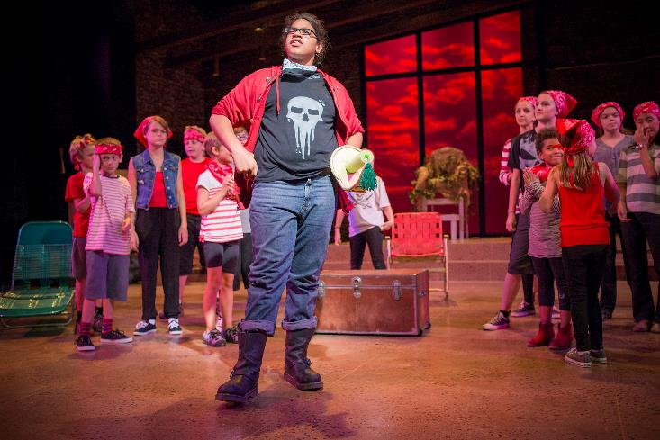
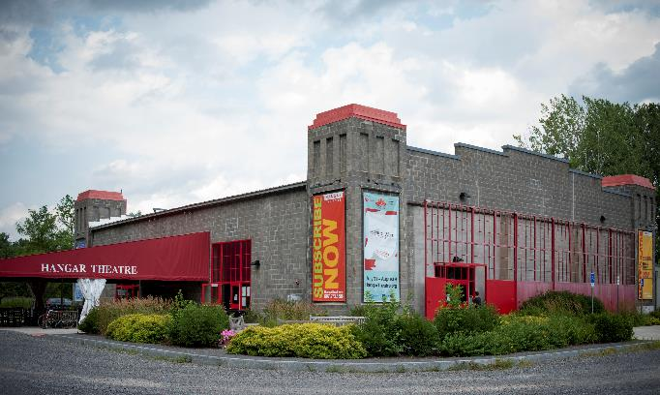
Hangar Theatre
Photos by Rachel Philipson

Slide 16
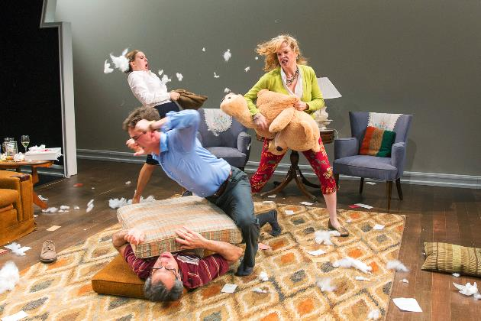

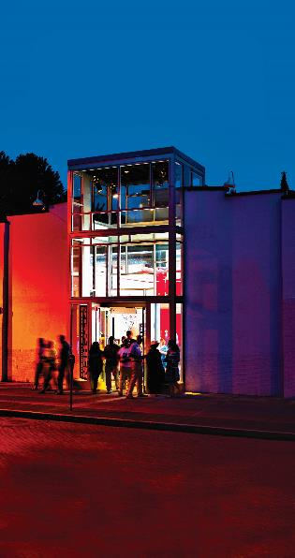


Kitchen Theatre
Photo by Dave Burbanks

Slide 17
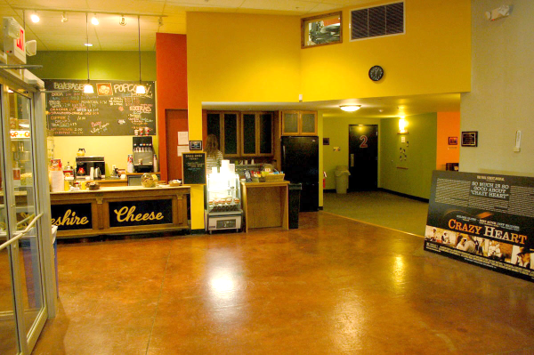
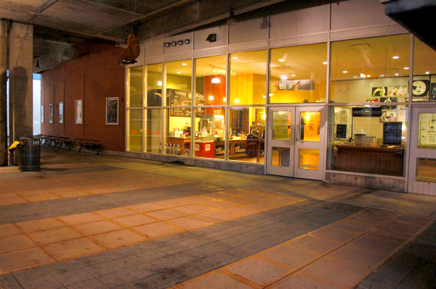
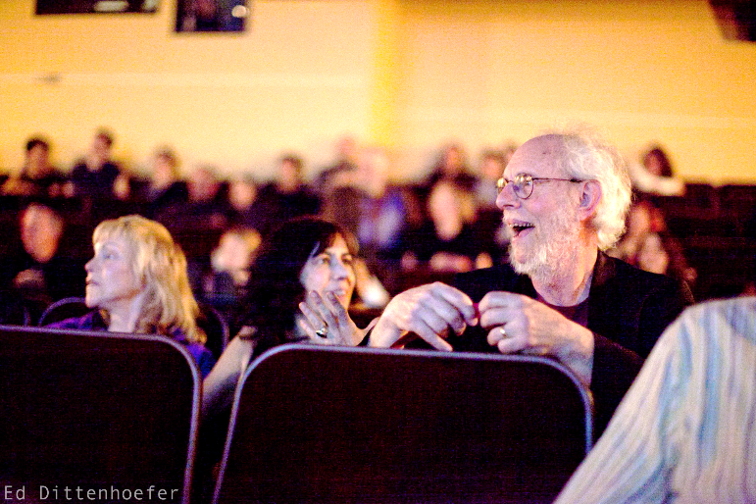
Cinemapolis

Slide 18
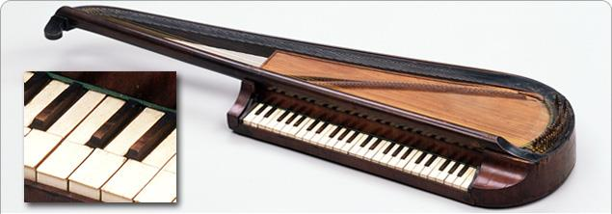
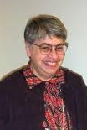
RILM – U.S. Office
RILM is supported by the Lenore Coral Fund, an endowed fund of the Community Foundation.
Répertoire International de Littérature Musicale (RILM) publishes a comprehensive bibliography of writings on music serving the global music research community. Today RILM abstracts of music literature has over 800,000 records in 171 languages from 174 countries.
Lenore Coral

Slide 19

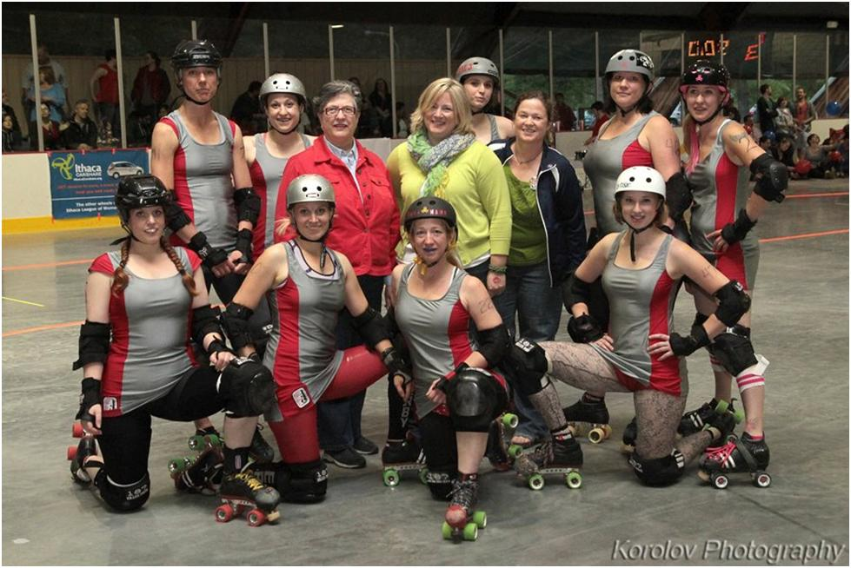
Ithaca League of Women Rollers

Slide 20
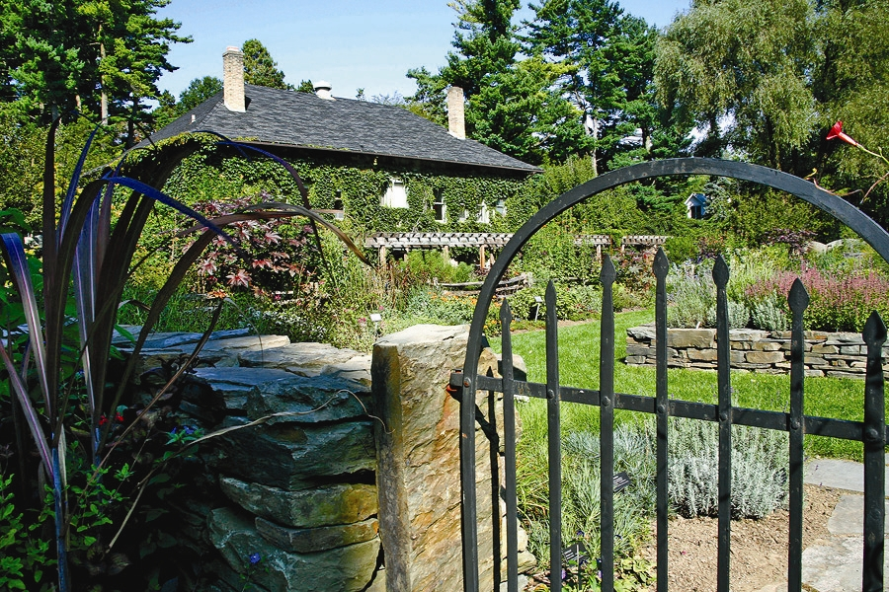
Discovery Trail
Cornell Plantations
Robison Herb Garden

Slide 21
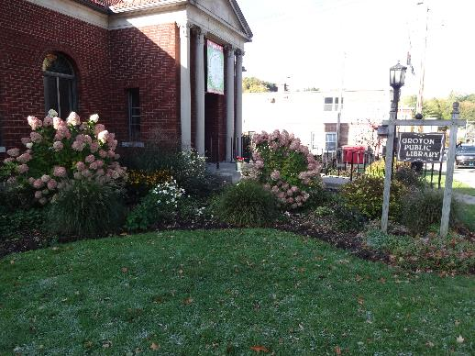
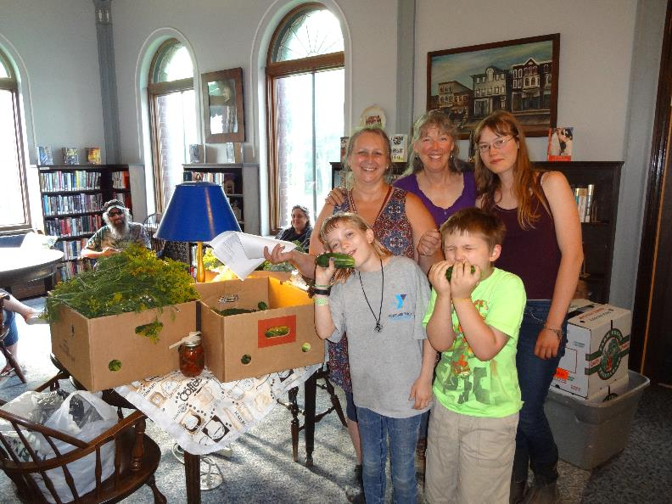
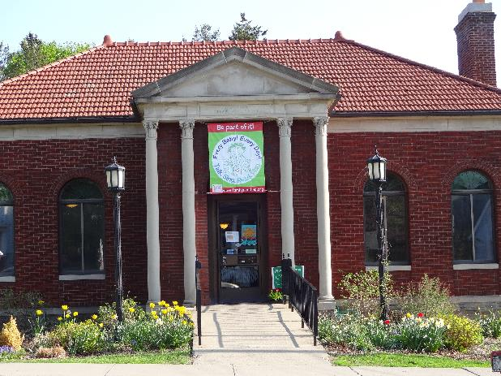
Groton Public Library

Slide 22

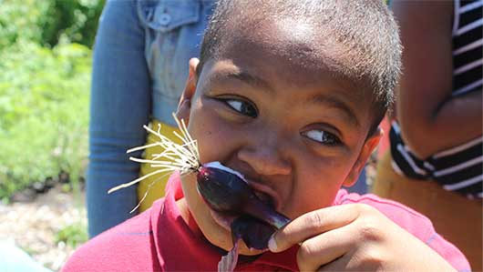
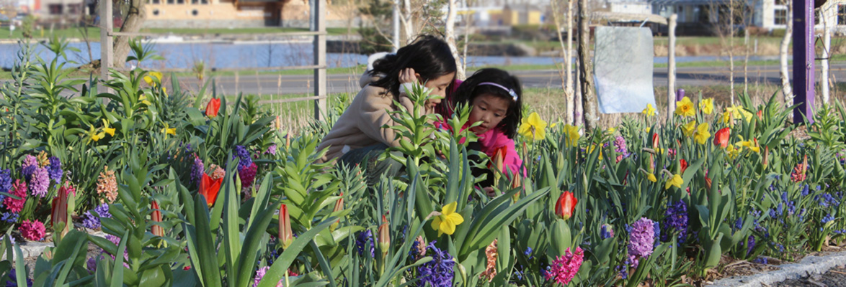
Ithaca Children’s Garden

Slide 23
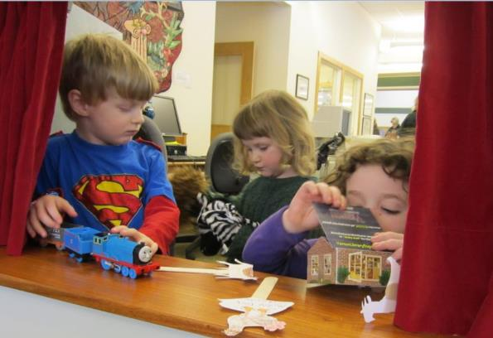
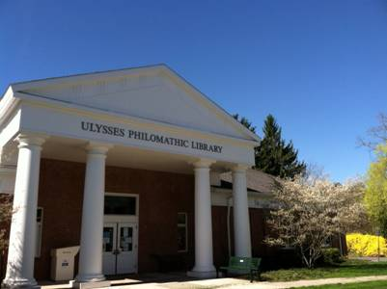
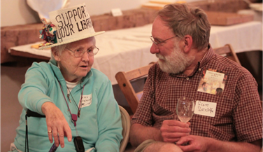
Ulysses Philomathic Library

Slide 24
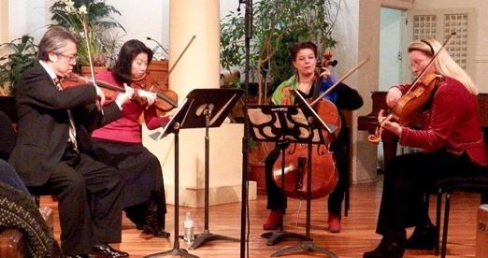
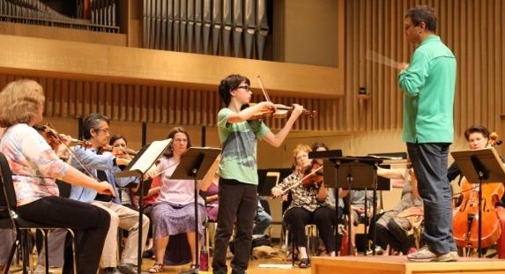
Cayuga Chamber Orchestra

Slide 25
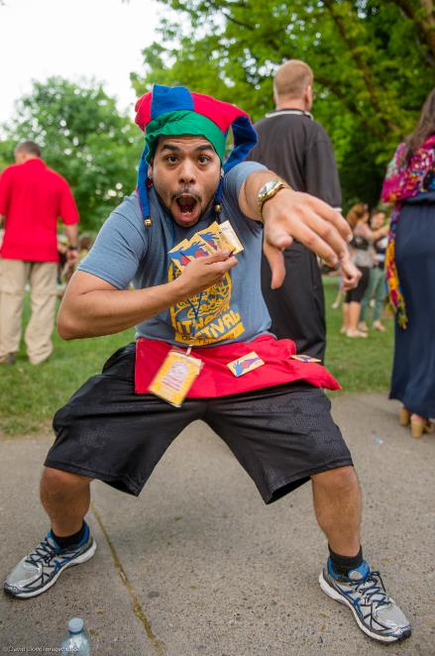
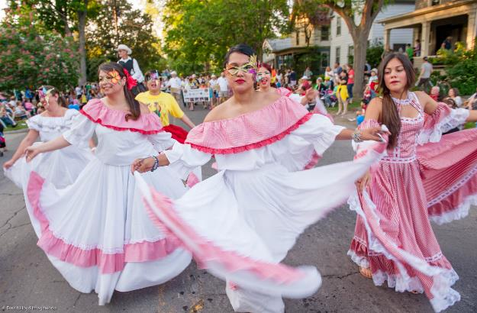
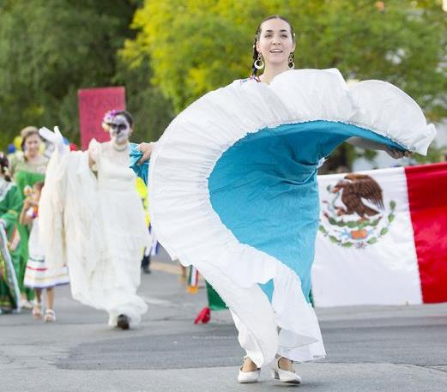

Ithaca Festival

Slide 26
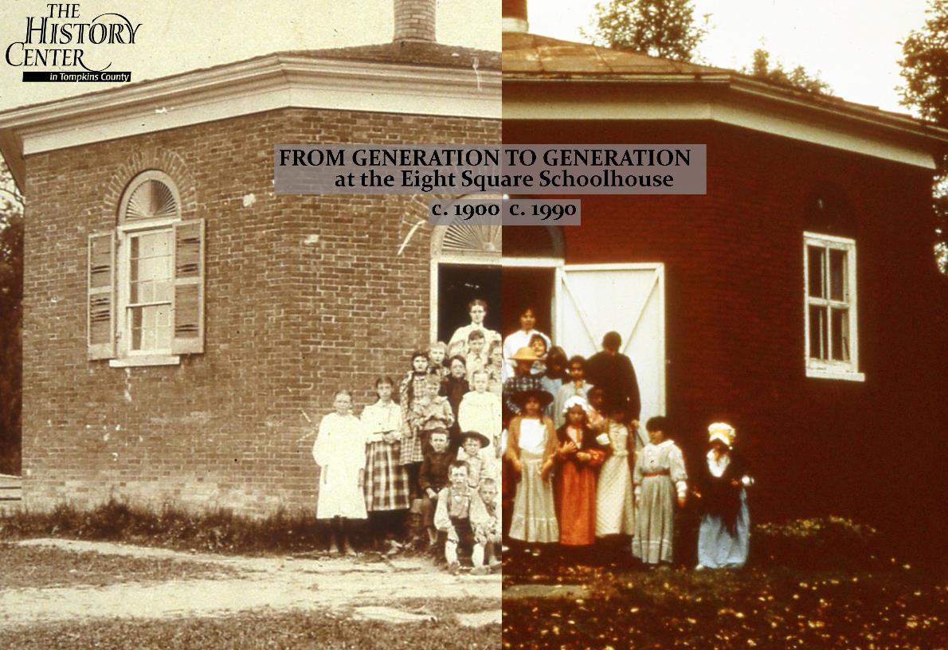
History Center
8 Square School House

Slide 27
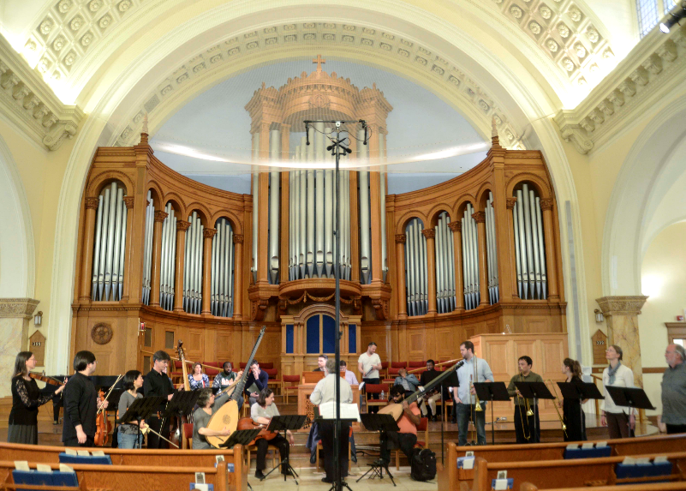
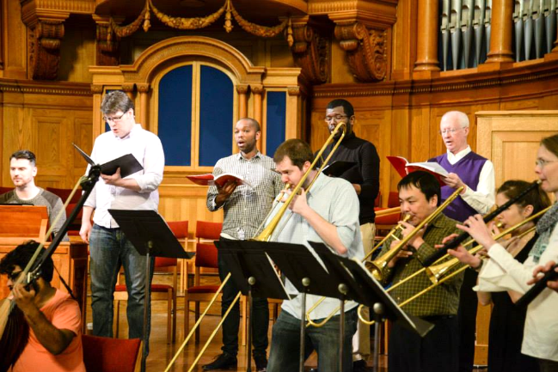

NYS Baroque

Slide 28

Community Unity Music Education Program International (CUMEP)

Slide 29

Discovery Trail
Johnson Museum of Art

Slide 31

Vitamin L

Slide 32

Sciencenter

Slide 33

Historic Ithaca

Slide 34


Slide 35

Discovery Trail –
Lab of Ornithology

Slide 36


Community School of Music and Art (CSMA)

Slide 37

Running To Places

Slide 38

Trumansburg Conservatory of Fine Arts

Slide 39

Music’s Recreation

Slide 40


WSKG
The Blind Spots

Slide 41


Ithaca Underground

Slide 42

Southworth Library Association

Slide 43
For the very latest in
Community Foundation events, grant opportunities, and donor services, visit the Community Foundation’s website at www.cftompkins.org

