Slide 1
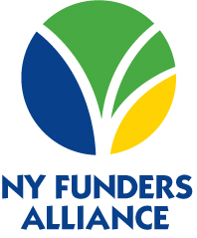
Using Your DAF to Drive Impact
April 21, 2016
Community Foundation for Tompkins County

Slide 2

Today’s Discussion
A little About Me
The Sector
Opportunities for Impact
How Can you Engage with the NY Funders Alliance
Questions & Answers

Slide 3
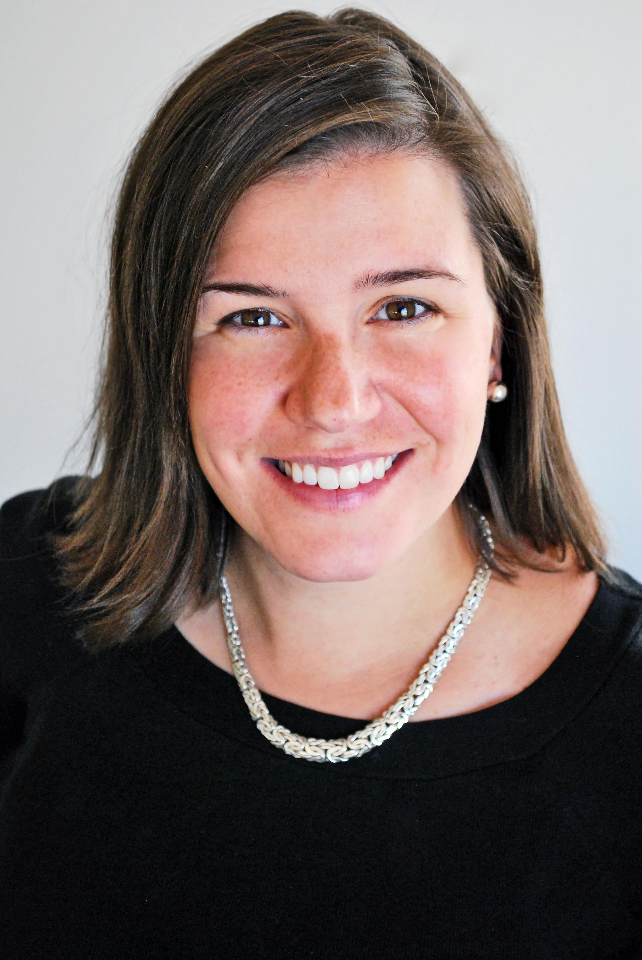
Credentials
Education
  William Smith College
  University of Colorado Denver/MSS
Professional Experience
  The Madeira School, McLean, VA
  Executive Director of Social Venture Partners Denver
  Scholarship Officer, The Denver Foundation
  Program Coordinator, Maxwell School
  Executive Director, NY Funders Alliance
Service Includes
  Hobart and William Smith (Admission/Alumni)
  YMCA Camp Cory Board of Directors
  CNY Women’s Fund Leadership Council, Development Committee
  McLoraine Scholarship for Emancipated & Foster Youth
  CNY United Way Community Investment Cabinet
  CO Common App and Final Report Committee
  Rose Community Foundation Young Jewish Study

Slide 4
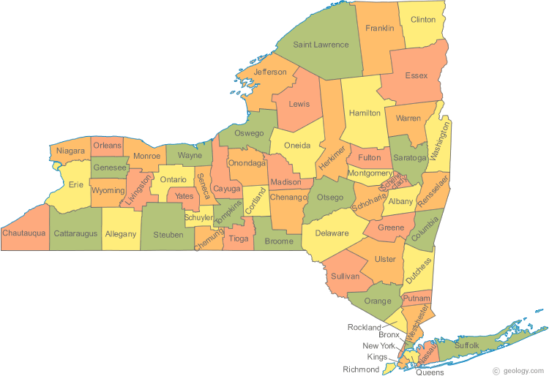
NY FUNDERS ALLIANCE
1 of 33 associations that represent nearly 6,000 grantmakers throughout the United States. It is the largest network of American philanthropy.
NYS has 2 regional associations
Organizational and professional development
Networking, convening, education, shared learning, public policy
Protecting philanthropy through a common voice

Slide 5
Philanthropy is an engaging, sustained activity aimed at permanent social change. Unlike charitable giving, which entails little more than writing a check in support of a worthy cause, strategic philanthropy involves the donor more actively. It necessitates setting long-term goals, which can be achieved through rational and thoughtful decision-making, along with diligent monitoring and assessment. This requires not only capital, but vision, expertise and a long-term horizon.

Slide 6
The Sector
National –
2014 – Total giving was about $358 billion
86,192 number of foundations, hold about $715 billion in assets
Foundation giving is only about 16% of giving – individuals, government are much higher
NYS
9,880 foundations, only 2,209 in UNY
You are part of a rich sector that fuels the community

Slide 7
3 Strategies
Impact shouldn’t just mean how your philanthropy impacts the community, it can also mean how your DAF can impact you and/or your family

Slide 8
Philanthropic Mission Statement
Writing down your PMS provides not only you, but your family and understanding of your philanthropic interests. What do you fund, when? How, and why?
Be as specific in your intent as possible.
At the end of the year review your giving – does it match your PMS? If not, consider revising. Your philanthropy might change – that is okay.
An idea – write a short paragraph at the end of the year, leave with your fund statements/or record of giving to explain your decisions throughout the year. This preserves your giving history, your legacy, and gives your family direction.
Let the Community Fndn staff help you – maybe they can facilitate a family meeting. Help you think about ways to leverage your giving.

Slide 9
Inspire
Get family involved
  Give the gift of philanthropy (birthdays, holidays). Give people a set amount to give away. They do research, and provide you with a glimpse into their thinking about the reasons for giving.
  Use this as an opportunity to talk about your values of giving.
  Consider making a gift as a family at the holidays.
An idea:
  Consider setting up a fund for your family
  Take children/family on a site visit to see how your donation is being use.
  Use the holidays/bdays to donate items to a charity of their choice, you provide a grant. Partnering with family to increase the impact.
  Encourage friends to co-fund with you (leverage giving). Share in the joy of giving together.

Slide 10
Leave a Legacy
Giving a legacy gift to the Community Fndn continues your impact beyond your lifetime. Unrestricted gifts allows the Fndn to respond to community needs. You can’t predict what will be needed in 20 years (example polio fund)
Field of Interest funds
Designated funds

Slide 11
Final Thoughts
Impact from beginning to end:
  Philanthropic Mission Statement – provides direction, intention, a way to reflect on your values
  Inspiring others to find the joy in philanthropy and to be part of your values system. No greater impact than to share your passion for the community.
  Leaving a legacy – giving a gift to the community where you lived, raised a family, worked, played, and enjoyed inspires others to give and be engaged.

Slide 12

Engage With Us
Newsletter
  Monthly
  Latest News
  Upcoming Events
Events
  May 25 – Impact Investing, Rochester, NY
  September 15 – Annual Meeting, Syracuse, NY
  October 14 – Community Philanthropy, Ithaca, NY

Slide 13
Contact Me
Lisa Fasolo Frishman
Executive Director
The NY Funders Alliance
lisa@nyfunders.org
585.232.2380
@NYFunders

