Slide 1

Notes:
(Customize this slide with information on your funds and grantmaking,
as well as your logo)
[logo appears on screen - click to bring up facts]
[Your local foundation name] has more than [ insert number] funds.
[$$ insert number] in endowed assets.
More than [insert $$ number] in annual grants.
And cumulative grants — total grants awarded since our inception — of nearly [insert $$ number].
[You may want to talk about prudent investment practices and statistics on the growth of your local foundation here. This information on grants and financial performance helps you establish credibility and trust with your audience.]
[click]

Slide 2
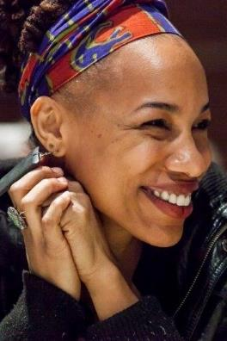
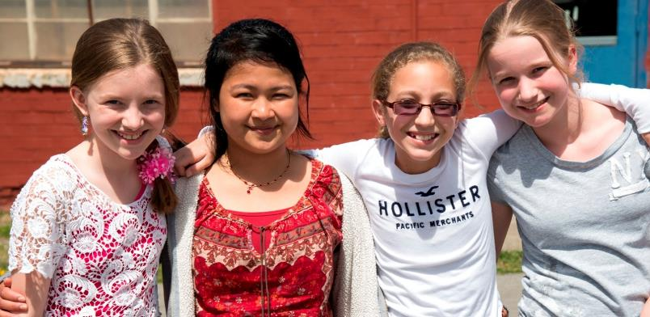

We are a tax-exempt public charity created in 2000 by and for the people of Tompkins County to serve as a growing permanent endowment and information source to support everyone’s philanthropic action as a means of improving the quality of life for the Tompkins County community.
Notes:
(Customize this slide with your community foundation identity)
Thank you for taking time to meet with me today.
We are the [your local foundation name]... your community foundation. And we are here...
“For good. For ever.” This phrase lies at the heart of what I’d like to address with you today... it’s what community foundations are all about.
My point in talking with you today is that if you choose to give, and do so effectively, you should consider your values, your reasons for giving, your goals (philanthropic and financial), and create a plan. We have with us today a person representing one of the means of strategic giving you have available to you — your local community foundation.
Your community foundation can help you realize your goals and deliver you customized personalized service as you work to achieve them. Here to speak with us today is [name of community foundation presenter], [title/role] of [your local foundation name]. I think that you will find [his/her] presentation useful as you consider how you’d like to get involved and give back.
[click]

Slide 3
Our Mission is to Improve the Quality of Life in Tompkins County by Inspiring and Supporting Enduring Philanthropy by…
Encouraging the growth of a permanent charitable endowment
Making strategic grants as community investments
Providing donors with vehicles to make giving easy and effective
Serving as a community catalyst and convener to solve problems and improve quality of life
Notes:
(Customize this slide with your community foundation identity)
Thank you for taking time to meet with me today.
We are the [your local foundation name]... your community foundation. And we are here...
“For good. For ever.” This phrase lies at the heart of what I’d like to address with you today... it’s what community foundations are all about.
My point in talking with you today is that if you choose to give, and do so effectively, you should consider your values, your reasons for giving, your goals (philanthropic and financial), and create a plan. We have with us today a person representing one of the means of strategic giving you have available to you — your local community foundation.
Your community foundation can help you realize your goals and deliver you customized personalized service as you work to achieve them. Here to speak with us today is [name of community foundation presenter], [title/role] of [your local foundation name]. I think that you will find [his/her] presentation useful as you consider how you’d like to get involved and give back.
[click]

Slide 4
94 Community Foundation Funds
Tompkins Today and Tomorrow Fund
  Unrestricted Grant making fund
Field of Interest Funds
  Arts and Culture Fund
  Children & Youth Fund
  Collective Impact Fund
  Crime and Sexual Assault Victims Fund
  Social Justice Fund
  Women’s Fund
Donor Advised Funds
  These funds have originated to fill the philanthropic goals of individuals, families, or organizations
Notes:
(Customize this slide with information on your funds and grantmaking,
as well as your logo)
[logo appears on screen - click to bring up facts]
[Your local foundation name] has more than [ insert number] funds.
[$$ insert number] in endowed assets.
More than [insert $$ number] in annual grants.
And cumulative grants — total grants awarded since our inception — of nearly [insert $$ number].
[You may want to talk about prudent investment practices and statistics on the growth of your local foundation here. This information on grants and financial performance helps you establish credibility and trust with your audience.]
[click]

Slide 5

To promote educational, economic, social and political equality for women
To enable women to achieve economic self-sufficiency
To insure that women have necessary healthcare resources
Notes:
(Customize this slide with information on your funds and grantmaking,
as well as your logo)
[logo appears on screen - click to bring up facts]
[Your local foundation name] has more than [ insert number] funds.
[$$ insert number] in endowed assets.
More than [insert $$ number] in annual grants.
And cumulative grants — total grants awarded since our inception — of nearly [insert $$ number].
[You may want to talk about prudent investment practices and statistics on the growth of your local foundation here. This information on grants and financial performance helps you establish credibility and trust with your audience.]
[click]

Slide 6
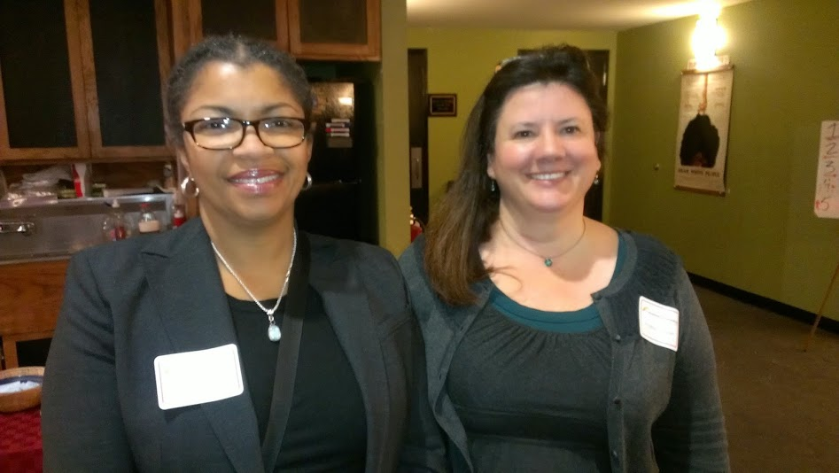
Women’s Fund Advisory Committee
Angela Sullivan (Chair)
Stephanie Bailey
Jill Burlington
Jan Hertel
Elsa Hyde
Ann Mathews
Carrie Regenstein
Nancy Schuler
Suzanne Smith Jablonski
Carol Travis
Annie Wall
Notes:
6
We are a local organization with deep roots in the community.
Our professional program staff has broad expertise regarding community issues and needs.
We provide highly personalized service, tailored to each individual’s charitable and financial interests.
Our Donor Advised Funds help people invest in the causes they care
about most.
We accept a wide variety of assets, and can facilitate even the most complex forms of giving.
[click]

Slide 7
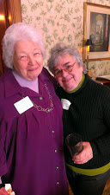
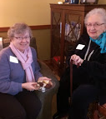
events
Building the Women’s Fund Endowment
Annual
Women's Fund Endowment Tea
An afternoon of celebration honoring Beverly Baker Society Members and Founders of the Women’s Fund
Notes:
(Customize this slide with your community foundation identity)
Thank you for taking time to meet with me today.
We are the [your local foundation name]... your community foundation. And we are here...
“For good. For ever.” This phrase lies at the heart of what I’d like to address with you today... it’s what community foundations are all about.
My point in talking with you today is that if you choose to give, and do so effectively, you should consider your values, your reasons for giving, your goals (philanthropic and financial), and create a plan. We have with us today a person representing one of the means of strategic giving you have available to you — your local community foundation.
Your community foundation can help you realize your goals and deliver you customized personalized service as you work to achieve them. Here to speak with us today is [name of community foundation presenter], [title/role] of [your local foundation name]. I think that you will find [his/her] presentation useful as you consider how you’d like to get involved and give back.
[click]

Slide 8
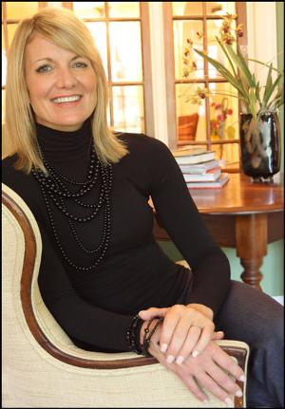
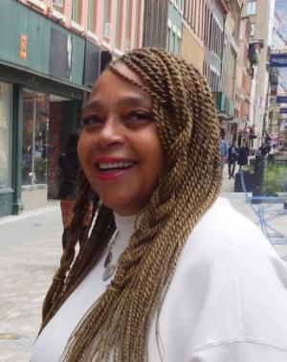
events
2016 Community Foundation's
Women's Fund Luncheon
Tuesday, March 15th, 2016 11:45-1:30 pm
Emerson Suites, Ithaca College
Tickets $25, register at www.cftompkins.org
Over $32,000 of grants will be awarded
Keynote Speaker:
Elizabeth Classen Ambrose
Proprietor, Bridges Cornell Heights
Phoebe Brown
2016 Laura Holmberg Awardee
Notes:
(Customize this slide with your community foundation identity)
Thank you for taking time to meet with me today.
We are the [your local foundation name]... your community foundation. And we are here...
“For good. For ever.” This phrase lies at the heart of what I’d like to address with you today... it’s what community foundations are all about.
My point in talking with you today is that if you choose to give, and do so effectively, you should consider your values, your reasons for giving, your goals (philanthropic and financial), and create a plan. We have with us today a person representing one of the means of strategic giving you have available to you — your local community foundation.
Your community foundation can help you realize your goals and deliver you customized personalized service as you work to achieve them. Here to speak with us today is [name of community foundation presenter], [title/role] of [your local foundation name]. I think that you will find [his/her] presentation useful as you consider how you’d like to get involved and give back.
[click]

Slide 9
2016 Women’s Fund Grant Awards
1). To promote educational, economic, social and political equality for women
$3,000 for assisting low income immigrant women when applying for work authorization and citizenship benefits to Catholic Charities
$3,250 for emerging women leaders to access community building workshops building confidence, inspiration, and leadership networks to Natural Leaders Initiative
$3,300 for teen girls to build self-esteem and job skills to GIAC
$1,500 for young women from the Lehman Alternative Community School to learn basic carpentry skills for picnic tables for the West Hill community
$1,475 for provide scholarships for women and girls to attend Sister Friends, an annual celebration of diverse women coordinated by the Multicultural Resource Center
Notes:
(Customize this slide with information on your funds and grantmaking,
as well as your logo)
[logo appears on screen - click to bring up facts]
[Your local foundation name] has more than [ insert number] funds.
[$$ insert number] in endowed assets.
More than [insert $$ number] in annual grants.
And cumulative grants — total grants awarded since our inception — of nearly [insert $$ number].
[You may want to talk about prudent investment practices and statistics on the growth of your local foundation here. This information on grants and financial performance helps you establish credibility and trust with your audience.]
[click]

Slide 10
2). To enable women to achieve economic self-sufficiency
$3,500 for women to have short term supportive residential placement to build self-sufficiency, a program of Catholic Charities
$3,500 for economically vulnerable single mothers to engage in peer support improving access to vital services, a program of Southside Community Center
$2,250 for women to address barriers to employment to Women’s Opportunity Center
$1,520 for women gaining employment with transportation barriers to the Child Development Council
Notes:
(Customize this slide with information on your funds and grantmaking,
as well as your logo)
[logo appears on screen - click to bring up facts]
[Your local foundation name] has more than [ insert number] funds.
[$$ insert number] in endowed assets.
More than [insert $$ number] in annual grants.
And cumulative grants — total grants awarded since our inception — of nearly [insert $$ number].
[You may want to talk about prudent investment practices and statistics on the growth of your local foundation here. This information on grants and financial performance helps you establish credibility and trust with your audience.]
[click]

Slide 11
3). To insure that women have necessary healthcare resources
$3,500 for low income women to partially support the expenses of lab test and clinical supplies to the Ithaca Health Alliance
$1,850 for women surviving domestic violence and sexual assault to assist with home safety and emergency communications to the Advocacy Center
$2,000 for women to be trained as diabetes prevention coaches as well as program participant scholarships to the Healthy Planning Council of the Human Services Coalition
$1,800 for low income women in cancer treatment to provide free wigs to the Cancer Resource Center
Notes:
(Customize this slide with information on your funds and grantmaking,
as well as your logo)
[logo appears on screen - click to bring up facts]
[Your local foundation name] has more than [ insert number] funds.
[$$ insert number] in endowed assets.
More than [insert $$ number] in annual grants.
And cumulative grants — total grants awarded since our inception — of nearly [insert $$ number].
[You may want to talk about prudent investment practices and statistics on the growth of your local foundation here. This information on grants and financial performance helps you establish credibility and trust with your audience.]
[click]

Slide 12
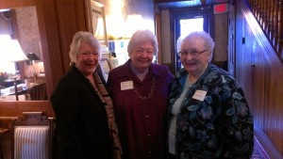
Laura Holmberg Award Recipients
2015 Joan Barber
2014 Schelley Michell-Nunn
2013 Beverly Baker
2012 Carol Kammen
2011 Mimi Melegrito
2010 Jennie Graham
2009 Rebecca Elgie
2008 Betsy Darlington
2007 Sara Pines
2006 Joan Ormondroyd
2005 Rachel Siegel
Notes:
12
We are a local organization with deep roots in the community.
Our professional program staff has broad expertise regarding community issues and needs.
We provide highly personalized service, tailored to each individual’s charitable and financial interests.
Our Donor Advised Funds help people invest in the causes they care
about most.
We accept a wide variety of assets, and can facilitate even the most complex forms of giving.
[click]

Slide 13
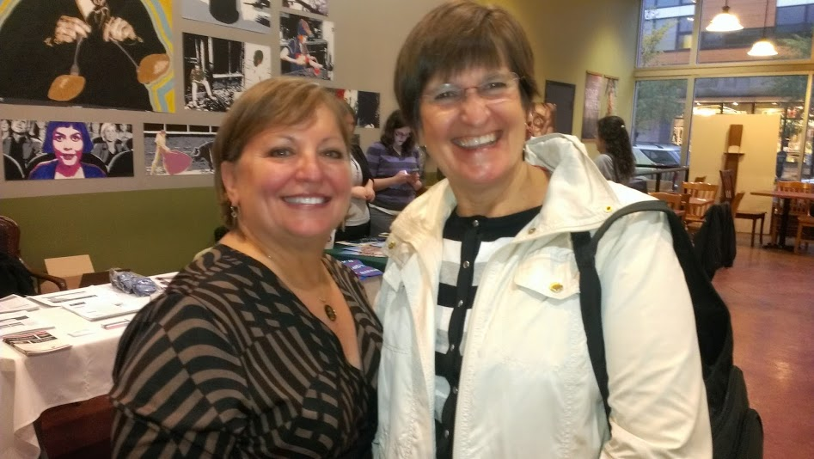
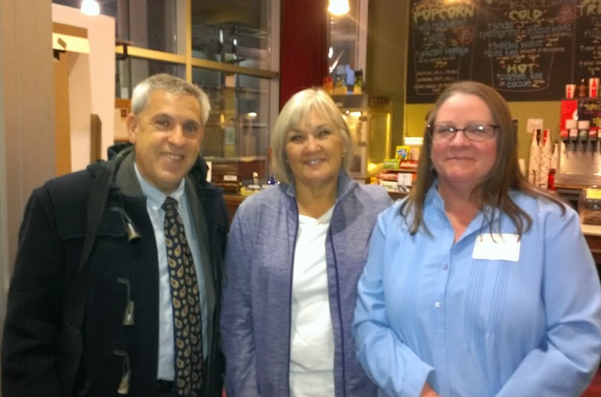
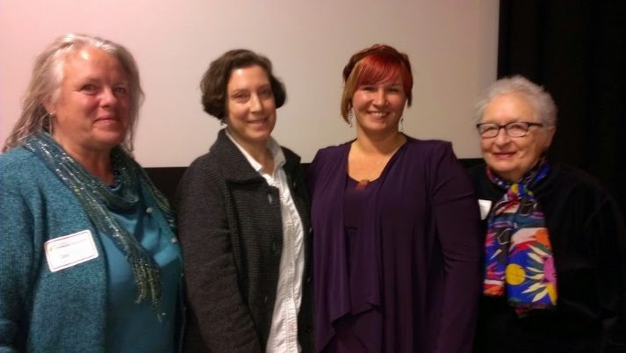
Community Supports: Serving Women Veterans
Notes:
13
We are a local organization with deep roots in the community.
Our professional program staff has broad expertise regarding community issues and needs.
We provide highly personalized service, tailored to each individual’s charitable and financial interests.
Our Donor Advised Funds help people invest in the causes they care
about most.
We accept a wide variety of assets, and can facilitate even the most complex forms of giving.
[click]

Slide 14
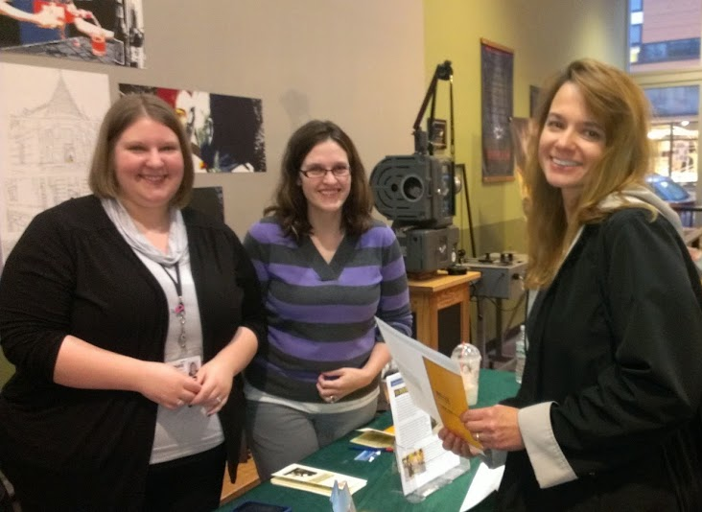
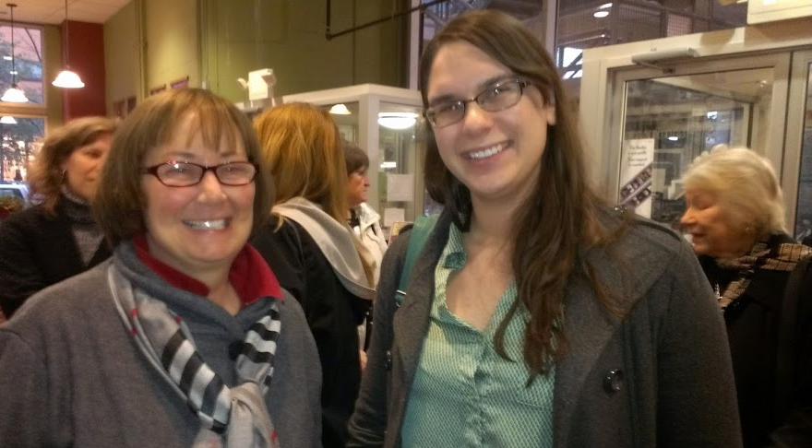
Women’s Fund Fall Gatherings
Notes:
14
We are a local organization with deep roots in the community.
Our professional program staff has broad expertise regarding community issues and needs.
We provide highly personalized service, tailored to each individual’s charitable and financial interests.
Our Donor Advised Funds help people invest in the causes they care
about most.
We accept a wide variety of assets, and can facilitate even the most complex forms of giving.
[click]

Slide 15
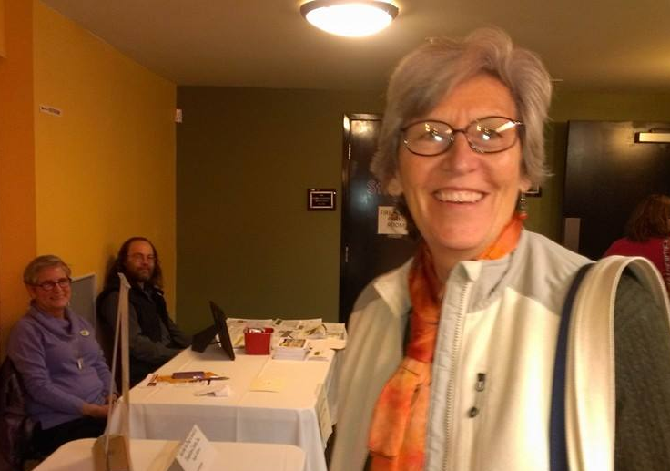
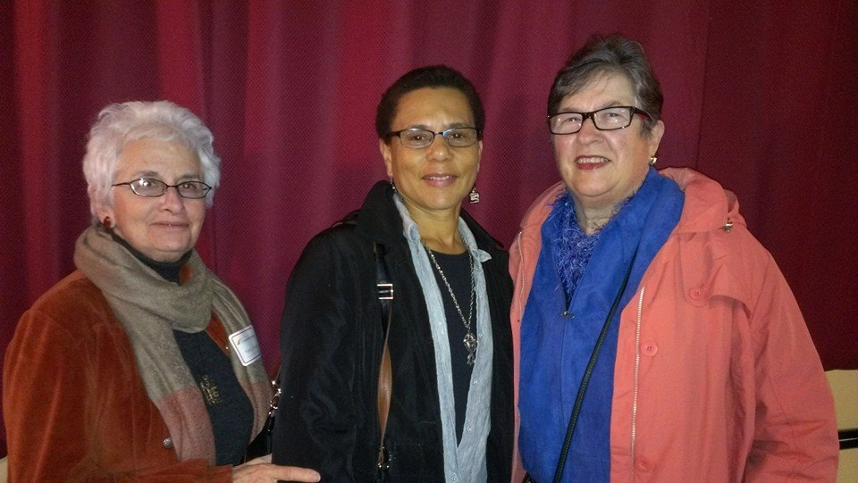
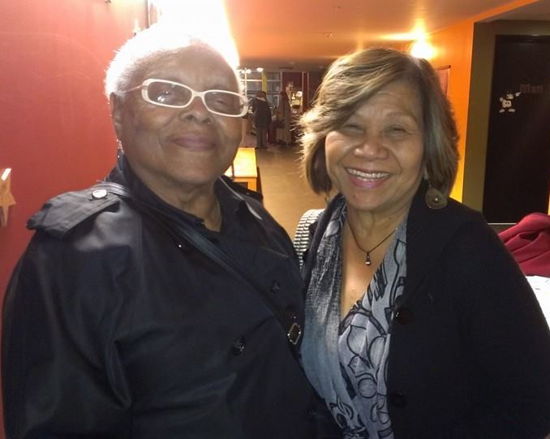
Women’s Fund Fall Gathering
Notes:
15
We are a local organization with deep roots in the community.
Our professional program staff has broad expertise regarding community issues and needs.
We provide highly personalized service, tailored to each individual’s charitable and financial interests.
Our Donor Advised Funds help people invest in the causes they care
about most.
We accept a wide variety of assets, and can facilitate even the most complex forms of giving.
[click]

Slide 16
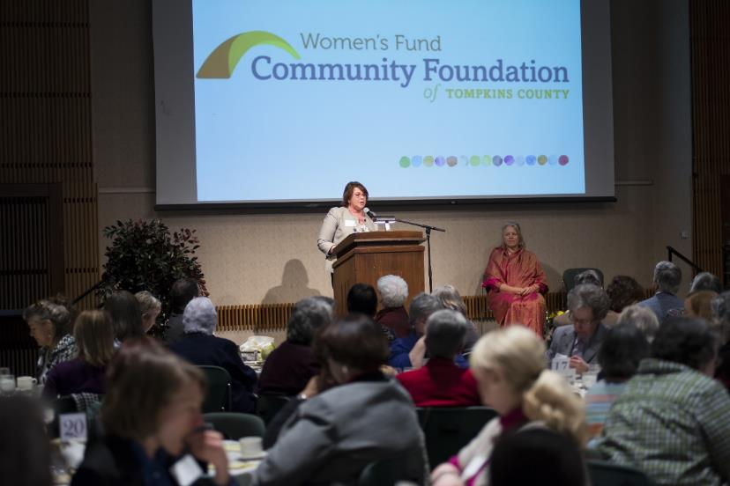
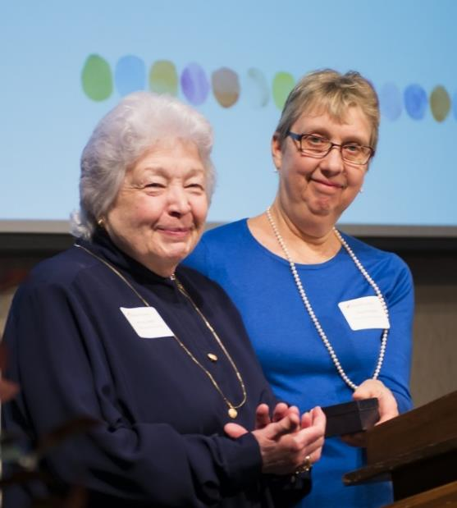
Women’s Fund Annual Luncheon
Notes:
16
We are a local organization with deep roots in the community.
Our professional program staff has broad expertise regarding community issues and needs.
We provide highly personalized service, tailored to each individual’s charitable and financial interests.
Our Donor Advised Funds help people invest in the causes they care
about most.
We accept a wide variety of assets, and can facilitate even the most complex forms of giving.
[click]

Slide 17
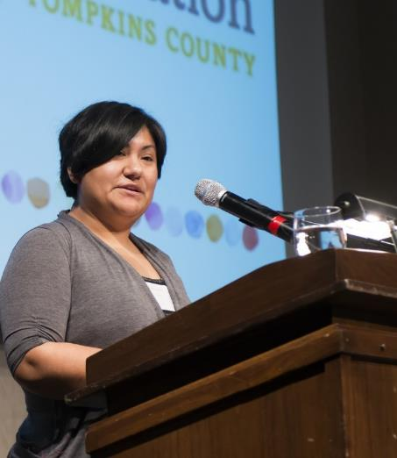
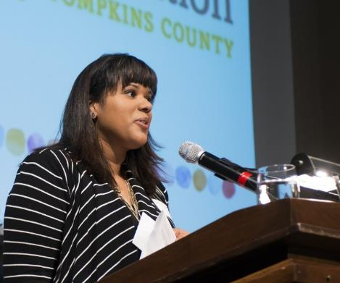
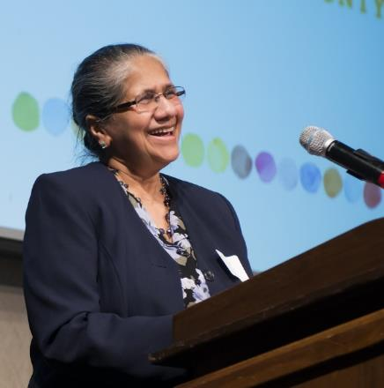
Women’s Fund Annual Luncheon
Notes:
17
We are a local organization with deep roots in the community.
Our professional program staff has broad expertise regarding community issues and needs.
We provide highly personalized service, tailored to each individual’s charitable and financial interests.
Our Donor Advised Funds help people invest in the causes they care
about most.
We accept a wide variety of assets, and can facilitate even the most complex forms of giving.
[click]

Slide 18
Please Visit Us!
200 E. Buffalo St. Suite 202
Ithaca, NY 14850
607-272-9333
www.facebook.com/cftompkins
Notes:
18
We are a local organization with deep roots in the community.
Our professional program staff has broad expertise regarding community issues and needs.
We provide highly personalized service, tailored to each individual’s charitable and financial interests.
Our Donor Advised Funds help people invest in the causes they care
about most.
We accept a wide variety of assets, and can facilitate even the most complex forms of giving.
[click]

