Slide 1
Community Foundation of Tompkins County
Investment Review
As of 12/31/2012

Slide 2
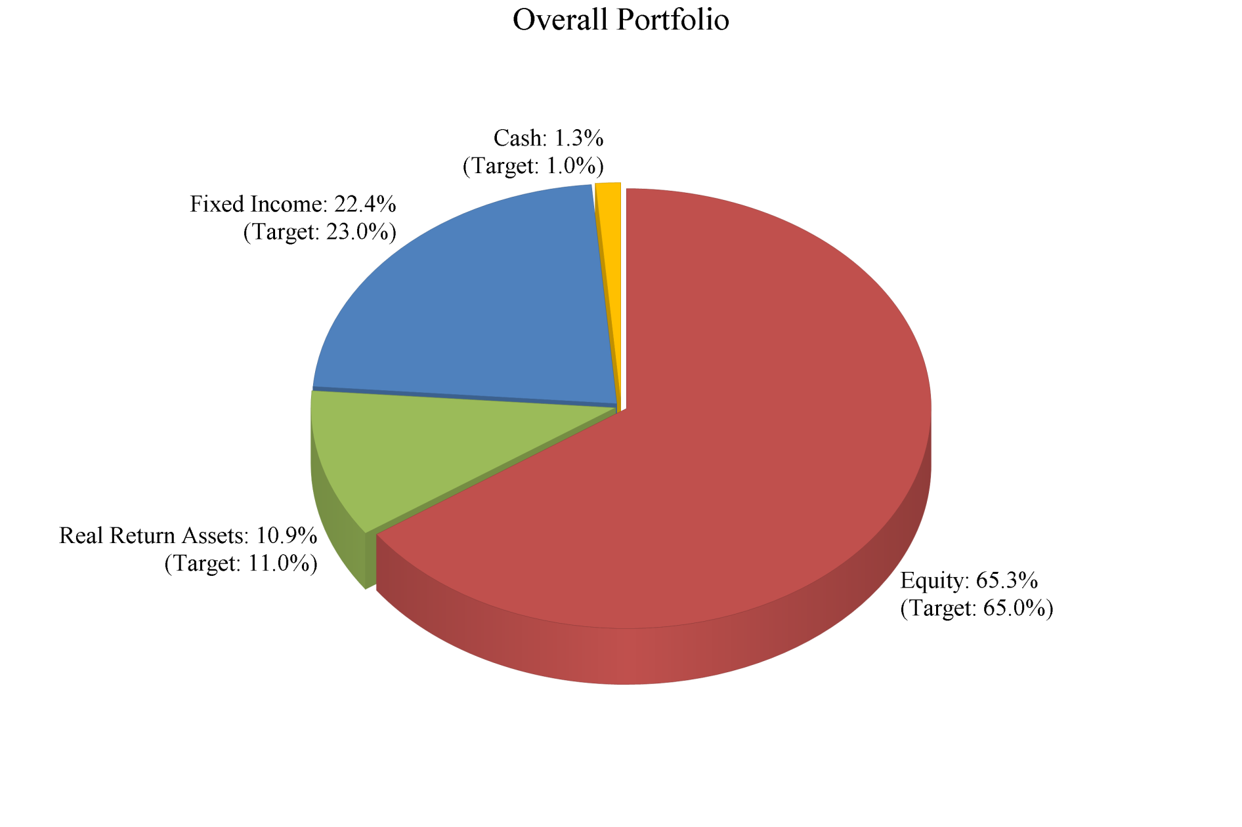
The sum of the values may not equal 100% due to rounding.

Slide 3
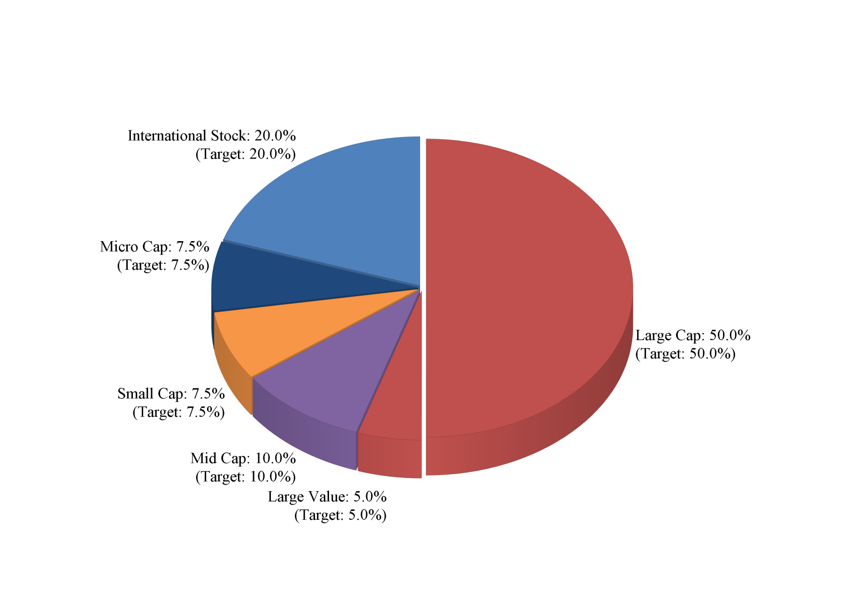
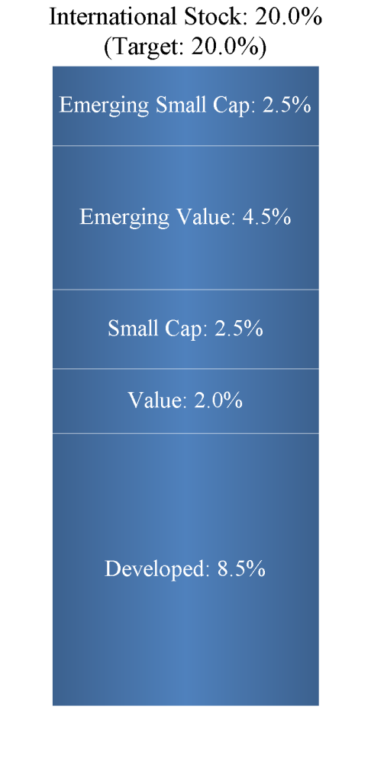
Equity Portfolio
The sum of the values may not equal 100% due to rounding.

Slide 4
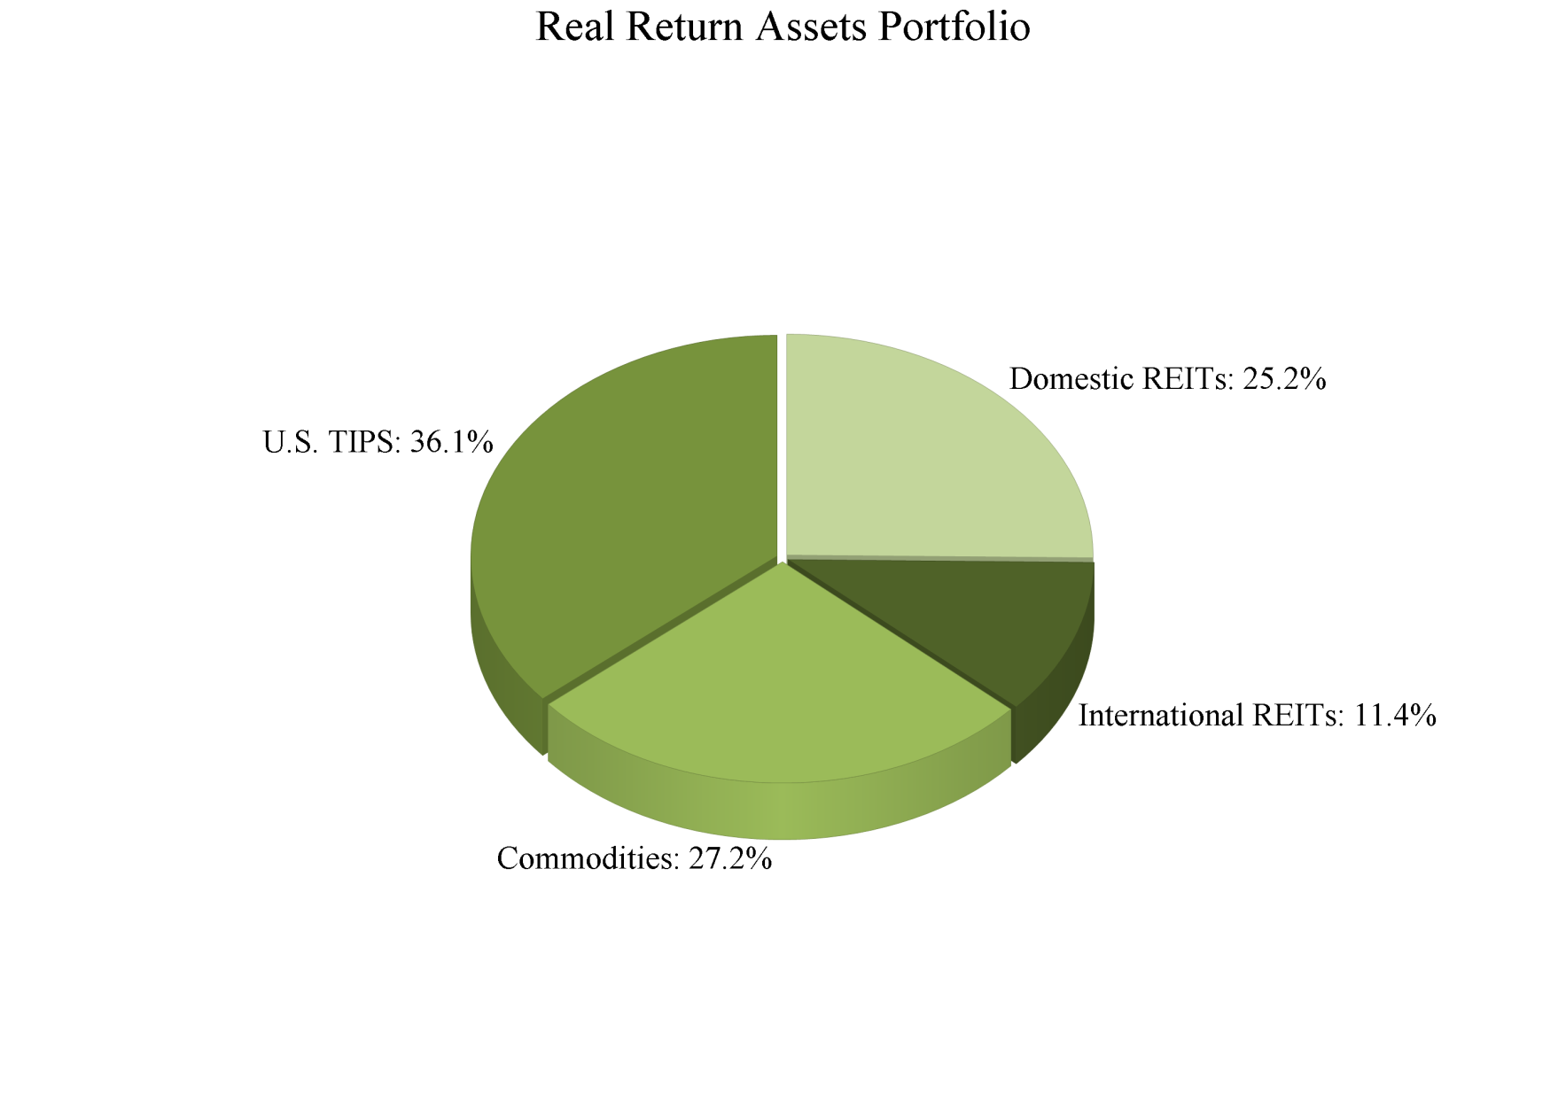
The sum of the values may not equal 100% due to rounding.

Slide 5
Portfolio Activity and Performance
Activity |  | 4Q 2012 ($) | 1 Year ($) | 3 Years ($) | 5 Years ($) | Since Inception ($)
Value at Beginning of Period |  | 6,616,796.85 | 5,953,321.91 | 3,830,466.24 | 2,707,106.54 | 2,666,367.95
 | Contributions | 2,012,662.52 | 2,184,396.45 | 4,104,309.89 | 5,759,674.56 | 5,980,856.15
 | Withdrawals | -126,455.95 | -302,725.00 | -845,302.39 | -1,198,357.59 | -1,410,901.01
 | Income Received | 82,153.59 | 178,237.15 | 470,179.61 | 623,069.20 | 702,396.63
 | Capital Gain/Loss | 25,914.59 | 597,841.09 | 1,051,418.24 | 719,578.88 | 672,351.88
Value at End of Period |  | 8,611,071.60 | 8,611,071.60 | 8,611,071.60 | 8,611,071.60 | 8,611,071.60
Total Investment Gain after Fees |  | 108,068.18 | 776,078.24 | 1,521,597.85 | 1,342,648.08 | 1,374,748.51
Performance
Portfolio |  | 1.36% | 12.73% | 9.06% | 3.33% | 3.03%
Weighted Benchmark Return¹ |  | 0.83% | 11.98% | 8.53% | 2.93% | 3.32%
Inception Date: 02/13/2007 Periods greater than 12 months are annualized
Performance is net of fees; Performance is based on time weighted returns
¹Weighted Benchmark is comprised of 55.25% Russell 3000, 9.75% MSCI ACW exUS, 11% CPI, 24% Barclays Aggregate from inception - 11/30/10 and 53.62% Russell 3000, 11.38% MSCI ACW exUS, 11% CPI, 24% Barclays Aggregate from 12/1/10 - present

Slide 6
Performance
 | 4Q 2012 | 1 Year | 3 Year Annualized | 5 Year Annualized | Since Inception Annualized
EQUITIES | 1.84% | 16.92% | 10.24% | 1.54% | 1.42%
Weighted Equity Benchmark¹ | 1.22% | 16.56% | 10.00% | 1.28% | 1.79%
S&P 500 | -0.38% | 16.00% | 10.87% | 1.66% | 1.99%
S&P 400 | 3.61% | 17.88% | 13.62% | 5.14% | 4.72%
Russell 2000 | 1.85% | 16.35% | 12.25% | 3.56% | 2.18%
MSCI EAFE | 6.57% | 17.32% | 3.56% | -3.69% | -1.80%
FIXED INCOME | 0.22% | 4.48% | 6.01% | 6.09% | 6.26%
BarCap Aggregate | 0.21% | 4.22% | 6.19% | 5.95% | 6.21%
REAL RETURN ASSETS | 1.02% | 10.18% | 11.21% | 7.44% | 5.57%
Consumer Price Index | -0.19% | 1.74% | 2.05% | 1.78% | 2.18%
TOTAL PORTFOLIO | 1.36% | 12.73% | 9.06% | 3.33% | 3.03%
Inception Date: 02/13/2007
Performance is net of fees; Performance is based on time weighted returns
¹Weighted Equity Benchmark is comprised of 85% Russell 3000, 15% MSCI ACW exUS from inception - 11/30/10 and 82.5% Russell 3000, 17.5% MSCI ACW exUS from 12/1/10 - present

Slide 8
Community Foundation of Tompkins County
Portfolio Holdings
Security |  | Symbol | Quantity | Unit Cost ($) | Total Cost ($) | Price ($) | Value ($) | Percent of Portfolio
 | CASH AND EQUIVALENTS
CASH |  | cash |  |  | 58,947.98 |  | 58,947.98 | 0.68%
SCHWAB ADVISOR CASH RESERVES-PREMIER |  | SWZXX |  |  | 55,566.30 |  | 55,566.30 | 0.65%
Subtotal |  |  |  |  | 114,514.28 |  | 114,514.28 | 1.33%
TOTAL |  |  |  |  | 114,514.28 |  | 114,514.28 | 1.33%
 | EQUITIES
S&P 500 SPDR |  | SPY | 17,225.000 | 118.31 | 2,037,902.52 | 142.41 | 2,453,012.25 | 28.49%
ISHARES CORE S&P 400 MIDCAP INDEX |  | IJH | 5,525.000 | 75.23 | 415,658.84 | 101.70 | 561,892.50 | 6.53%
ISHARES MSCI EAFE INDEX FUND |  | EFA | 8,425.000 | 56.35 | 474,748.66 | 56.86 | 479,045.50 | 5.56%
ISHARES CORE S&P 600 SMALLCAP INDEX |  | IJR | 5,425.000 | 62.05 | 336,595.67 | 78.10 | 423,692.50 | 4.92%
DFA US MICRO-CAP FUND |  | DFSCX | 22,636.525 | 11.58 | 262,230.85 | 14.60 | 330,493.27 | 3.84%
DFA US LARGE-CAP VALUE FUND |  | DFLVX | 12,284.068 | 18.95 | 232,733.51 | 22.90 | 281,305.16 | 3.27%
SPDR DOW JONES INDUSTRIAL AVERAGE ETF TRST |  | DIA | 2,150.000 | 114.03 | 245,153.85 | 130.58 | 280,747.00 | 3.26%
DFA EMERGING MARKETS VALUE FUND |  | DFEVX | 8,455.254 | 28.47 | 240,749.33 | 29.84 | 252,304.78 | 2.93%

Slide 9
Community Foundation of Tompkins County
Portfolio Holdings: Continued...
Security |  | Symbol | Quantity | Unit Cost ($) | Total Cost ($) | Price ($) | Value ($) | Percent of Portfolio
DFA EMERGING MARKETS SMALL-CAP FUND |  | DEMSX | 6,615.995 | 22.40 | 148,182.17 | 21.17 | 140,060.61 | 1.63%
DFA INTERNATIONAL SMALL-CAP FUND |  | DFISX | 8,781.055 | 15.98 | 140,338.19 | 15.93 | 139,882.21 | 1.62%
DFA INTERNATIONAL VALUE PORTFOLIO |  | DFIVX | 6,779.448 | 17.56 | 119,050.93 | 16.60 | 112,538.84 | 1.31%
BRIDGEWAY ULTRA-SMALL COMPANY MARKET FUND |  | BRSIX | 7,357.600 | 12.50 | 92,000.00 | 12.50 | 91,970.00 | 1.07%
SPDR S&P BANKS ETF |  | KBE | 3,150.000 | 25.77 | 81,168.40 | 23.83 | 75,064.50 | 0.87%
APPLE INC. |  | AAPL | 3.000 | 532.17 | 1,596.52 | 532.17 | 1,596.52 | 0.02%
Subtotal |  |  |  |  | 4,828,109.44 |  | 5,623,605.63 | 65.31%
TOTAL |  |  |  |  | 4,828,109.44 |  | 5,623,605.63 | 65.31%

Slide 10
Community Foundation of Tompkins County
Portfolio Holdings: Continued...
Security |  | Symbol | Quantity | Unit Cost ($) | Total Cost ($) | Price ($) | Value ($) | Percent of Portfolio
 | FIXED INCOME
VANGUARD TOTAL BOND MARKET INDEX FUND -SIG |  | VBTSX | 141,196.219 | 10.45 | 1,475,171.83 | 11.09 | 1,565,866.10 | 18.18%
RIDGEWORTH SEIX FLOATING RATE I |  | SAMBX | 32,843.535 | 9.00 | 295,490.50 | 8.98 | 294,934.94 | 3.43%
VANGUARD GNMA FUND-ADMIRAL |  | VFIJX | 6,508.527 | 10.88 | 70,829.52 | 10.91 | 71,008.03 | 0.82%
Subtotal |  |  |  |  | 1,841,491.85 |  | 1,931,809.07 | 22.43%
TOTAL |  |  |  |  | 1,841,491.85 |  | 1,931,809.07 | 22.43%
 | REAL RETURN ASSETS
VANGUARD INFLATION PROTECTED SECURITIES FD |  | VAIPX | 11,919.640 | 25.26 | 301,112.39 | 28.54 | 340,186.52 | 3.95%
PIMCO COMMODITIESPLUS STRATEGY FUND - INST |  | PCLIX | 23,448.637 | 11.25 | 263,681.27 | 10.93 | 256,293.60 | 2.98%
SPDR DOW JONES REIT ETF |  | RWR | 3,250.000 | 52.98 | 172,193.93 | 72.97 | 237,152.50 | 2.75%

Slide 11
Community Foundation of Tompkins County
Portfolio Holdings: Continued...
Security |  | Symbol | Quantity | Unit Cost ($) | Total Cost ($) | Price ($) | Value ($) | Percent of Portfolio
SPDR DJ WILSHIRE INTERNATIONAL REAL ESTATE |  | RWX | 2,600.000 | 40.22 | 104,567.55 | 41.35 | 107,510.00 | 1.25%
Subtotal |  |  |  |  | 841,555.15 |  | 941,142.63 | 10.93%
TOTAL |  |  |  |  | 841,555.15 |  | 941,142.63 | 10.93%
GRAND TOTAL |  |  |  |  | 7,625,670.72 |  | 8,611,071.60 | 100.00%

Slide 12
The sum of the values may not equal 100% due to rounding.

Slide 13
The sum of the values may not equal 100% due to rounding.

Slide 14
The sum of the values may not equal 100% due to rounding.

Slide 15
Portfolio Activity and Performance
Activity |  | 4Q 2012 ($) | 1 Year ($) | 3 Years ($) | 5 Years ($) | Since Inception ($)
Value at Beginning of Period |  | 1,394,618.80 | 1,316,170.56 | 1,259,437.66 | 977,651.68 | 730,662.31
 | Contributions | 0.00 | 7,370.75 | 75,096.96 | 455,808.86 | 765,270.98
 | Withdrawals | -30,824.27 | -97,427.49 | -249,475.44 | -362,108.53 | -436,099.61
 | Income Received | 21,811.94 | 35,207.71 | 87,920.42 | 139,761.18 | 178,649.36
 | Capital Gain/Loss | 9,475.77 | 133,760.70 | 222,102.63 | 183,969.04 | 156,599.19
Value at End of Period |  | 1,395,082.23 | 1,395,082.23 | 1,395,082.23 | 1,395,082.23 | 1,395,082.23
Total Investment Gain after Fees |  | 31,287.71 | 168,968.41 | 310,023.05 | 323,730.22 | 335,248.55
Performance
Portfolio |  | 2.26% | 13.17% | 7.97% | 2.78% | 2.62%
Inception Date: 01/31/2007 Periods greater than 12 months are annualized
Performance is net of fees; Performance is based on time weighted returns

Slide 16
Performance
 | 4Q 2012 | 1 Year | 3 Year Annualized | 5 Year Annualized | Since Inception¹ Annualized
EQUITIES | 3.40% | 18.06% | 9.18% | 1.49% | 0.99%
Broad Market Social Index² | 2.13% | 13.94% | 8.87% | 1.56% | 1.18%
S&P 500 | -0.38% | 16.00% | 10.87% | 1.66% | 1.53%
S&P 400 | 3.61% | 17.88% | 13.62% | 5.14% | 4.33%
Russell 2000 | 1.85% | 16.35% | 12.25% | 3.56% | 2.17%
MSCI EAFE³ | 6.57% | 17.32% | NA | NA | NA
FIXED INCOME | -0.12% | 3.96% | 5.91% | 4.56% | 4.97%
BarCap Aggregate | 0.21% | 4.22% | 6.19% | 5.95% | 6.21%
REAL RETURN ASSETS | 0.52% | 9.15% | NA | NA | NA
Consumer Price Index | -0.19% | 1.74% | NA | NA | NA
TOTAL PORTFOLIO | 2.26% | 13.17% | 7.97% | 2.78% | 2.62%
Performance is net of fees; Performance is based on time weighted returns
¹Inception Dates: 05/01/2007 for Equities, 01/31/2007 for Fixed Income, 08/01/2011 for Real Return Assets
²Broad Market Social Index is comprised of KLD All-Cap Sustainability index (discontinued) from inception through 6/30/10, MSCI USA Broad ESG Index from 7/1/10 - 7/31/11, and 77% MSCI USA Broad ESG Index/23% MSCI World ex USA ESG Index from 8/1/11 - present
³International position incepted on 8/1/11

Slide 17
Community Foundation of Tompkins County SRI Account
Portfolio Holdings
Security |  | Symbol | Quantity | Unit Cost ($) | Total Cost ($) | Price ($) | Value ($) | Percent of Portfolio
 | CASH AND EQUIVALENTS
CASH |  | cash |  |  | 12,232.49 |  | 12,232.49 | 0.88%
Subtotal |  |  |  |  | 12,232.49 |  | 12,232.49 | 0.88%
TOTAL |  |  |  |  | 12,232.49 |  | 12,232.49 | 0.88%
 | EQUITIES
DFA U.S. SOCIAL CORE EQUITY 2 PORTFOLIO |  | DFUEX | 41,805.664 | 8.70 | 363,577.56 | 9.47 | 395,899.66 | 28.38%
VANGUARD FTSE SOCIAL INDX-IV |  | VFTSX | 40,651.012 | 7.72 | 313,997.48 | 8.59 | 349,192.19 | 25.03%
DFA INTL SUSTAINABILITY CORE |  | DFSPX | 13,518.736 | 8.57 | 115,916.02 | 8.35 | 112,881.45 | 8.09%
DFA EMERGING MARKETS SOCIAL CORE EQUITY |  | DFESX | 4,934.412 | 14.25 | 70,313.10 | 13.15 | 64,887.52 | 4.65%
Subtotal |  |  |  |  | 863,804.17 |  | 922,860.81 | 66.15%
TOTAL |  |  |  |  | 863,804.17 |  | 922,860.81 | 66.15%

Slide 18
Community Foundation of Tompkins County SRI Account
Portfolio Holdings: Continued...
Security |  | Symbol | Quantity | Unit Cost ($) | Total Cost ($) | Price ($) | Value ($) | Percent of Portfolio
 | FIXED INCOME
VANGUARD GNMA FUND-ADMIRAL |  | VFIJX | 9,478.773 | 11.08 | 105,025.63 | 10.91 | 103,413.41 | 7.41%
ISHARES BARCLAYS 7-10 YEAR TREASURY BOND |  | IEF | 725.000 | 98.89 | 71,695.63 | 107.49 | 77,930.25 | 5.59%
PIMCO TOTAL RETURN FUND III INSTL |  | PTSAX | 6,910.105 | 9.74 | 67,309.41 | 9.89 | 68,340.94 | 4.90%
ISHARES BARCLAYS AGENCY BOND FUND |  | AGZ | 275.000 | 111.26 | 30,597.65 | 113.30 | 31,156.13 | 2.23%
ISHARES BARCLAYS 3-7 YEAR TREASURY BOND |  | IEI | 210.000 | 119.46 | 25,087.15 | 123.22 | 25,876.20 | 1.85%
Subtotal |  |  |  |  | 299,715.47 |  | 306,716.93 | 21.99%
TOTAL |  |  |  |  | 299,715.47 |  | 306,716.93 | 21.99%
 | REAL RETURN ASSETS
VANGUARD INFLATION PROTECTED SECURITIES FD |  | VAIPX | 2,045.725 | 27.53 | 56,315.34 | 28.54 | 58,385.00 | 4.19%
POWERSHARES DB COMMODITY INDEX TRACKING FD |  | DBC | 1,450.000 | 29.18 | 42,305.31 | 27.78 | 40,281.00 | 2.89%
SPDR DOW JONES REIT ETF |  | RWR | 550.000 | 66.02 | 36,312.04 | 72.97 | 40,133.50 | 2.88%

Slide 19
Community Foundation of Tompkins County SRI Account
Portfolio Holdings: Continued...
Security |  | Symbol | Quantity | Unit Cost ($) | Total Cost ($) | Price ($) | Value ($) | Percent of Portfolio
SPDR DJ WILSHIRE INTERNATIONAL REAL ESTATE |  | RWX | 350.000 | 39.03 | 13,658.95 | 41.35 | 14,472.50 | 1.04%
Subtotal |  |  |  |  | 148,591.64 |  | 153,272.00 | 10.99%
TOTAL |  |  |  |  | 148,591.64 |  | 153,272.00 | 10.99%
GRAND TOTAL |  |  |  |  | 1,324,343.77 |  | 1,395,082.23 | 100.00%

