Slide 1
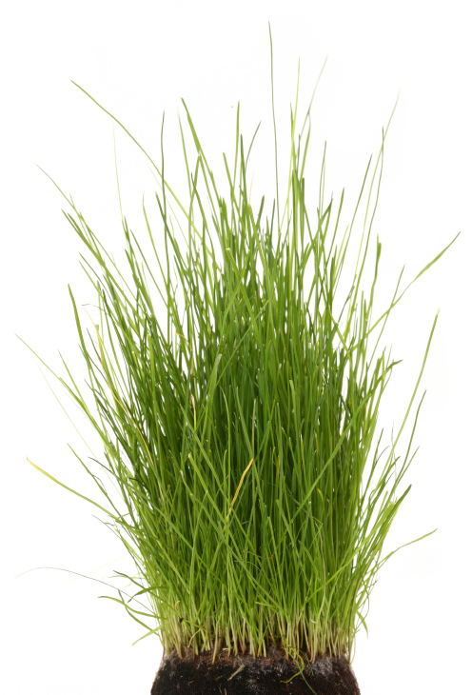
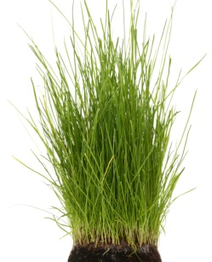

One gift, many generations
YEAR 1
YEAR 15
YEAR 25
YEAR 50
Establish an endowment
$100,000 in cumulative grants and services
$158,000 balance
$200,000 in cumulative grants and services
$213,000 balance
$625,000 in cumulative grants and services
$455,000 balance
$100,000 gift
INITIAL GIFT INVESTED
1 TIME
2 TIMES
6+ TIMES
LOOKING AHEAD
assumes 5% annual payout and 8.5% rate of return
Notes:
Consider how one gift of $100,000 can grow.
In the first 15 years, it has doubled in value: generating $100,000 in grants to support local causes and programs, and retaining all of its original value.
By year 25, the value has doubled again, having paid out $200,000 in grants while growing to be worth $213,000.
In just 50 years, the original $100,000 gift has generated nearly $1 million in value: $625,000 in grants, and $355,000 in asset growth.

