Slide 1


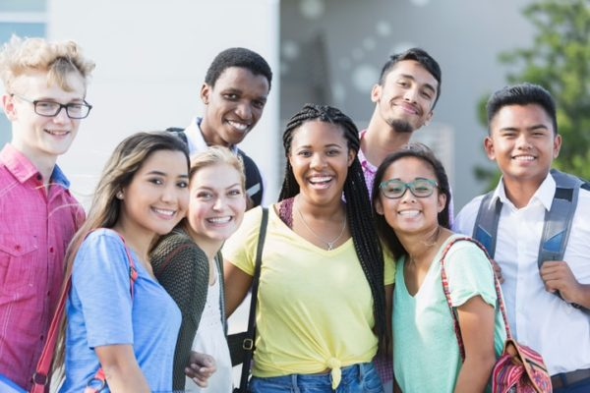
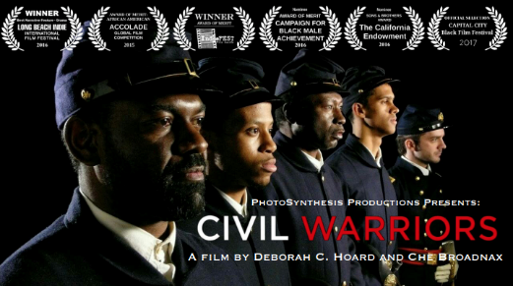
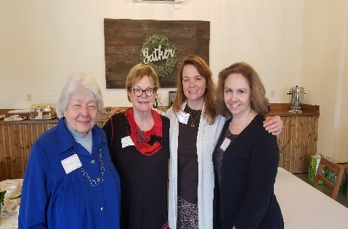
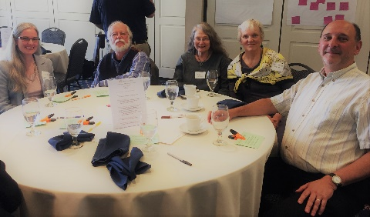
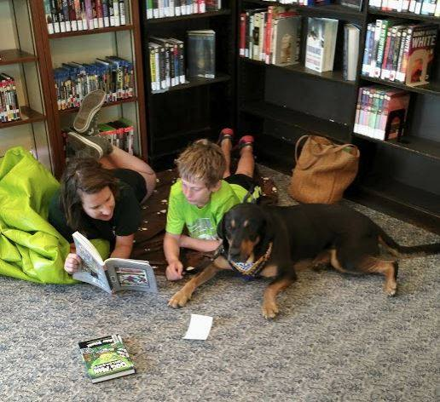
Spring 2019
INSPIRING PHILANTHROPY, STRENGTHENING COMMUNITIES
Spotlight
One Grant, Many Connections – Civil Warriors Movie
Civil Warriors is a story about determination, and Ithaca is its setting!
It draws much of its power as monologues filmed at historically significant locations around Ithaca. Indeed! One of the filming locations, the St. James AME Zion Church, is a historical conduit for black political organizing and Ithaca's role as a stop on the Underground Railroad!
Civil Warriors narrator Sean Eversley Bradwell, "History is not just what we choose to retell. History is also what we choose to recover.“
This film, Civil Warriors, while reaching national audiences, has the potential to help youth in Tompkins County
have a deeper understanding of the
legacy and impact of racism in American society. Teach-ins and facilitated conversations are included as part of the film’s educational curriculum.
"It is a privilege to support a project that not only celebrates local talent and history, but one that will inspire and engage students and families across the country in a more enlightened narrative of black history." Janet Cotraccia, Chief Impact Officer, Community Foundation of Tompkins County.
Supported by Community Foundation, Ithaca College, Legacy Foundation, Park Foundation, Tompkins Charitable Gift Fund, and Tompkins County. Funding provided in part, from donor advisors, Thomas Bruce and Judith Pratt.
Production by:
Photosynthesis Productions, President & Producer, Deborah C. Hoard
Cinematographer, Ithaca College Alumnus, David Huntley
Narrator and Ithaca College professor, Sean Eversley Bradwell
Imagery support, The History Center
Find out more at our Annual Celebration Luncheon on June 11th.
Read more at www.cftompkins.org under Granting, Grant Impact Stories
COMMUNITY IMPACT
Thank You Community Leaders
Serving on grant review teams, committee and board service, community engagement and more. Photo: Beverly Baker, Alice Moore, Stacey Murphy, Suzanne Brache.
.
Community Education and Events
Philanthropy continues to engage and empower our community. Share your story with us at our
Annual Celebration Luncheon on June 11th . Register today on Events www.cftompkins.org
A Universe of Stories Summer Reading
Library Grant Cycle: over $182,000 of grants supporting youth programming through the libraries of the Finger Lakes Library System. Photo: Groton Public Library
You can get involved with your Community Foundation, call us, or visit www.cftompkins.org

Slide 2

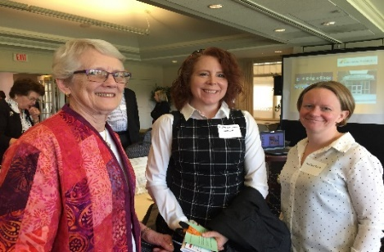





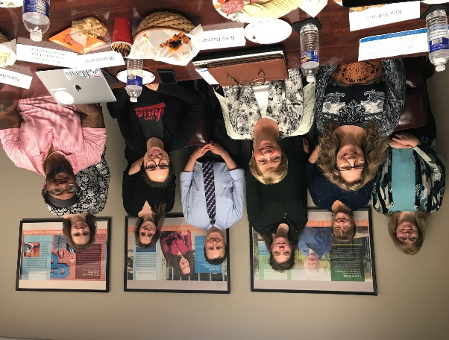
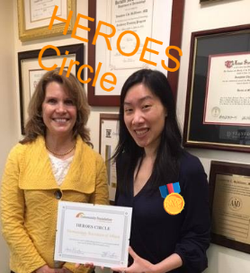

By The Numbers (3/31/2019)
Assets: $19.1 Million
$ 12.7 Million Endowed Funds
$ 6.4 Million Non-Endowed Funds
Fund Types (121 Funds)
7 Community Impact Funds
12 Field of Interest Funds
34 Agency and Designated Funds
68 Donor Advised Funds
1Q19 Investment Performance (net of fees)
8.9% General Portfolio
9.2% ESG Portfolio
2019 Fund Advisors Annual Luncheon:
The Art of Participatory Leadership
Community Investments
Thank you to our donors who made the following milestones possible! In our 19th year with over $14.9 million in 3,700 awards, Community Foundation is a leading public grantmaker in Tompkins County.
2019 Spring Grant Cycle Review Team (photo taken at one of four meetings, some not present).
2019 Grant Cycles ($ granted)
$ 182,365 Library Grant Cycle
$ 134,947 Spring Grant Cycle
$ 2,500 Out of Cycle Requests
Community Connections
We would like to recognize our 2019 HEROES Circle corporate members (as of 5/1/19, complete listing at year-end 12/31/19): CFCU Community Credit Union, Cornell University, C.S.P. Management, Dermatology Associates of Ithaca, Dryden Mutual Insurance Company, Insero & Co CPAs, The Philanthropic Fund, Triad Foundation, Visions Federal Credit Union. Thank you to our business community and private foundations for your partnership in local philanthropy!
Thank you Dermatology Associates of Ithaca! Photo: Nancy Massicci and Dr. McAllister

