Slide 1
Let’s Talk Arts & Culture
Megan Barber, Executive Director
Community Arts Partnership

Slide 2
Agenda
Intro to the Community Arts Partnership
Our arts & culture ecosystem
The impact of the pandemic year
What was learned?
What’s happening now?
Summer 2021
Ways to help

Slide 3
Community Arts Partnership

Slide 4
Our arts & culture ecosystem
Arts & cultural groups
Arts & cultural initiatives
Artists
Funders
Audiences

Slide 5
What happened in 2020?
Funding challenges
Opportunities (lost and gained)
Focus on equity and antiracism

Slide 6
Insights and lessons learned
Arts are essential to recovery
This community cares!
Keep virtual offerings

Slide 7
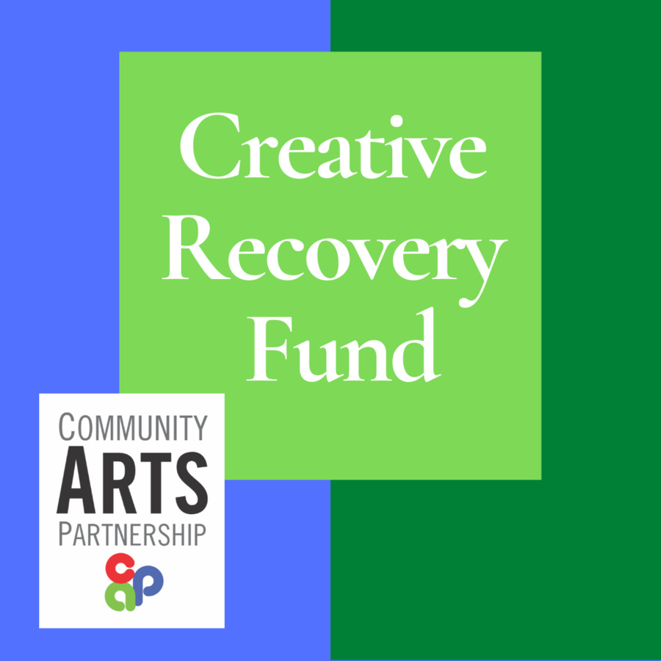
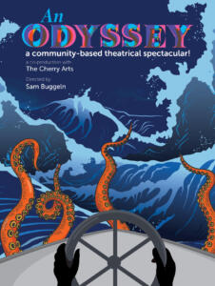
Now: excitement, resiliency, creativity

Slide 8
Summer 2021: Live and energized!
Arts and culture summer camps
Live performances
Virtual performances
Greater Ithaca Art Trail
Galleries and museums
Freedom Institute of Arts & Advancement

Slide 9
Ways to help
Go!
Spend!
Give!
Promote!
Thank!

Slide 10
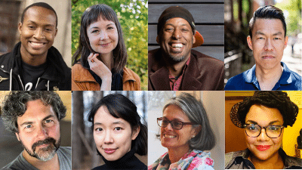
Thank you!
www.artspartner.org
director@artspartner.org

