Slide 1
Let’s Talk: Housing and 2-1-1 Services
Simone Gatson and Brett Irish, 2-1-1 Housing Specialists
Notes:
Simone and Brett

Slide 2
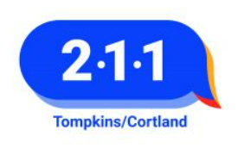

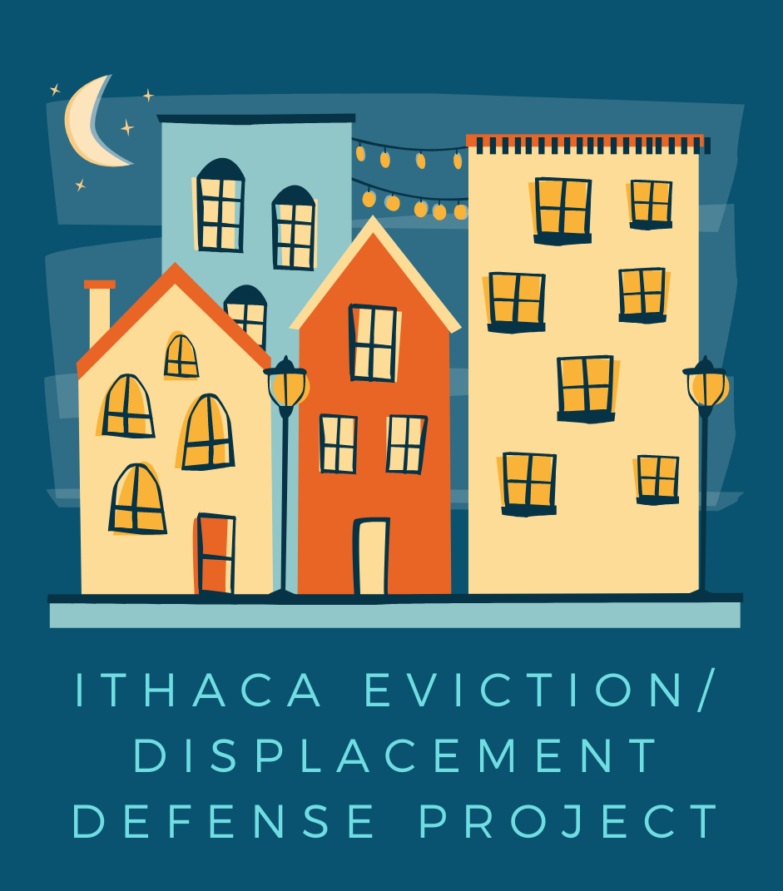
A little bit about our roles...
We work on the 2-1-1 Information and Referral Helpline for Tompkins and Cortland County. Through this line we take cold calls for people who need assistance with housing in our area.
We also work with the Ithaca Evictions/Displacement Defense (IEDD). The goal of this project is to prevent displacement from the City of Ithaca by preventing avoidable non-payment evictions. Through this program we work with a racial equity lens to address current and historic institutional inequities.
We help to meet those goals by administering a basic income program (Housing Stability Supplement Program) for City of Ithaca residents, attending eviction court, and completing Emergency Rental Assistance Program (ERAP) applications with tenants.

Slide 3
Ithaca is Rent Burdened.
Ithaca is Evictions.
74% of City residents are renters (HUD Consolidated Plan 2019-2023).
56% of City tenants are cost-burdened (rent = more than 30% of their income).
41% of those tenants are severely cost-burdened (rent= more than 50% of income).
Only ~ 3% of tenants in City eviction court had legal representation (2018 local data).
Black residents and female-headed households are disproportionately subject to non-payment evictions (2018 local data).

Slide 4
54% of evictees were Black residents, even though they only made up 6% of our city’s total population.
A majority were female single head of households with one or more children.
Ithaca is Disproportionately Expensive for People of Color.
There are a number of reasons for this, including that
Almost 75% of Black residents in the Ithaca MSA are paid less than a living wage, compared to 28% of white residents.
49% of Black renters and 45% of Latinx renters are severely cost burdened with their rent, compared to 27% of white renters
Notes:
Source for blue statistics

Slide 5
What is driving displacement in our community?
1. There is an overall lack of affordable, adequate housing, and assistance finding available housing.
2. More college students are moving into off-campus housing, and using external resources to pay high rents.
How is the pandemic affecting these issues?
1. There are increased costs and lower incomes due to the pandemic.
2. Incidences of domestic violence have increased since the beginning of the pandemic.
3. Strained landlord/tenant relationships are causing tenants to leave units even if they have a right to be there.
4. More landlords are selling tenant housing due to increased real estate prices.

Slide 6
How is our community recovering?

Slide 7
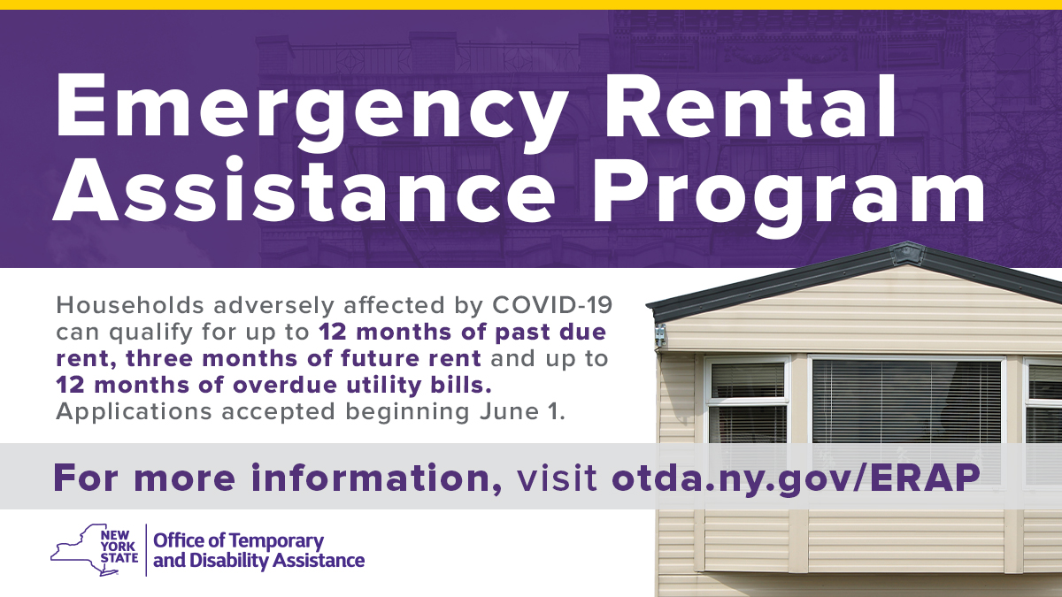
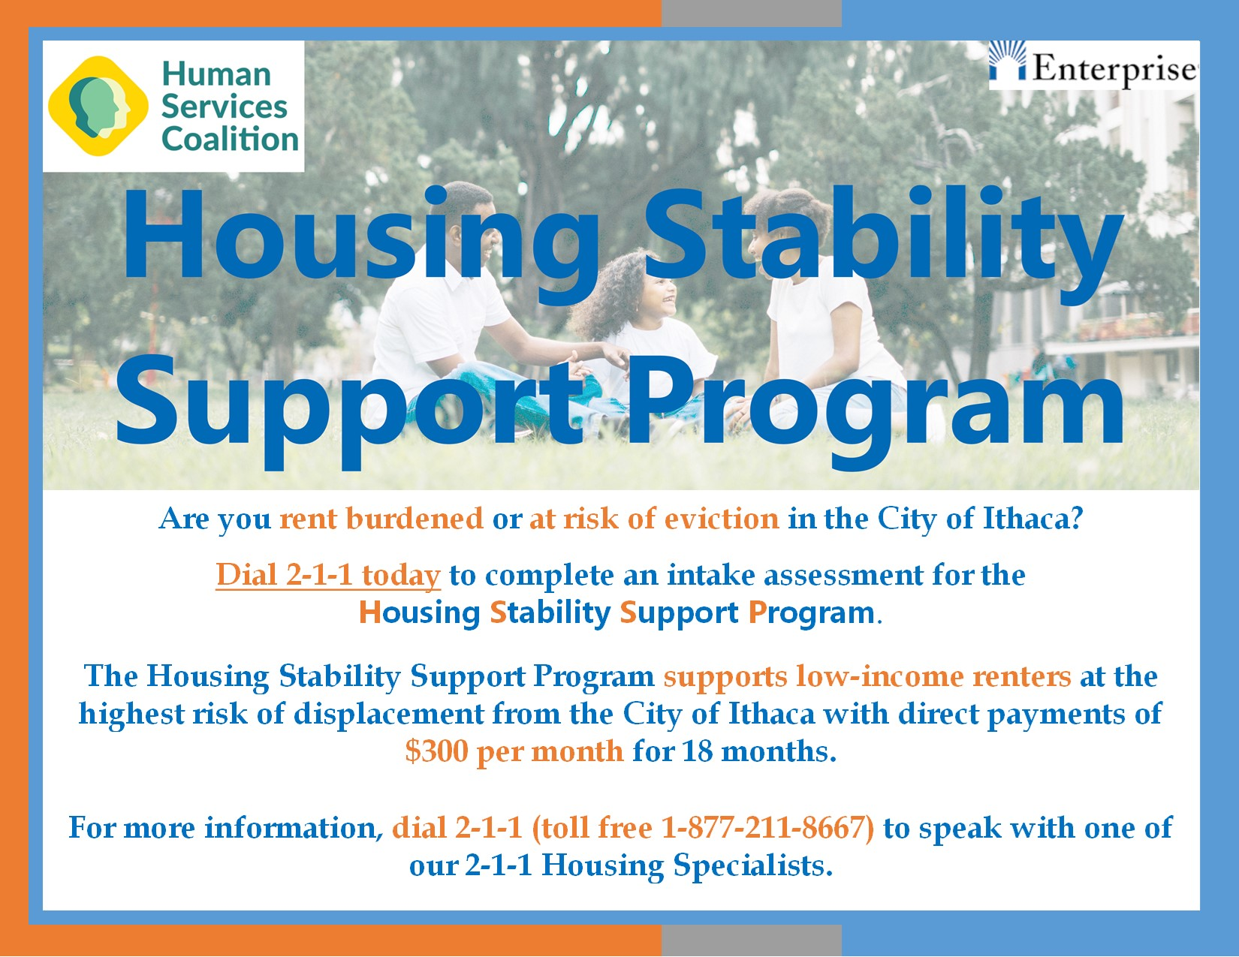
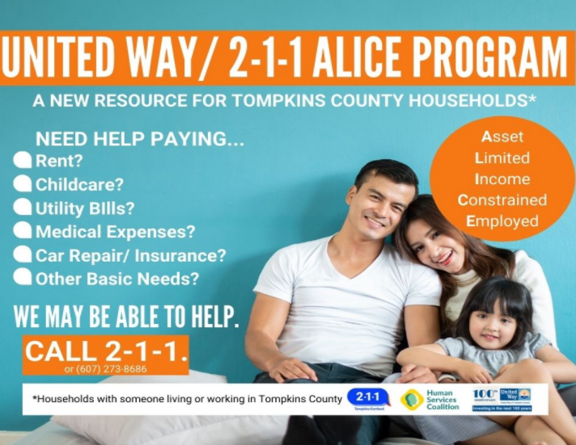
Programming through state programs and other local providers to provide financial assistance.

Slide 8


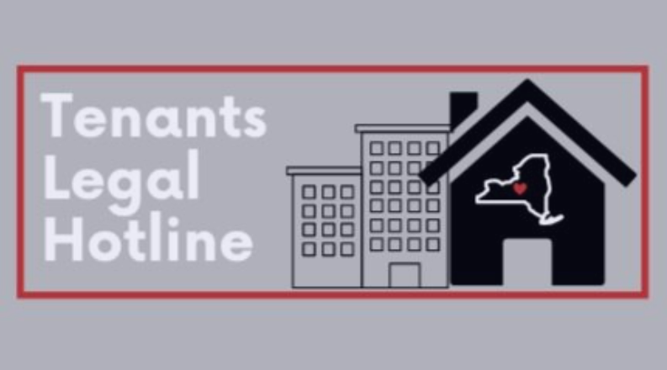
2. Dissemination of tenant rights and tenant advocacy to solve disputes with the landlord

Slide 9
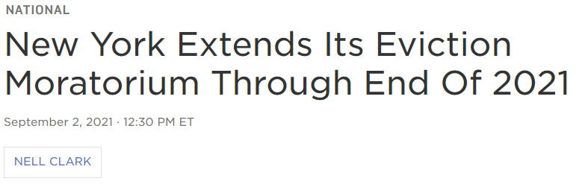
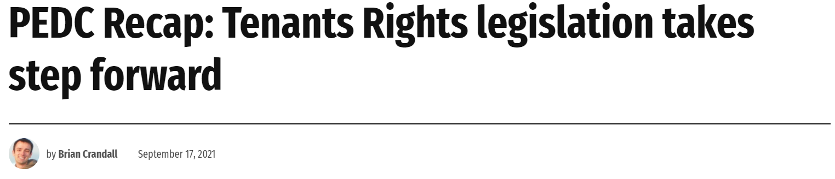
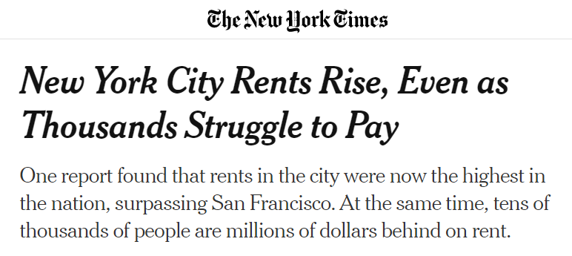
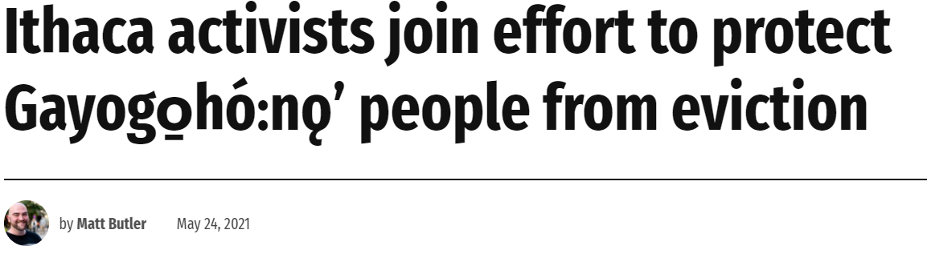
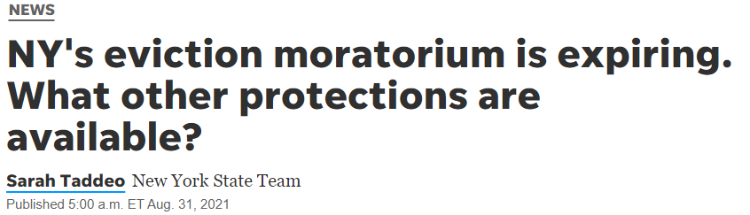
3. These issues are more public, more people are talking about how we can prevent displacement in our communities. There is a recognition of housing as a basic need.

Slide 10
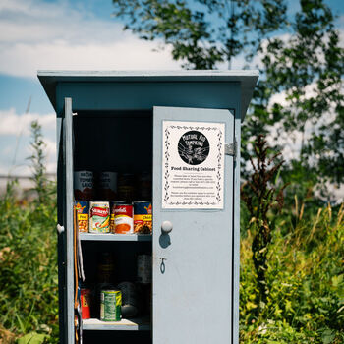
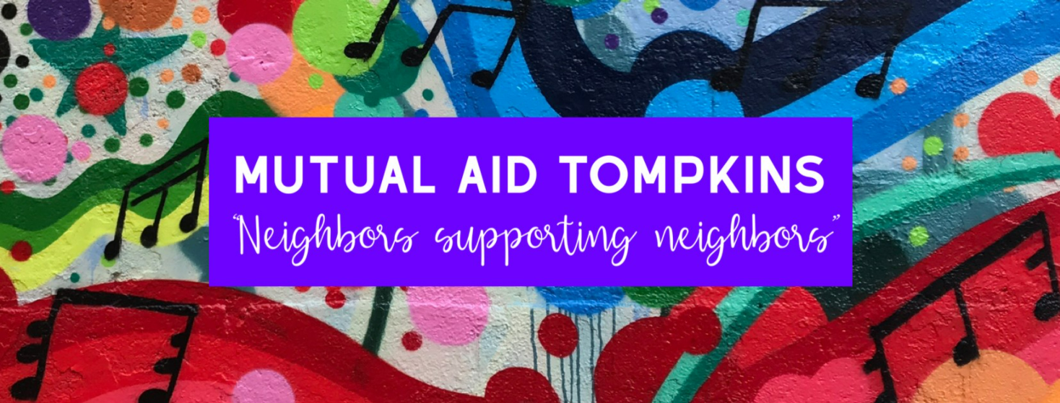
4. Mutual Aid.
Notes:
Charlie quote: Almost ten months ago, I started engaging in a local mutual aid project and wanted to extend our community efforts towards our unhoused neighbors. I was honestly surprised when I saw a mutual aid project pick up so much involvement, because most Anarchists have been trying to promote mutual aid as a practice for centuries. Before that, indigenous and marginalized communities based their societal survival around this praxis. I define mutual aid as basically, the understanding that everyone has needs, and everyone has something to offer that is valuable to collective survival regardless of monetary value...What I do, is bottom up solidarity. I’ve found some of the most brilliant minds in the bodies that the people up the hill will call the cops on for sleeping in public, the people they will dismiss as “addicts” and cross the street to avoid go out of their way to give me the most beautiful and heartfelt gifts ranging from handmade metalworking and art to high end perfume. The hardest workers you’ll never hire because of their criminal record. I will never understand what is exceedingly “good” of me when most of what I do is just get to know people for their true selves and offer them basic empathy and dignity.

Slide 11
What should our community invest in to prevent displacement of our long-term residents?
Encourage landlords you know to connect their tenants with 2-1-1. Talk with your neighbors, friends, and family about housing, and connect them to 2-1-1 if they need help.
Lobby for tenants rights locally to empower tenants and keep them in their housing, especially the right to counsel for eviction cases.
  Call your representative: County Legislature: 607-274-5434 Anna Kelles: 607-277-8030
Invest in local programming and grants for projects that provide financial and legal aid to tenants in crisis through basic income.

Slide 12
Questions?

Slide 13
Need help finding help? Dial 2-1-1 for assistance.
211 connects people in need with services designed to address that need. Callers are referred to service providers according to their situation. No question is too big or too small. Wondering about Food Pantries in the area? Trying to find after school programs for your child? Would you like more help finding employment? Need to find housing or health care? We can answer all of these questions, and more.
Call: 1 (877) 211-8667 or dial 211
Website: https://hsctc.org/211tompkins
Text: Text your zip code to TXT211 or 898211
Email: iandr@hsctc.org
Online chat at: www.211tompkins.org

Slide 14
Resources for rent assistance in Tompkins County:
Emergency Rental Assistance Program: Provides payment of up to 12 months of back due rent directly to the landlord. Can also potentially provide payments for 3 months of forward rent and 12 months of back due utility bills. Dial 2-1-1 (toll-free 877-211-8667) for help applying.
Housing Stability Support Program: Basic income and warm referrals to local resources for low-income City of Ithaca residents. Dial 2-1-1 (toll-free 877-211-8667) to complete an intake with a 2-1-1 Housing Specialist.
Department of Social Services: Help with paying rental arrears for up to 6 months for eligible renters or homeowners that are behind in payments and ongoing utility costs assistance. DSS Special Services can help to serve individuals with emergency needs for housing. Dial (607) 274-5680 to learn more.

Slide 15
Resources for financial assistance in Tompkins County:
Robin Fund: Benefits residents who are undergoing hardship or who may have special needs, e.g., emergency mortgage or rent assistance, family crises, special clothing needs, aid in attending summer programs or special events, scholastic needs, etc. Applicants should keep in mind that the Robin Fund has very limited resources. Email vsykes@cityofithaca.org or call (607)-272-3622.
United Way/2-1-1 ALICE Program: Assistance up to $500 for qualified households, can be used for rental assistance. Dial 2-1-1 (toll-free 877-211-8667) to apply for assistance.
Department of Social Services: Provides transitional cash assistance, SNAP benefits, child care assistance and other benefits that can assist individuals and families with meeting ongoing expenses so they can maintain housing. Dial (607) 274-5680 to learn more.

Slide 16
Resources for legal assistance and tenant rights advocacy in Tompkins County:
LawNY (Legal Assistance of Western New York): Provides free legal assistance to eligible tenants. Dial (607)-273-3666 or 1-(800)-724-4170 to complete an intake.
Tenants Legal Hotline: A resource for Ithaca tenants seeking free legal advice about their rights and options. Dial (607)-301-1560 or email TenantsLegalHotline@gmail.com.
Ithaca Tenants Union: A union by and for the tenants of Ithaca, to protect tenant rights and advance their collective power. Dial (607)-358-5048 or visit their website at ithacatu.org.

Slide 17
Resources for general assistance in Tompkins County:
Catholic Charities: The Samaritan Center provides emergency financial assistance, free clothing and personal care items, and guidance and referrals to families and individuals in need. Dial 607-272-5062 for more information.
Learning Web: Youth Outreach, a program within The Learning Web, guides and assists homeless and transient young people age 16-24 in moving from dependence to self-sufficiency. Supportive services are offered for 12 to 18 months to assist households to maintain stable housing and become self-sufficient. Dial (607)-272-8162 or visit their website, learning-web.org.
Advocacy Center: Provides support, advocacy and education for survivors, friends, and families of domestic violence, and sexual assault in Tompkins County. Dial (607)-277-5000 to reach the 24-hour hotline.

Slide 18
“Almost ten months ago, I started engaging in a local mutual aid project and wanted to extend our community efforts towards our unhoused neighbors. I was honestly surprised when I saw a mutual aid project pick up so much involvement, because most Anarchists have been trying to promote mutual aid as a practice for centuries. Before that, indigenous and marginalized communities based their societal survival around this praxis. I define mutual aid as basically, the understanding that everyone has needs, and everyone has something to offer that is valuable to collective survival regardless of monetary value...What I do, is bottom up solidarity. I’ve found some of the most brilliant minds in the bodies that the people up the hill will call the cops on for sleeping in public, the people they will dismiss as “addicts” and cross the street to avoid go out of their way to give me the most beautiful and heartfelt gifts ranging from handmade metalworking and art to high end perfume. The hardest workers you’ll never hire because of their criminal record. I will never understand what is exceedingly “good” of me when most of what I do is just get to know people for their true selves and offer them basic empathy and dignity.”
-Charlie Spearman, Outreach Specialist

